Slide 1
HXU Integral Change Measured by Flexible PC Board

Slide 2
Flexible Board Design
Each board measures 36 poles. 1 m in length
Material: Kapton
Thickness 125 μm, 100 μm Space/Trace
Layers: 2
Copper Weight: 0.5 oz
Cost: 4 Boards = $2828

Slide 3
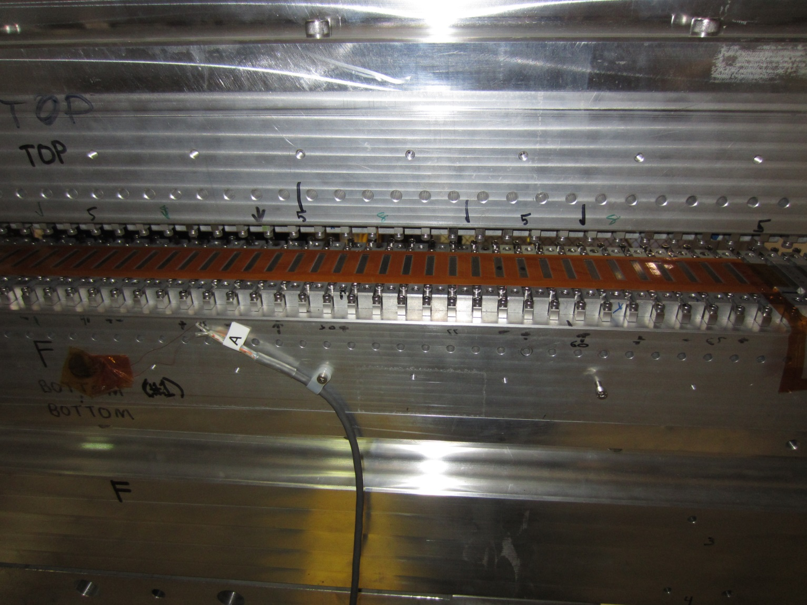
Flexible Board Mounted

Slide 4
Measurements over 3 weekends
Measure integral voltage as gap is moved from 7.3 mm to 11.3 mm.
Make 20 Measurements every 2 hours. Average these for each data point.

Slide 5
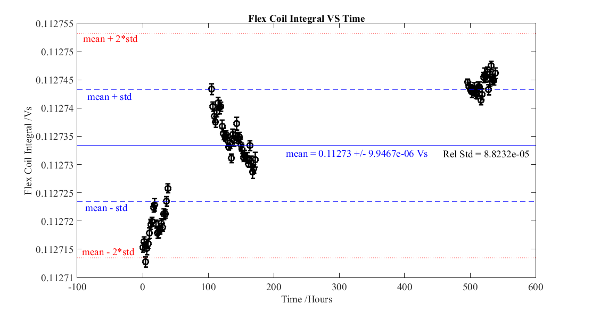
Measurement Results

