Slide 1
LCLS-II Undulator Measurements
Zachary Wolf
XFEL
January, 2017

Slide 2
Outline
Delta-II
Position dependence of the K value
Assembly tolerance to minimize phase errors
Measurement/assembly plan on CMM
LCLS-II
Undulator tuning plan
K vs gap fits
Phase matching
Radiation damage plans
Earth field strategy
Phase shifter measurements

Slide 3
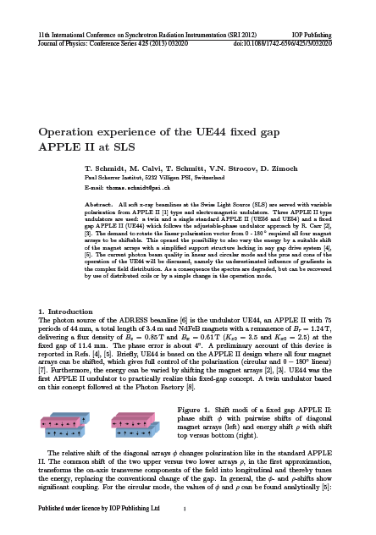
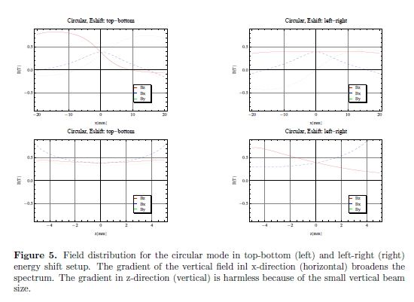
Delta-II K Value Position Dependence
Swiss Light Source

Slide 4
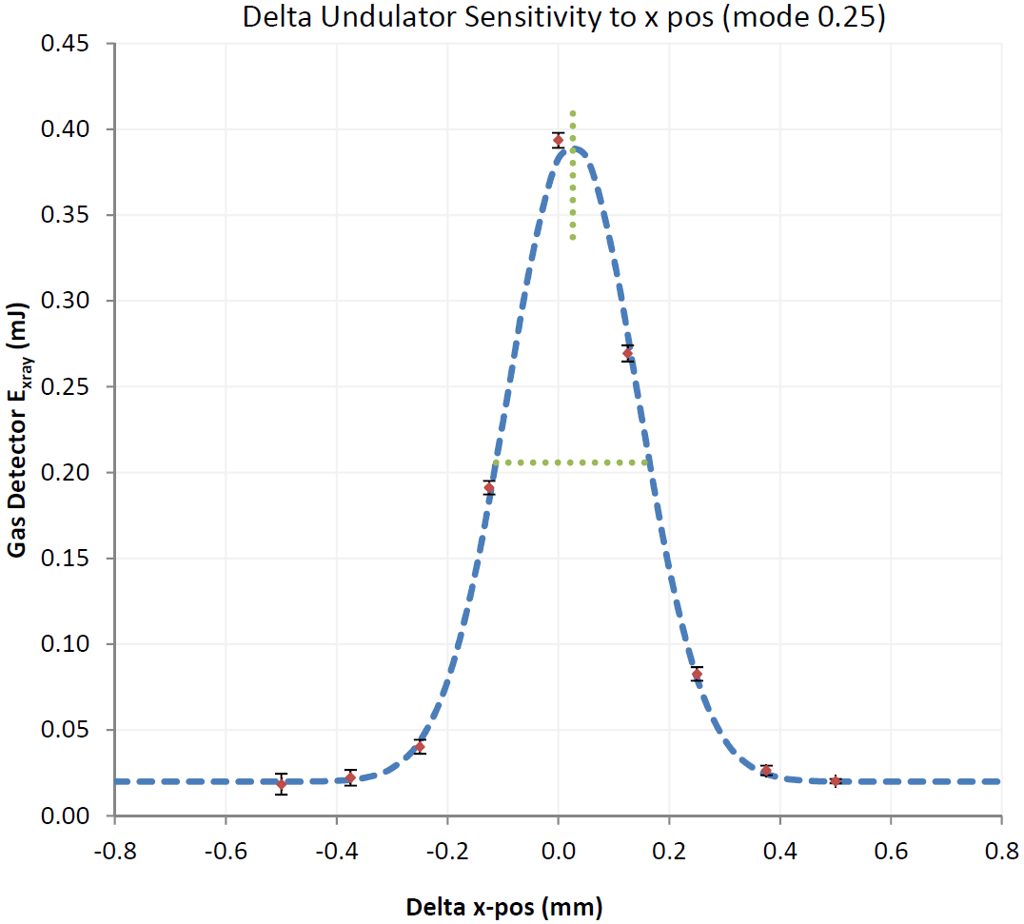
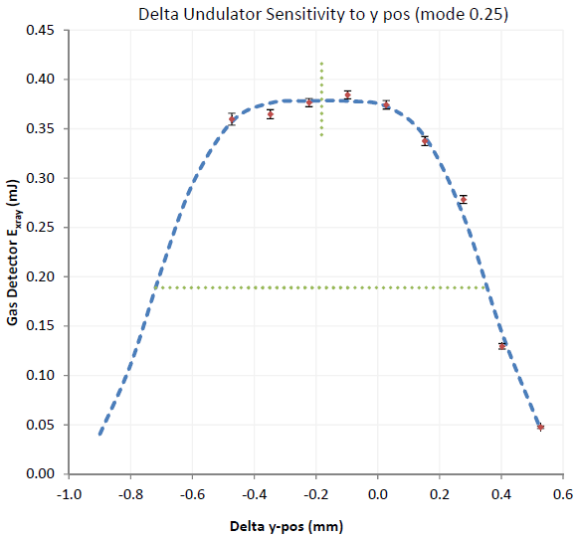

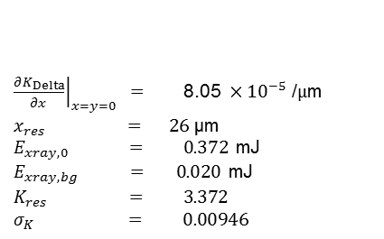

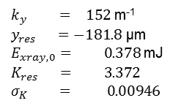





Delta: Horizontal and Vertical Position Sensitivity LCLS MD 11/17/2015
Heinz-Dieter Nuhn
$K_{Delta,res}$ / $K_{Delta,max}$ = 0.942
$$E_{ph}=\text{530 }\text{eV}$$
LCLS MD 11/17/2015
LCLS MD 11/17/2015
$\text{FWHM}=277$ µm
$\text{FWHM}=1074$ µm
$$E_{xray}=E_{xray,0} e^{− \frac{{\left({\left.\frac{∂K_{Delta}}{∂x}\right|}_{x=y=0}\left(x−x_{res}\right)\right)}^{2}}{2 {σ_{K}^{}}^{2}}}+E_{xray,bg}$$
$$E_{xray}=E_{xray,0} e^{− \frac{{\left(K_{res} \cosh\left(k_{y} \left(y−y_{res}\right)\right)−K_{res}\right)}^{2}}{2 {σ_{K}^{}}^{2}}}+E_{xray,bg}$$
${\left.\frac{∂K_{Delta}}{∂x}\right|}_{x=y=0} =$ $\text{8}\text{.}\text{0}\text{5 }×{10}^{−5}\text{ /}μ\text{m}$
$x_{res} = 26$ µm
$E_{xray,0} = 0.372$mJ
$E_{xray,bg} = 0.020$mJ
$K_{res} = 3.372$
$σ_{K} = 0.00946$
$k_{y} = 152$ m⁻¹
$y_{res} =−181.8$ µm
$E_{xray,0}= 0.378$mJ
$K_{res} = 3.372$
$σ_{K} = 0.00946$
[compare to $129.0$ m⁻¹ from model]*
*Alexander Temnikh, private communication

Slide 5
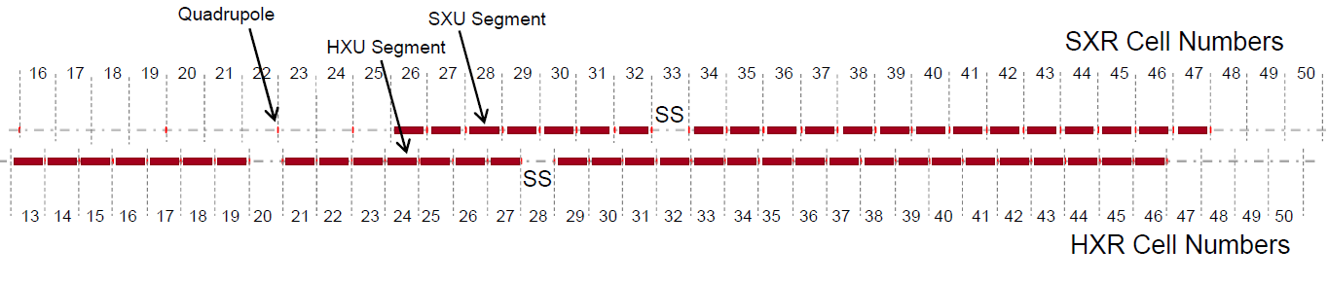
K Position Dependence Effect On Delta-II
Space for 2-stage HXRSS
Location for upgraded HXRSS
Space for SXRSS
Space for 3 Polarization Control Undulators
What causes the asymmetric position dependence of K?
There is only hyperbolic cosine position dependence in the model of two crossed adjustable phase planar undulators.
What are the alignment tolerance effects on Delta-II?
Is there a model to help explain this behavior so that we can make predictions for Delta-II?
Are there design changes that can minimize this effect?

Slide 6
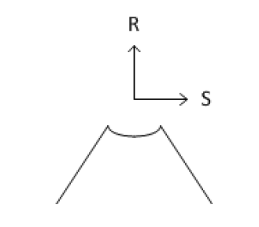

A Model To Explain The Delta-II K Value Position Dependence
LCLS-TN-16-1
Add field rolloff to the model of two crossed, planar, adjustable phase undulators.
Model to explain the position dependence of K
For one quadrant
Delta Measurements:
k_{u} = 196 1/m
k_{r} = 270 1/m
k_{s} = 186 1/m
Potential decreases exponentially away from the quadrant, decreases away
from the center line, varies sinusoidally in z, obeys Laplace’s equation.
This potential can be considered the dominant term in a Fourier expansion.

Slide 7
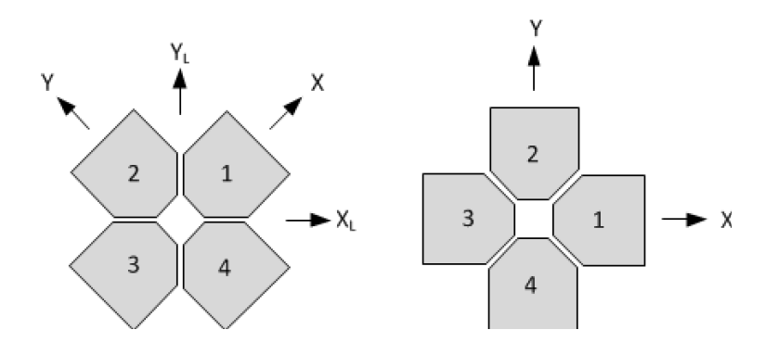
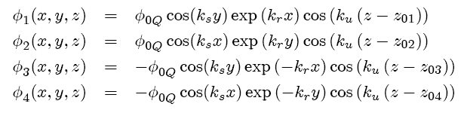
Delta-II K Value Position Dependence
Lab Frame
Undulator Frame
Potential for each quadrant:
Do calculations in the undulator frame.

Slide 8
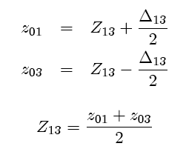
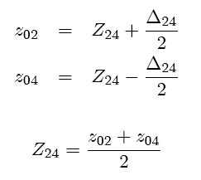


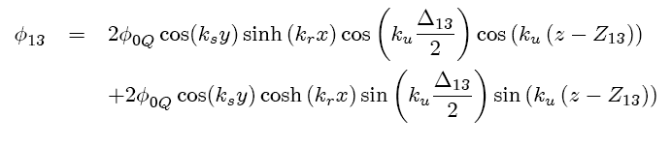
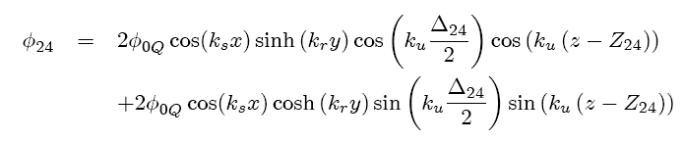
Delta-II K Value Position Dependence
Combine quadrants 1 and 3, also 2 and 4.
Two crossed adjustable phase undulators.

Slide 9
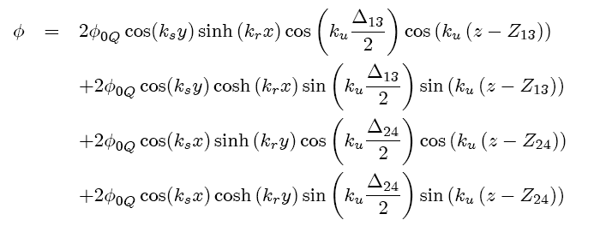
Delta-II K Value Position Dependence
Scalar potential for all row settings:
Δ₁₃ and Δ₂₄ give the shift between the rows of the adjustable phase undulators. This sets their strength.
Z₁₃ and Z₂₄ set the average position of each adjustable phase undulator. This sets the relative phase between them.

Slide 10
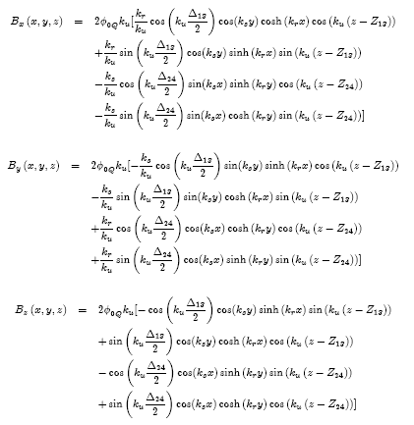
Delta-II K Value Position Dependence
The fields are calculated from the scalar potential. B = grad Φ

Slide 11
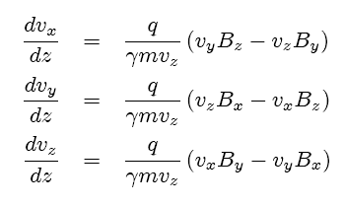
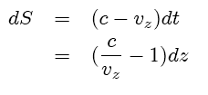


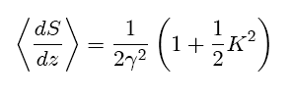
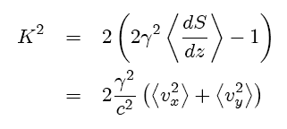
Delta-II K Value Position Dependence
Knowing the fields, the velocity
components can be found:
Knowing the velocity,
the slippage can be found:
The K value is calculated from the constant part of dS/dz:

Slide 12

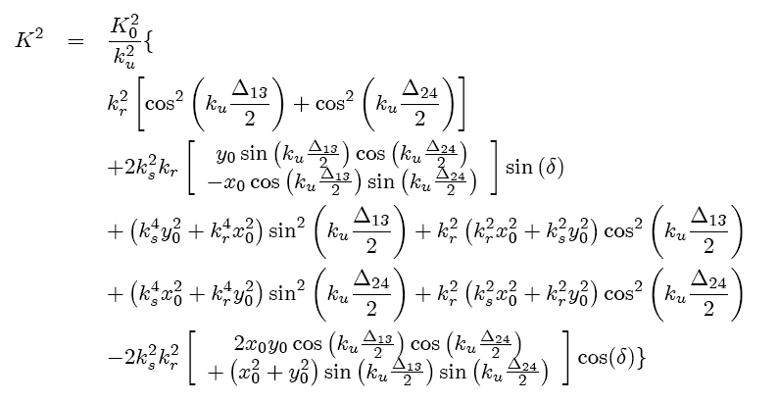
Delta-II K Value Position Dependence
This is the K value to second order in position away from the magnetic
center line (x=0, y=0). (x₀, y₀) is the beam position.
Note that there is a linear term. This causes alignment problems.

Slide 13
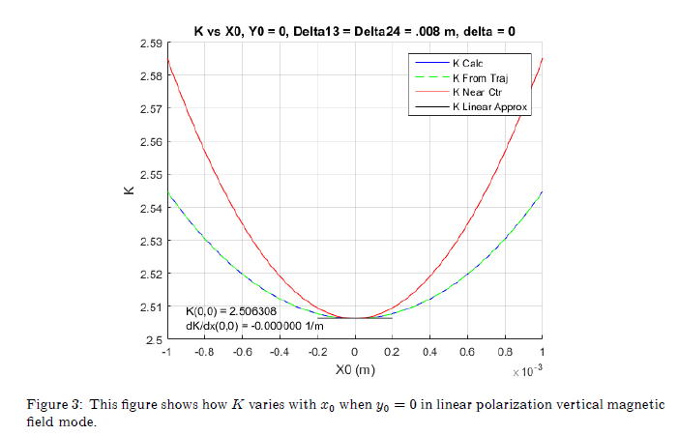
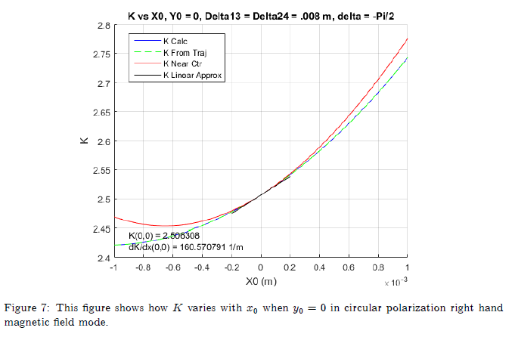
Delta-II K Value Position Dependence
LCLS-TN-16-1
Undulator frame.
Linear mode
Approximate K
near center
Circular mode
Full formula for K
In the linear modes K vs x does not have a slope at the beam axis. In the circular modes, however, K vs x does have a slope at the beam axis.
This can make setting several undulators to the same K value almost impossible using calibration and alignment techniques.

Slide 14
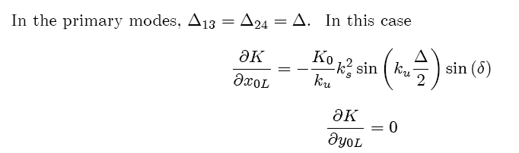




Delta-II K Value Position Dependence
LCLS-TN-16-1
Going to the laboratory frame and setting the relative shifts of the two
variable phase undulators to be the same, the formula simplifies.
There is a gradient in x, but not in y.
Note that the gradient comes from the field rolloff k_{s}. It grows as the row shift Δ increases. It is largest in the circular modes where δ = π/2.

Slide 15
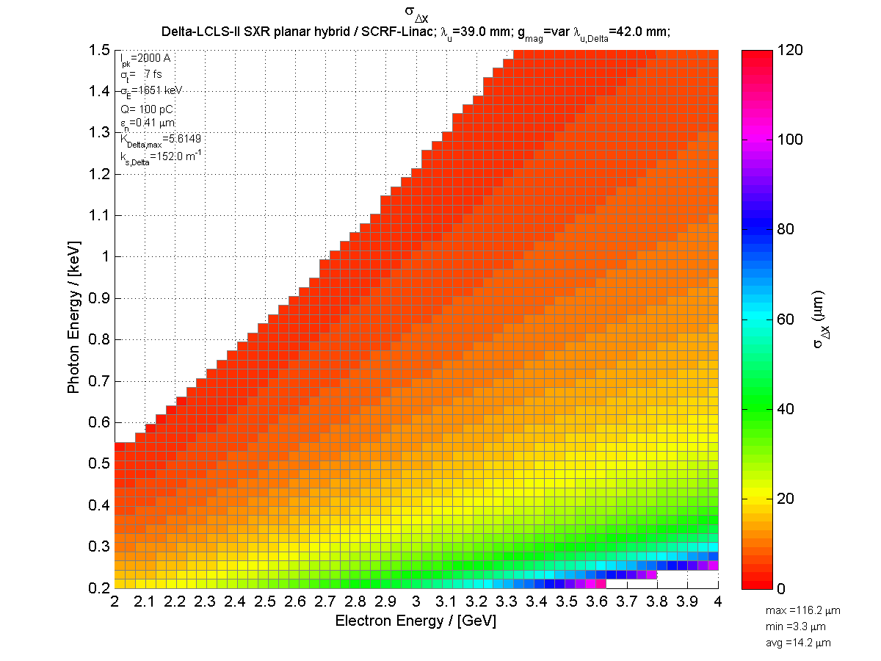
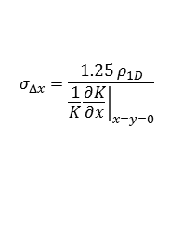
With A Delta-like Undulator Predicted DELTA-II RMS X-Resonance Width
Heinz-Dieter Nuhn
$$σ_{Δx}=\frac{1.25 ρ_{1D}}{{\left.\frac{1}{K}\frac{∂K}{∂x}\right|}_{x=y=0}}$$
No gap change.
Change K by shifting rows.

Slide 16
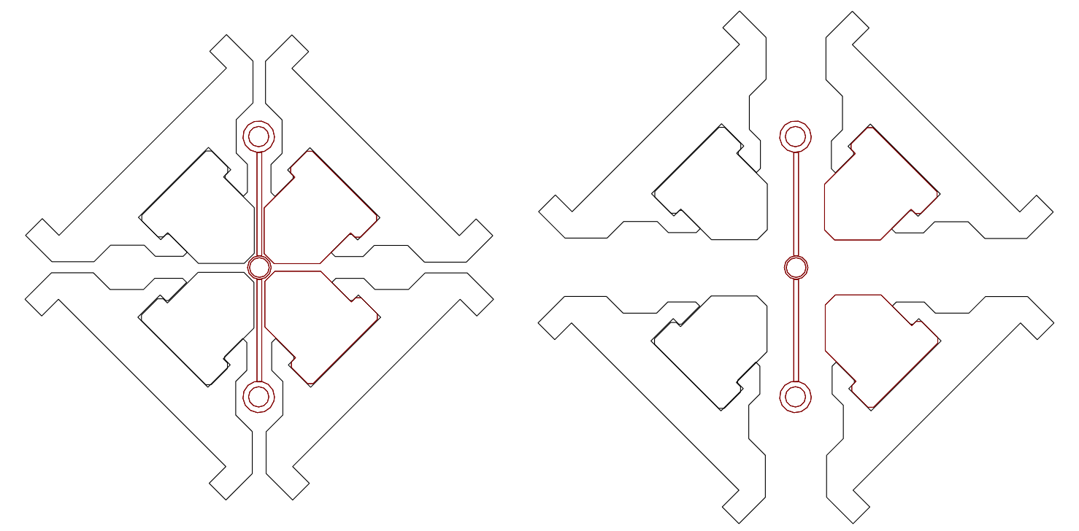
Delta-II K Value Position Dependence
The gradient depends on k_{s}. It is zero for crossed planar undulators.
The gradient gets bigger as the row shift gets bigger, or as the K value gets smaller.
The gradient is zero in the linear modes, and is largest in the circular modes.
The gradient will cause alignment problems with the three Delta-II undulators.
Remedy:
Franz Peters’ design
Tried to shape magnets to minimize k_{s}, but no success. Limited by block size.
Operate at small relative row shift and increase the gap to adjust K.

Slide 17
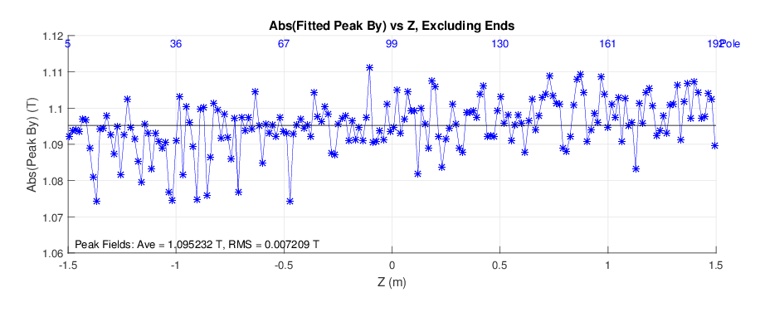
Delta-II Construction Tolerances
Delta Measured Peak Fields, LPVMF mode, Krel = 0.9
By is increasing with Z

Slide 18
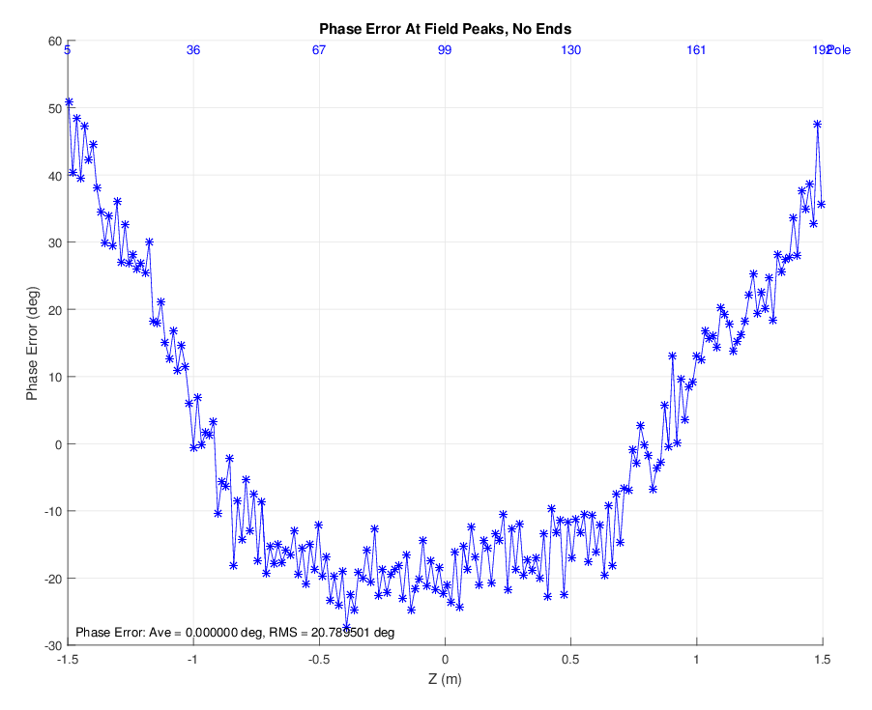
Delta-II Construction Tolerances
Delta Measured Phase Errors, LPVMF mode, Krel = 0.9

Slide 19
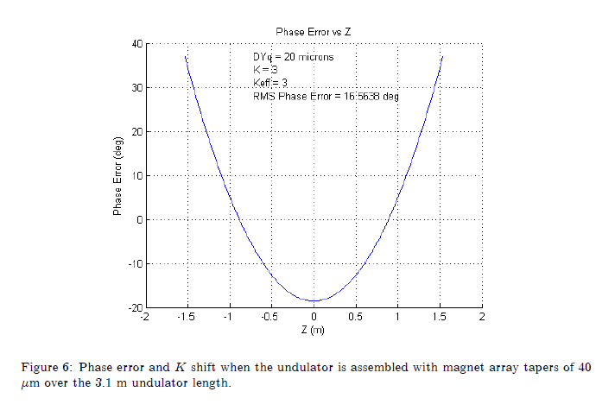
Simulation Phase Error With Undulator Taper
LCLS-TN-15-2

Slide 20
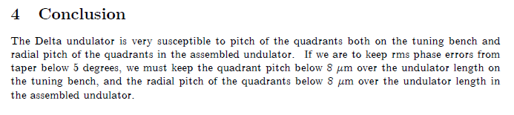
Undulator Taper Conclusion
LCLS-TN-15-2

Slide 21
Delta-II Assembly Plan Build Delta-II On A CMM
Lay E flat on CMM.
Tune one quadrant.
Remove.
Tune the other quadrant.
Reinstall the first quadrant.
Center slides remain fixed.
Should give repeatable position to first quadrant after reinstallation.

Slide 22
Delta-II Assembly Plan
Measure/Tune each half.
Measure assembled undulator.

Slide 23
Fiducialize Strongbacks

Slide 24
Adjust The Mechanical Axis
Move the blocks in order to move the magnet mechanical axis
to the fiducialized geometric axis of the strongback.

Slide 25
Measure On Line Between Pointed Magnet Centers
Line radial taper less than 8 microns.
Line radial bow less than 18 microns.
‘Pointed magnets’ make the connection between CMM probe position and Hall probe position.
We purchased software to move the CMM in a straight line and generate triggers uniformly spaced.
Move blocks to tune quadrant.

Slide 26
Assembled Undulator
Flats on E set Y and pitch.
Use tooling balls on E to set X and yaw.
Need tooling balls at ends to determine Y after assembly. (Green)
Planning new Hall probe for assembled Delta-II measurements.

Slide 27
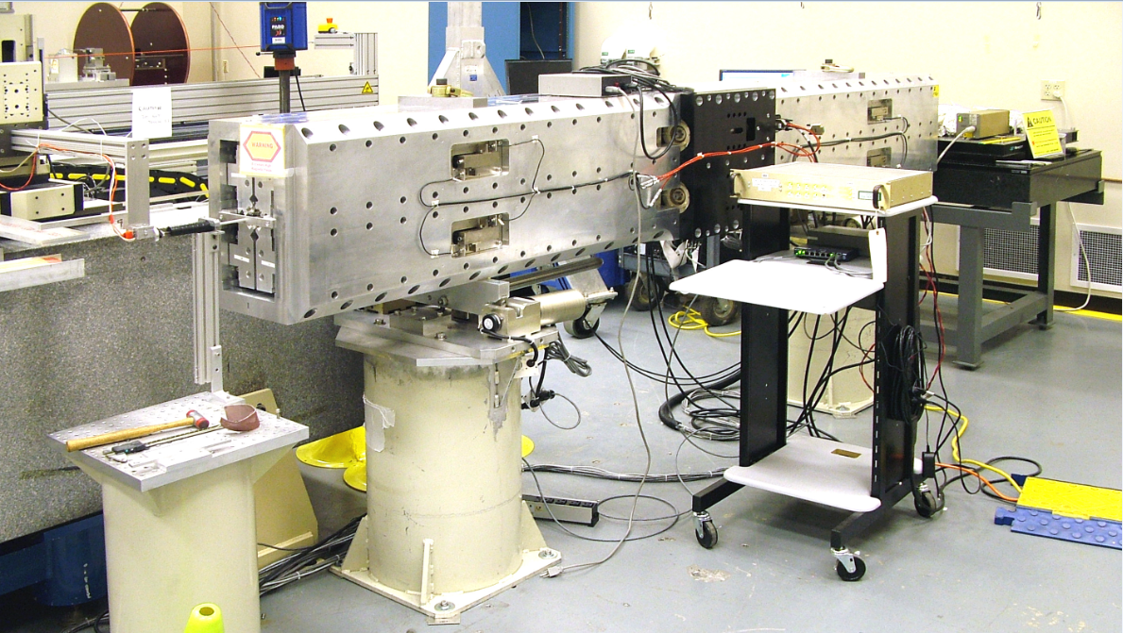
Hall Probe Measurements
Repeat the procedure used on the Delta undulator.

Slide 28
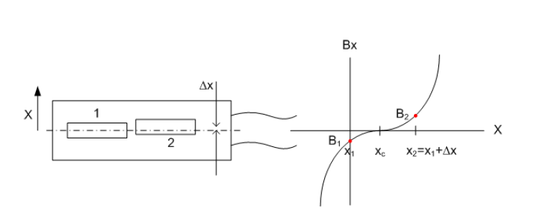
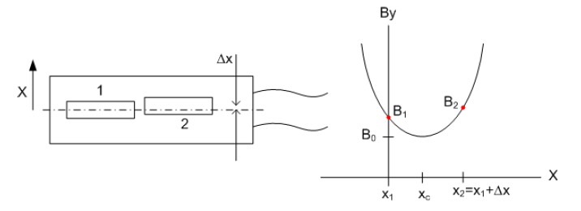
Locate Magnetic Center
Center relative to probes.
Use linear field mode.
Measure Bx and By.
Can rotate probes to measure
at two points along x or y.
Assume field shape
is first term in field
expansion near the
center.
LCLS-TN-13-9

Slide 29
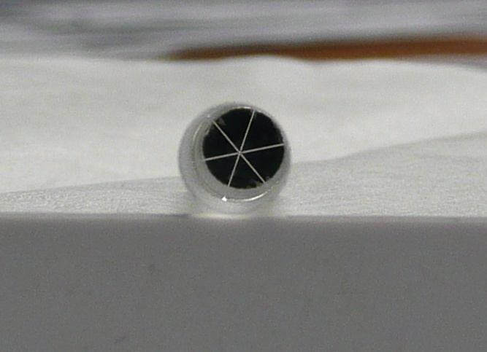
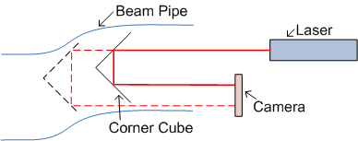
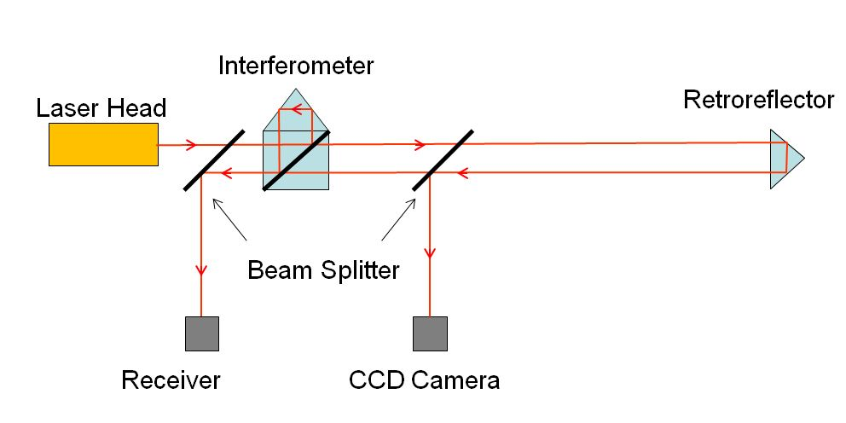
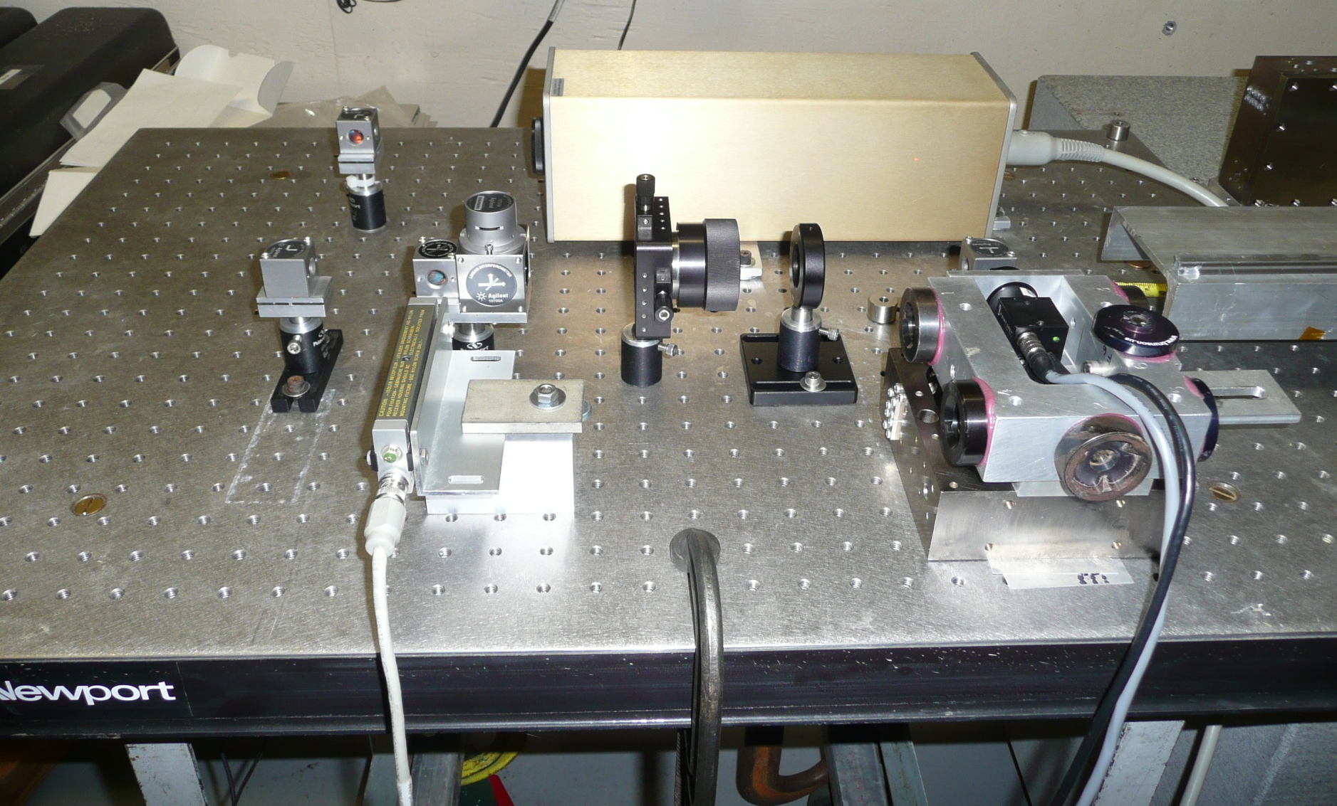
Measure Probe Position
Transverse location from corner cube. Longitudinal location from interferometer.
Georg Gassner

Slide 30
LCLS-II Undulators

Slide 31
LCLS-II Undulator Tuning Overview
22 SXR undulators (production plus spare)
33 HXR undulators (production plus spare)
3 measurement benches, 2 at SLAC, 1 at LBNL
All final data sets will be done at SLAC with the undulator in the same orientation as in the tunnel
For each undulator line, all final data sets will be done on the same bench and have the same set of systematic errors

Slide 32
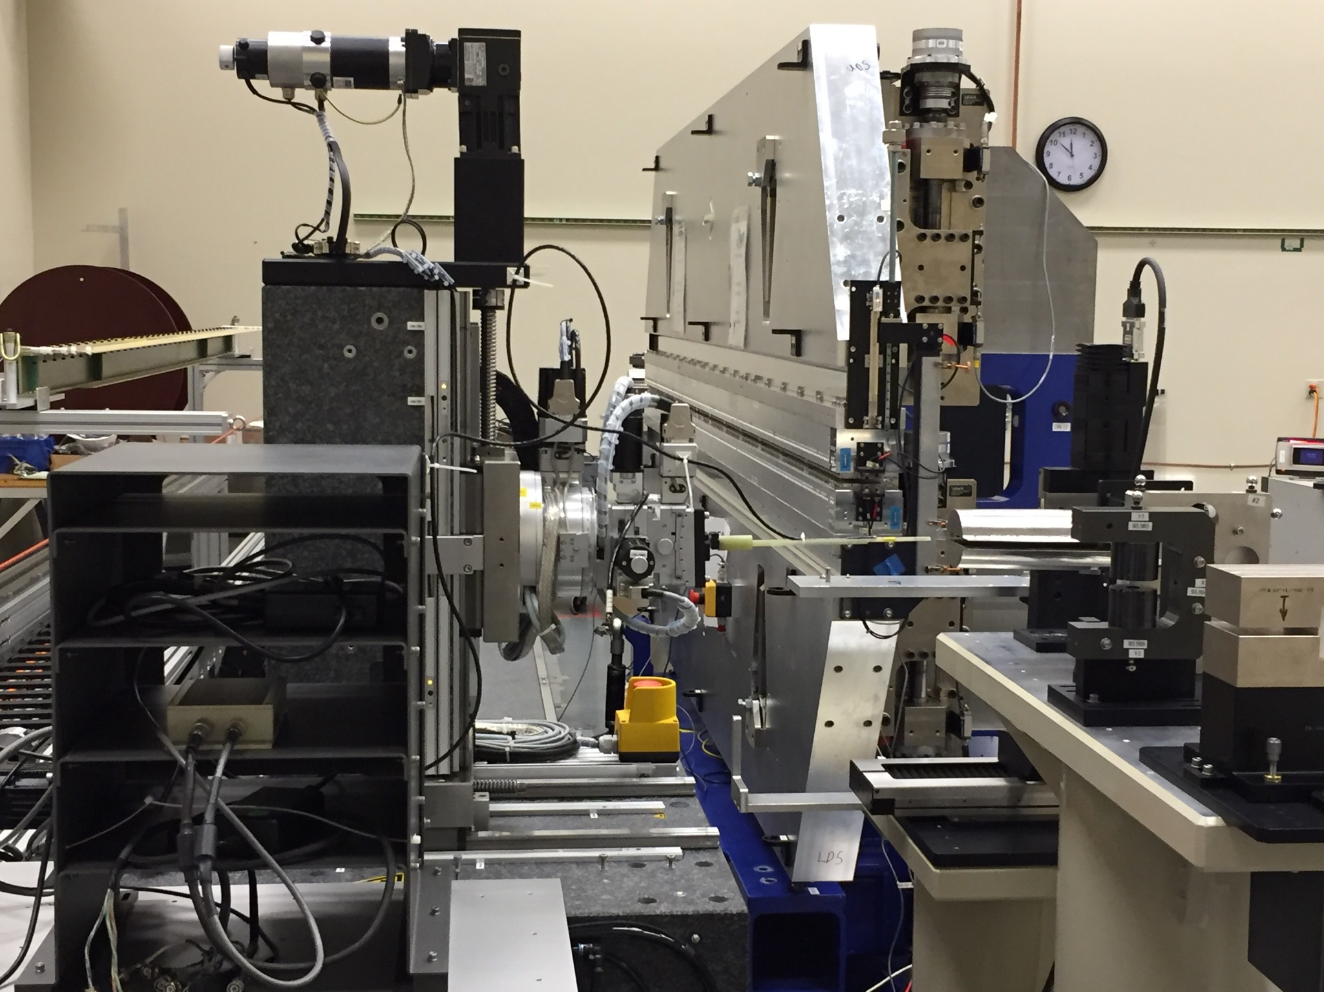
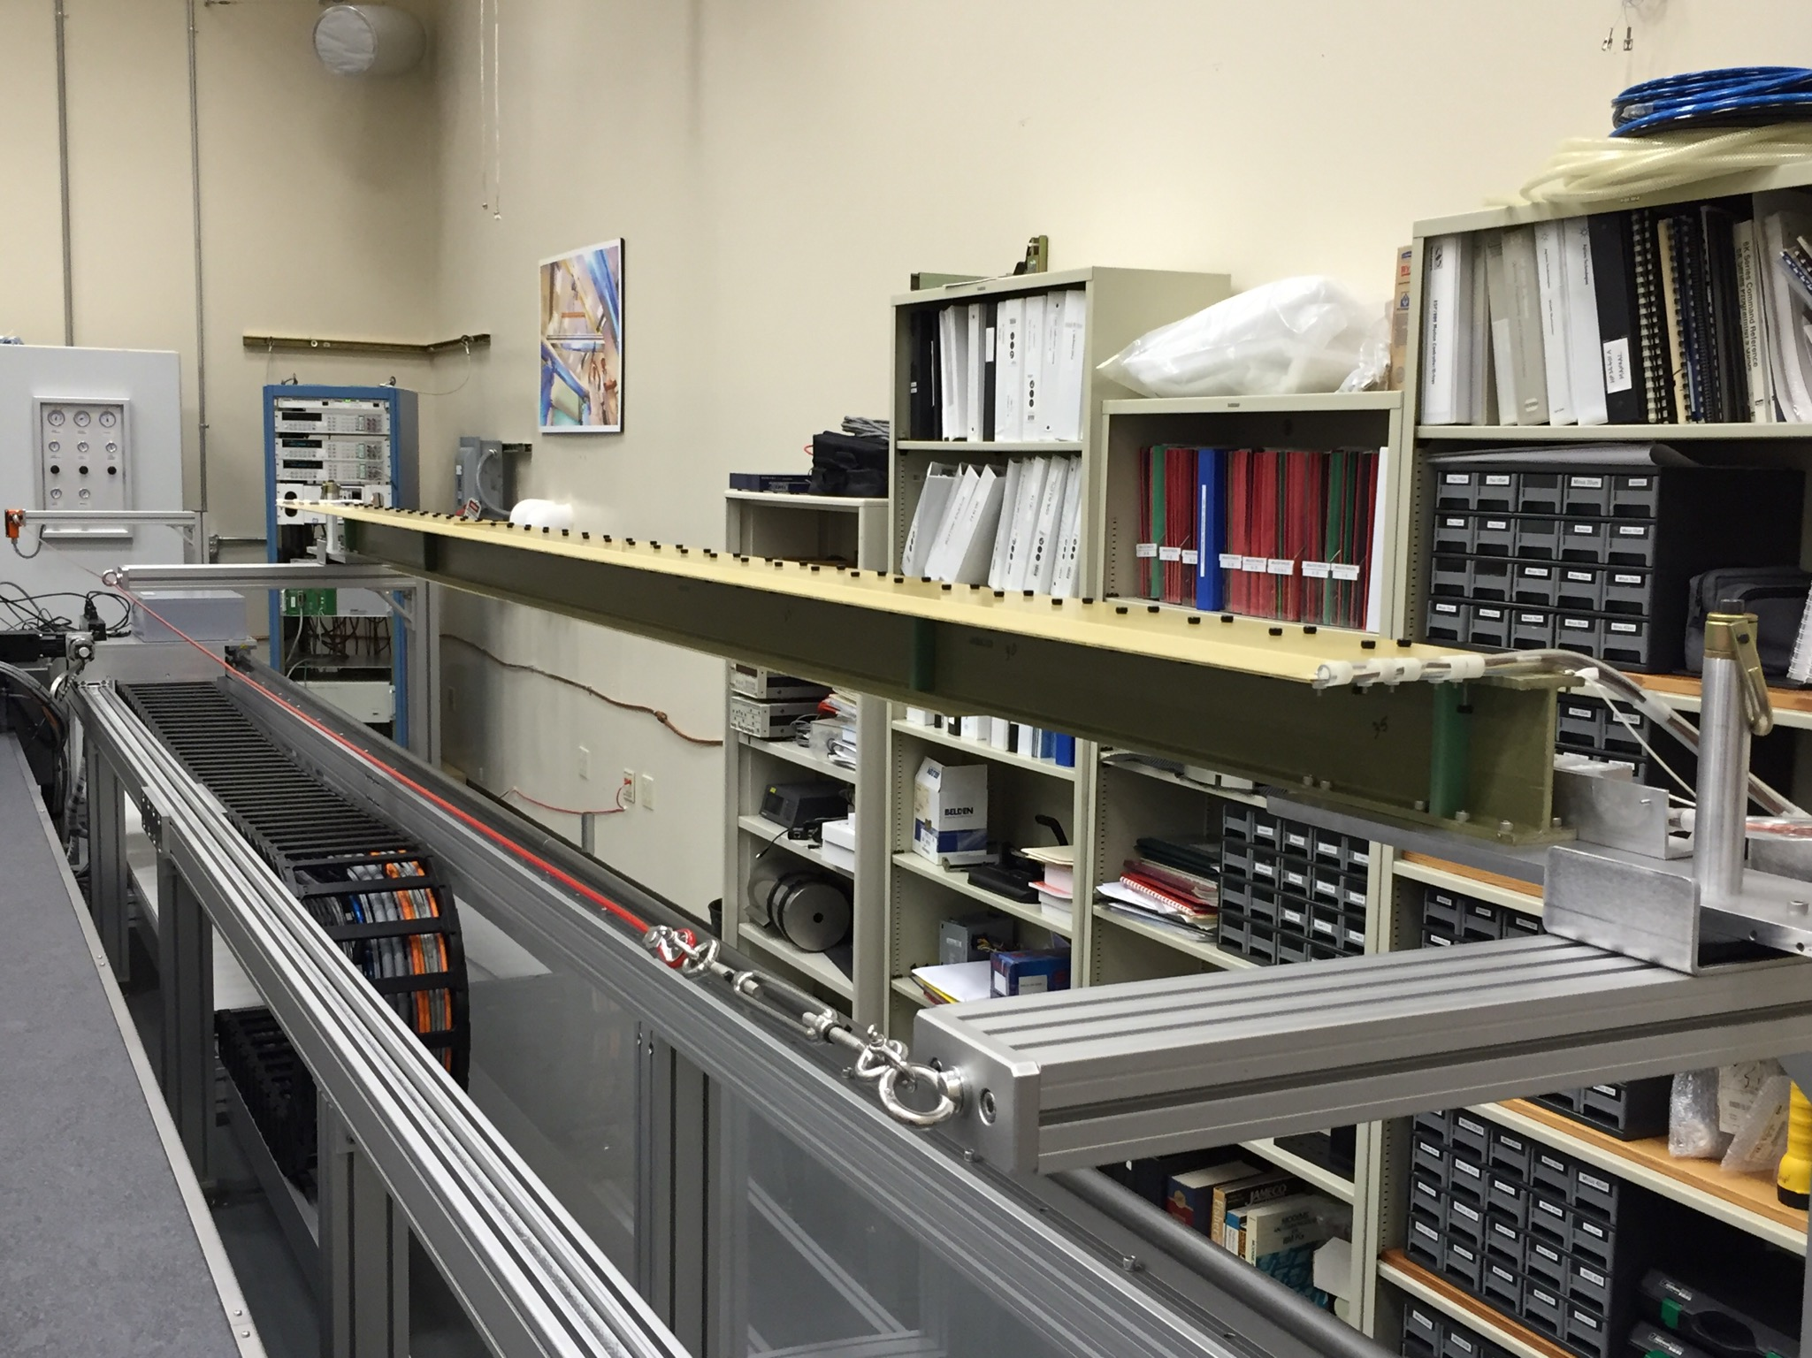
SXR Measurements With The HXU32 Prototype
Hall probe measurements are done with the Kugler bench.
Field integrals are measured with a long coil.

Slide 33
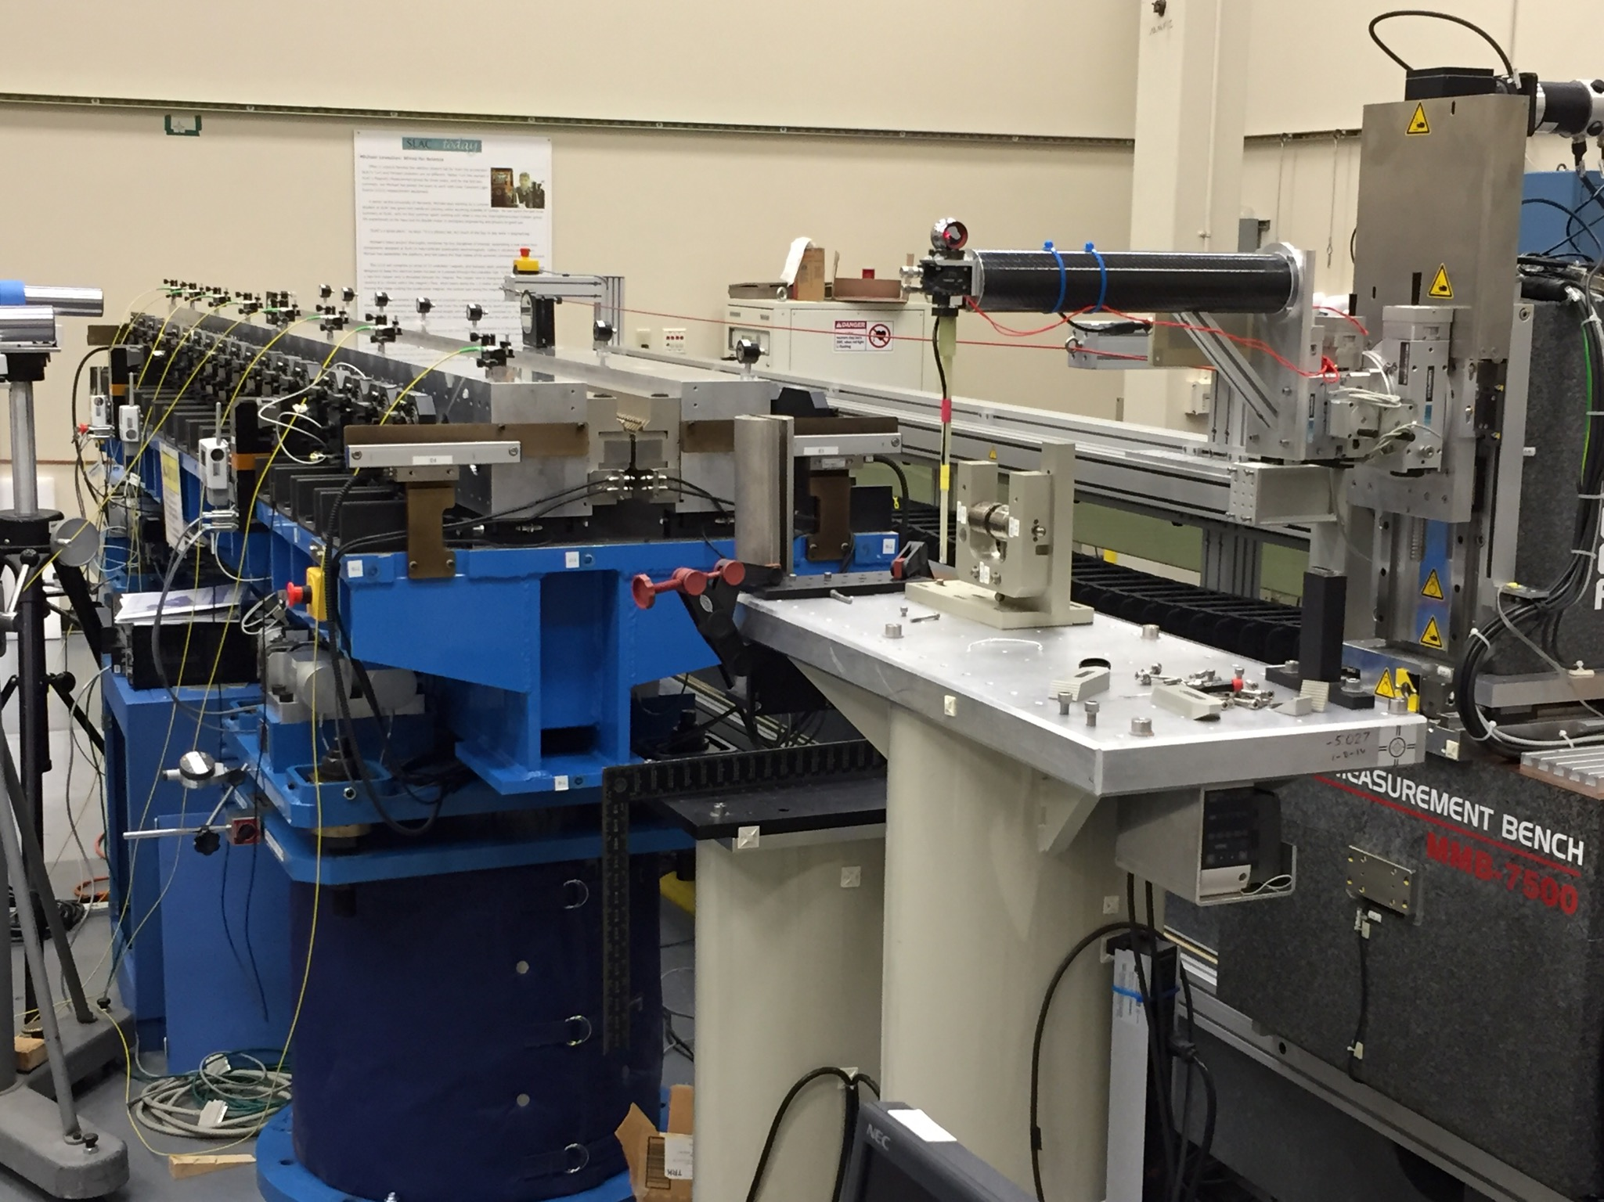
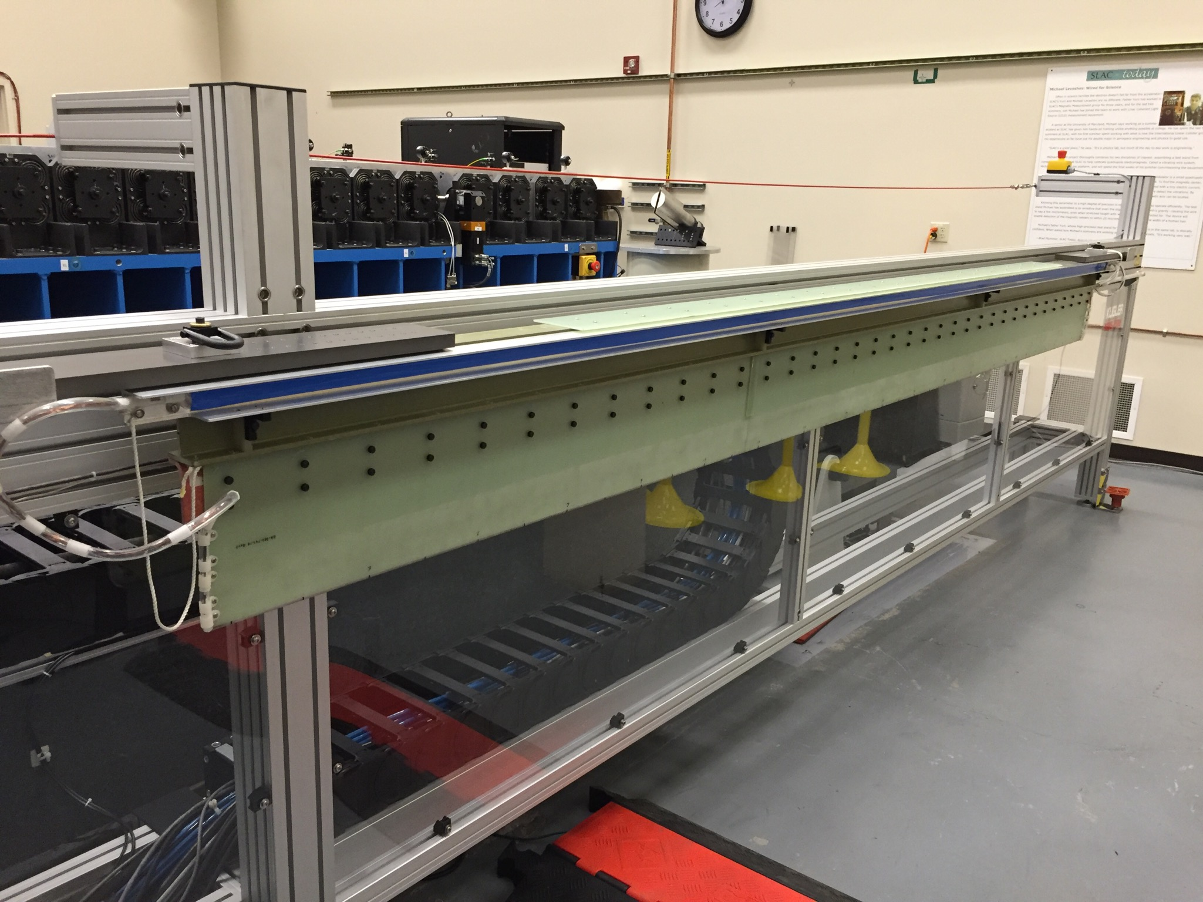
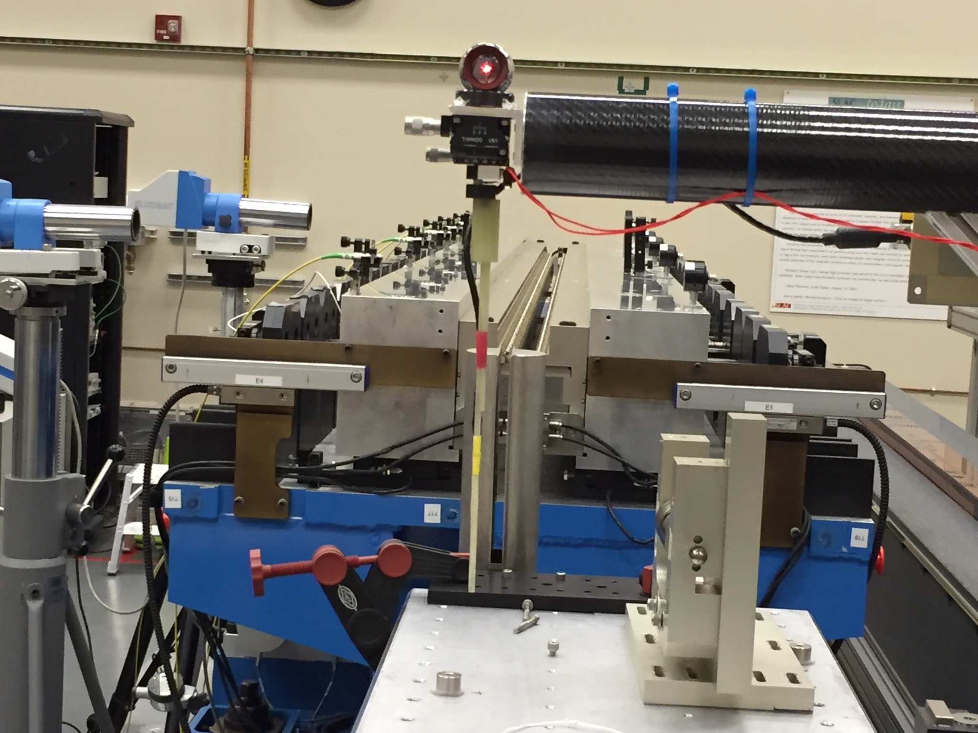
HXR Measurements With The HGVPU Prototype
Long coil measurements will be done with a vertical coil.
Hall probe measurements are done with the probe at the end of a large carbon fiber tube.

Slide 34
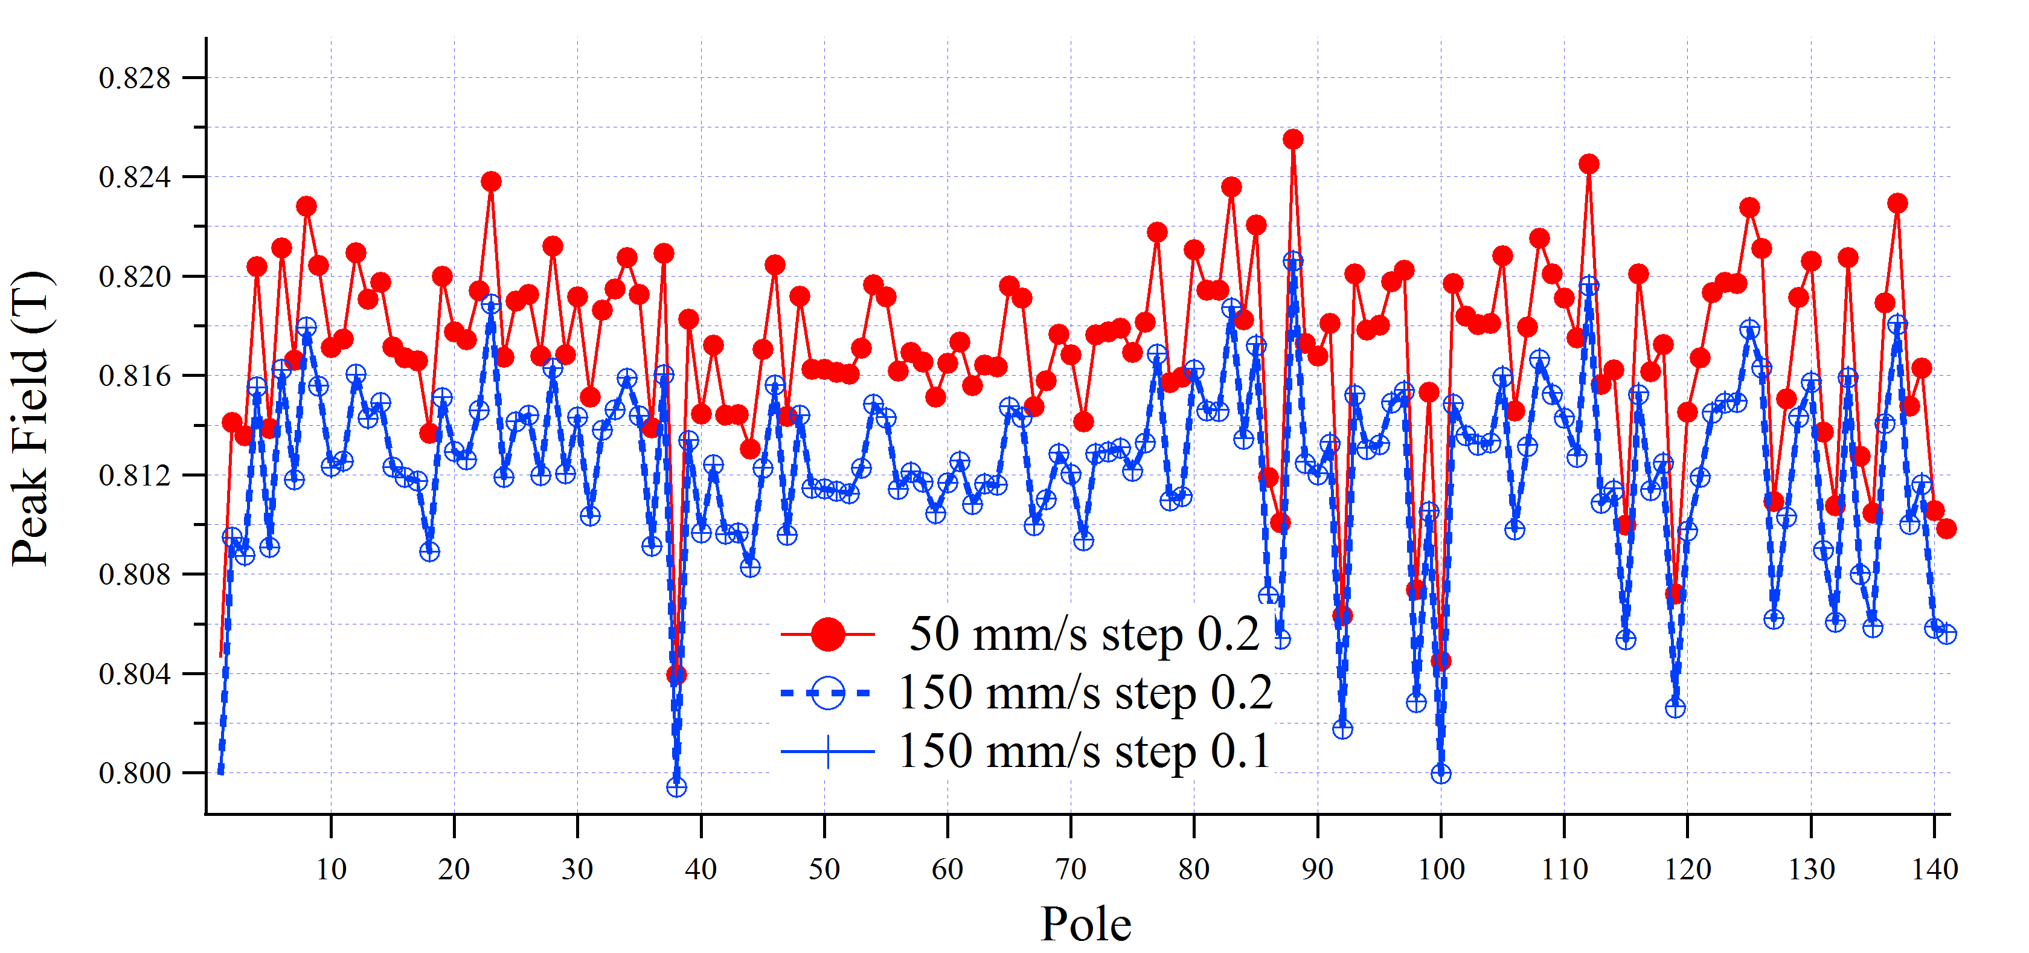
Hall Probe Speed Dependence
Yurii’s measurements
Signal frequency (Hz) Senis 118-114 peak field (T) Sentron 463 peak field (T)
0.33 1.276085 1.276314
0.67 1.274817 1.276309
1.33 1.273279 1.276304
2.67 1.269586 1.276329
Max rel. difference: 5·10-3 2·10-5
The new Senis probes seem to have a problem.
For now we will use our Sentron probe.
Isaac’s measurements

Slide 35
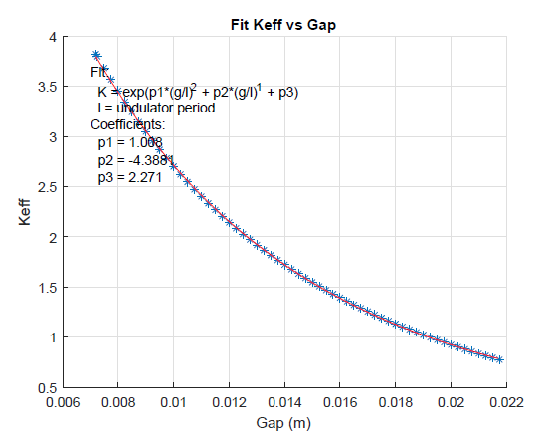
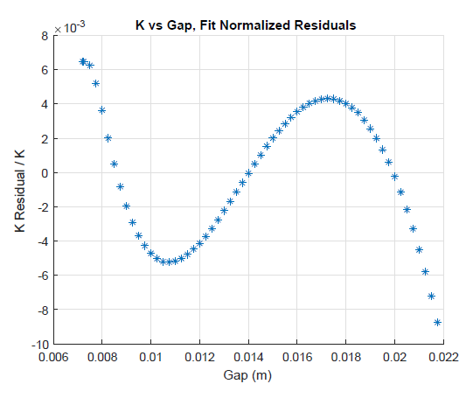
K Fit Tests
HXU32
Halbach formula
Fit only odd points, find residuals for even and odd points

Slide 36
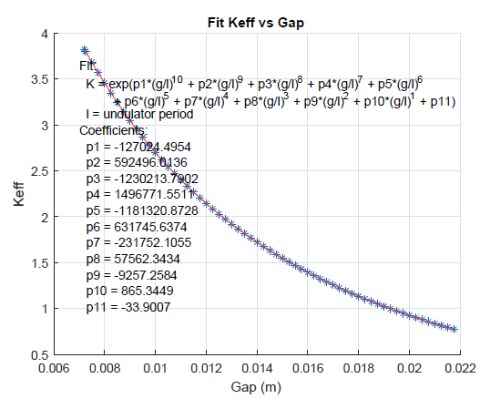
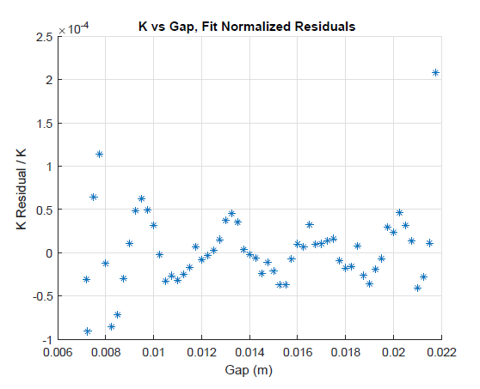
K Fit Tests
HXU32
Extended Halbach formula
Fit only odd points, find residuals for even and odd points

Slide 37
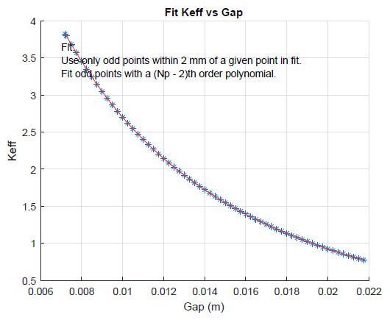
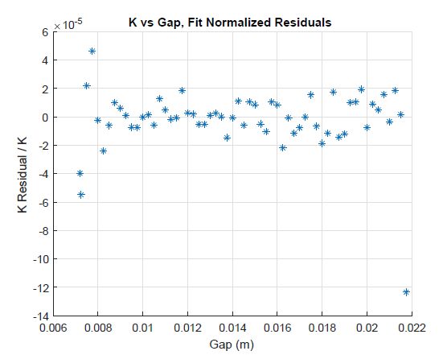
K Fit Tests
HXU32
Local polynomial fits
Fit only odd points, find residuals for even and odd points

Slide 38
Phase Matching
LCLS-TN-16-3
Phase shims set the phase matching error to zero at one K value.
This lets us commission the undulators without phase shifters.
The entrance phase shifter makes the phase matching error in the undulator center a multiple of 2π.
The exit phase shifter makes the phase error at the exit cell boundary a multiple of 2π.
The actual phase shifter has the phase of the sum of the entrance plus previous exit phase shifters.

Slide 39


Phase Matching Fits
HXU32 Measurements
We plan to use fits to determine the phase shifter settings between measured points.

Slide 40

Magnet Radiation Damage Measurement Plan For The Tunnel
S. Anderson
Kapton
1 m long
125 microns thick
2 layers
36 turns per pole
0.1 VS signal
We are testing thin printed circuit coils that sit on the magnets with the poles sticking through holes in the kapton substrate.
The coil voltage is integrated to give the flux change as the gap is changed between two values. Changes in the flux measurement will indicate radiation damage.

Slide 41

Repeatability Of Coil Measurements
S. Anderson

Slide 42


Gap Encoder Radiation Damage
Set the undulator gap to the same value as a reference piece using capacitive sensors.
Record encoder readings.
If an encoder fails, repeat the procedure and set the new encoder offset to give the same encoder reading.

Slide 43
Earth Field
Plan:
The undulators will be measured with the same orientation as they will have in the tunnel.
The fields in the tunnel will be mapped.
Correctors on the beam pipe will account for differences between the Earth field in the tunnel and in the lab.
We will construct a Helmholtz coil to simulate the Earth field differences between the tunnel and the lab.
We will determine current settings for the corrector coils based on the Helmholtz coil measurements and the tunnel map.
We will check the current settings in the tunnel using a portable vibrating wire system.

Slide 44

Earth Field At SLAC And LBNL
SLAC
LBNL
X = perpendicular to bench
Y = up
Z = along bench
SLAC
Bx = +0.269 G
By = -0.343 G
LBNL
Bx = +0.126 G
By = -0.335 G
LCLS-II
LBNL tuning won’t need major corrections at SLAC.

Slide 45


LCLS Tunnel Fields Measured For LCLS-I
0.3 G
0.1 G
-0.6 G
-0.25 G

Slide 46





Correct Earth Field Difference With Beam Pipe Corrector Coil
I = 1 A
I = 3 A
Pole steel simulated by image currents.

Slide 47



Beam Pipe And Magnet Array Heating
Temperature rise of beam pipe
Small thermistors on beam pipe and “undulator”
Temperature rise of “undulator jaws”
1 W/m corrector currents
plus
1 W/m heater (beam current)
Need water cooled chamber so we don’t change the K value.

Slide 48

Helmholtz Coil To Simulate Earth Field Difference Between MMF And Tunnel
Coils
I₂
I₁
Two power supplies for two coils on diagonals.
Truss structure
-I₁
-I₂

Slide 49




XFEL Earth Field Studies
Uwe Englisch

Slide 50

Helmholtz Coil

Slide 51




Field Integral Measurements In The Tunnel
Y. Levashov
Use beam pipe with corrector coils and a vibrating wire system at the beam position. The system is currently being tested.

Slide 52

Phase Shifter Measurements
The SLAC measurements agree
with the Danfysik measurements.
All strength and field integral requirements were met.

Slide 53


Phase Shifter Crosstalk Measurements
The edge of the phase shifter must be 14 cm from the last pole
of the undulator (using the 3 Gcm criterion, no mirror plates).
The current design meets this requirement.

Slide 54
Summary
The Delta undulator has a gradient in K that must be accounted for when using multiple Deltas in a system.
Assembly tolerances on the Delta undulator are at the 8 micron level if we are to avoid large phase errors.
We have a plan for sharing the LCLS-II tuning work with LBNL.
We have started to fit the phase matching errors and the K value so that we can determine what density of measurements are required for the phase shifters and the undulators.
We are testing a scheme to monitor radiation damage in the tunnel.
We are dealing with the Earth’s magnetic field by measuring the undulators in the same orientation as in the tunnel, mapping differences in the Earth’s field between the MMF and the tunnel, and using corrector coils on the beam pipe to compensate the differences.

