Slide 1
Tutorial On Fiducialization Of Accelerator Magnets And Undulators
Zachary Wolf
SLAC
IMMW19
October 25, 2015

Slide 2
Overview
Fiducialization Overview
Dipoles
CMM
Capacitive sensors
Moving wire
Quadrupoles, Sextupoles, etc.
CMM
Rotating coil
Vibrating wire
How to locate a wire
Pulsed wire
Solenoids
Small rotating coil
Undulators
CMM
Capacitive sensors
Hall probe measurements
How to locate a Hall probe

Slide 3
Fiducialization
Suppose we know the beam line coordinates X_{b} and Y_{b}
in the telescope’s coordinate system.
We know Δx₁, Δx₂, Δy₁, and Δy₂ from the fiducialization.
We put the tooling balls at X_{b}+ Δx₁, X_{b}+ Δx₂, Y_{b}+ Δy₁, Y_{b}+ Δy₂
in order to place the magnet on the beam line.
In this way, we don’t need to know the details of the magnet’s
magnetic field in the tunnel.
Fiducialization: Find the tooling ball locations relative to the
beam axis.

Slide 4
Dipoles Mechanical Fiducialization
In steel magnets, the magnetic field shape is
‘determined’ by the steel.
Steel dipoles can be fiducialized mechanically.
A CMM can measure the position of the poles
and relate the pole positions to the tooling ball
positions.
Typically the CMM can only touch the poles near the ends and the middle
is ignored. Adequate for short magnets. Also, the poles have some roughness.
Roll accuracy estimate: ~25 µm / 5 cm = 5 x 10⁻⁴ rad

Slide 5
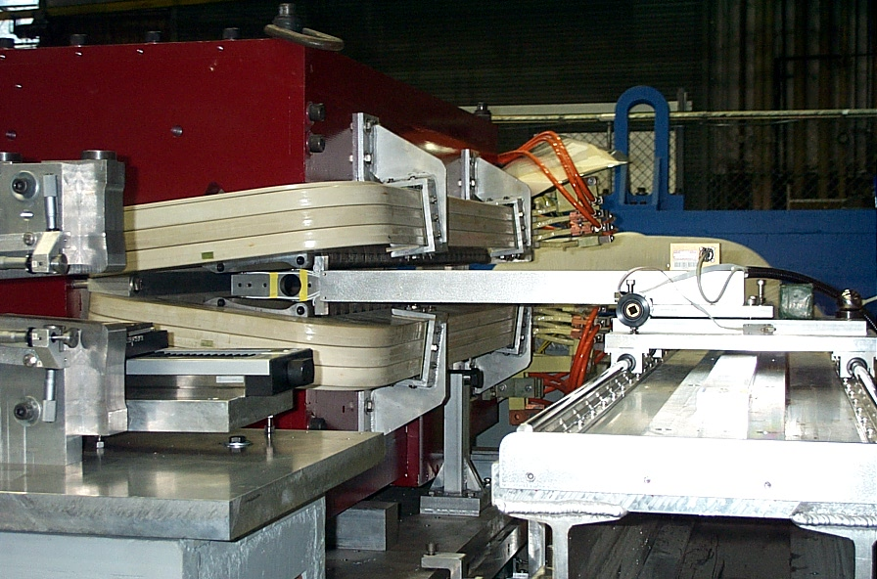
Dipoles Mechanical Fiducialization
Capacitive sensors can measure a reference pole
that has been fiducialized, and then measure the
magnet. Tooling balls on the magnet can be related
to tooling balls on the reference pole.
Measures over entire length of C-magnets. Need to correct for
sensor position and roll.
Roll accuracy estimate: ~10 µm / 10 cm = 1 x 10⁻⁴ rad
Sensors
Reference Pole
Position Detector
Electronic Level

Slide 6
Dipoles Magnetic Fiducialization, Moving Wire
Roll
X
Move wire
vertically,
measure ΔΦ.
Rotate magnet
until ΔΦ=0.
Move wire
horizontally,
measure ΔΦ.
Move magnet
until ΔΦ profile
is centered on
wire.
Similar for finding
vertical center.
Roll accuracy estimate: ~10 µTm / 1 Tm = 1 x 10⁻⁵ rad
Relate magnet position to wire.

Slide 7
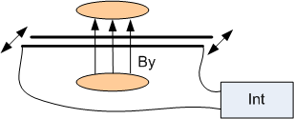
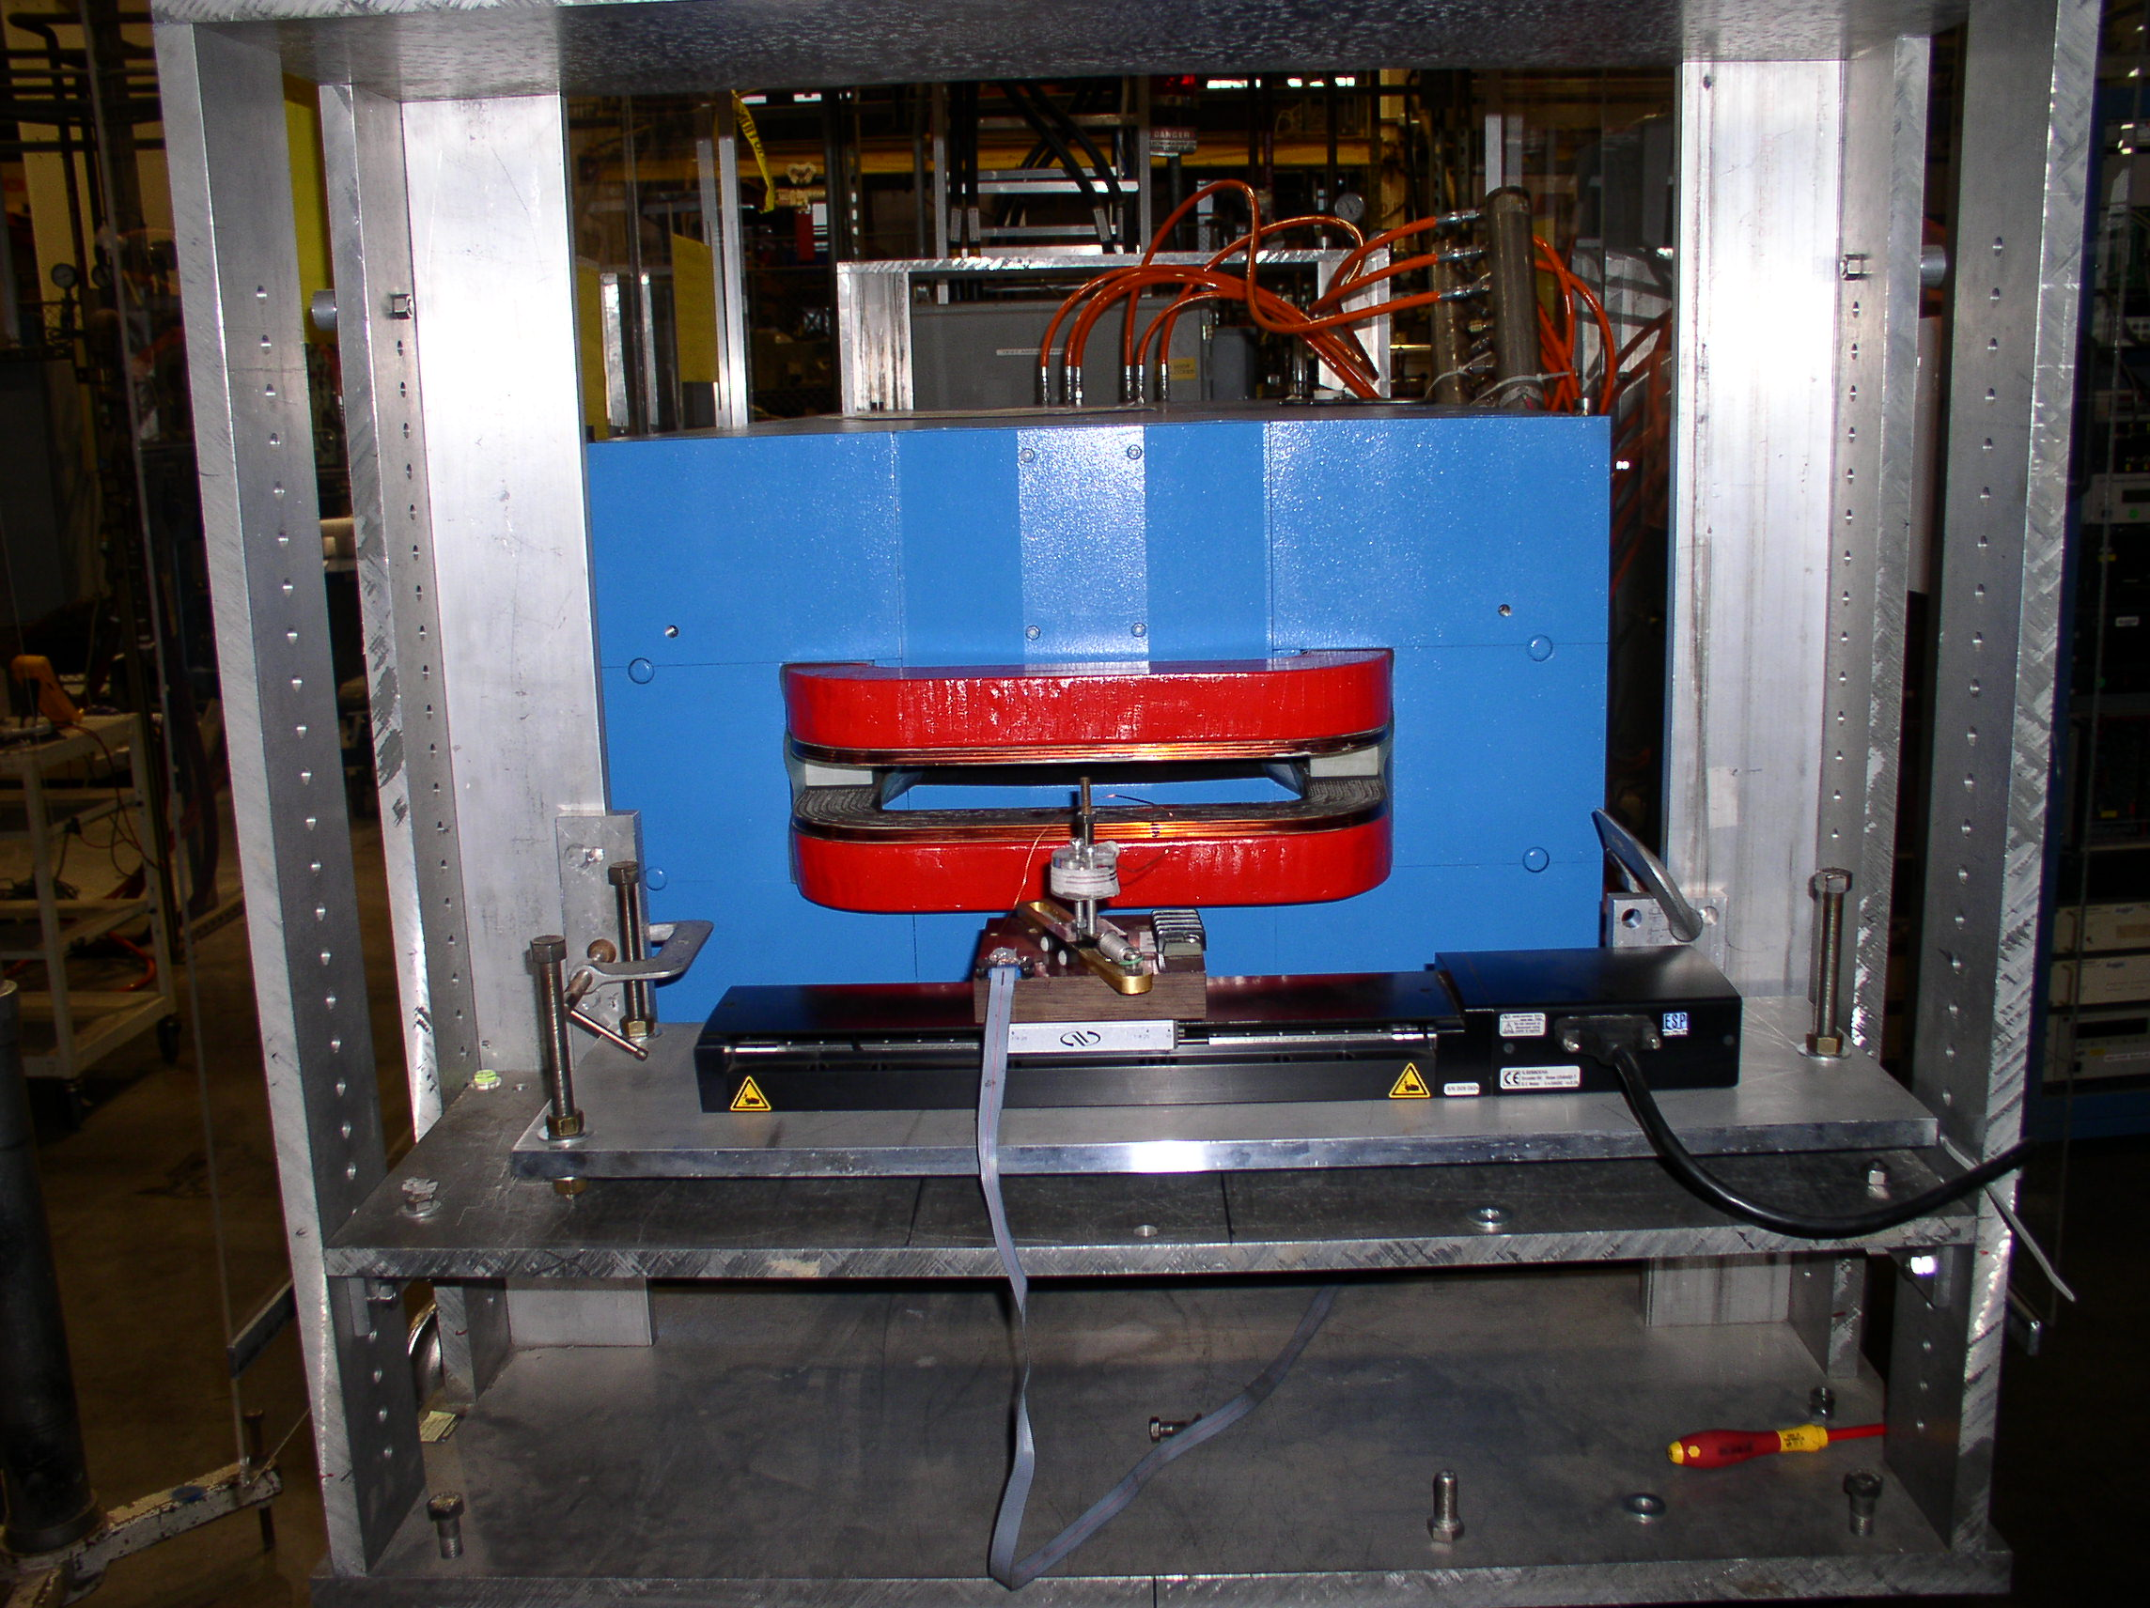

Field Integrals From A Moving Wire
Take out thermal emf:
V₊ = dΦ/dt + V_{t}
V₋ = -dΦ/dt + V_{t}
VT = (VT₊ - VT₋) / 2
= ΔΦ

Slide 8
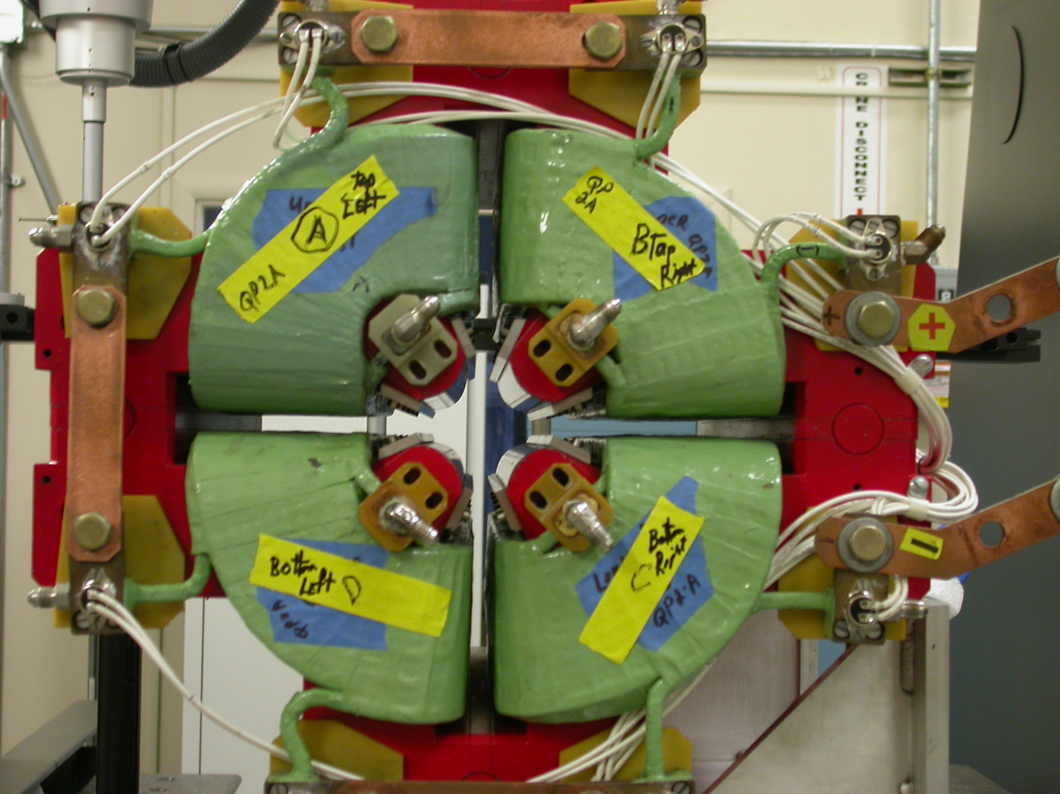
Quadrupoles And Higher Multipoles Mechanical Fiducialization
CMM probe touches poles
to measure point locations
on the poles.
An algorithm finds the mechanical
center from the sample points.
The mechanical center is related to
tooling balls on the magnet.
Touch poles at quadrupole ends. The middle is ignored. The poles have a roughness.
Quadrupole center position accuracy estimate: ~50 µm.

Slide 9
Quadrupole Fiducialization Rotating Coil
Quadrupole:
The dipole strength and the quadrupole strength can be used to
calculate the measurement position relative to the magnetic center.

Slide 10
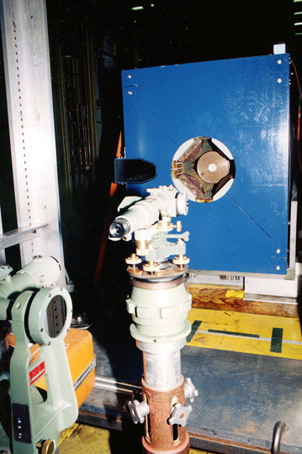
Quadrupoles And Higher Multipoles Rotating Coil
Locate axis of rotation from shaft ends.
Locate tooling balls relative to axis of rotation.
Harmonic feed down gives magnetic center
location relative to axis of rotation.
From these, calculate tooling ball location
relative to magnetic center.
Can also use short coils.
Move coil until dipole signal
goes to zero.

Slide 11
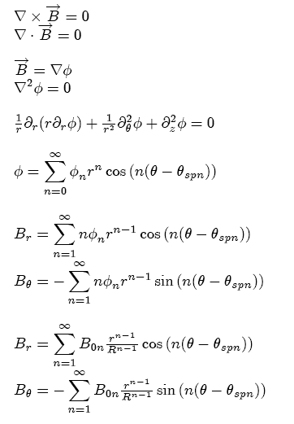
Rotating Coil Analysis Field In A Multipole Magnet
Assume ∂_{t} = 0, ∂_{z} = 0
θ_{spn} = angle of first south pole
of the n’th harmonic
R = ‘reference radius’

Slide 12
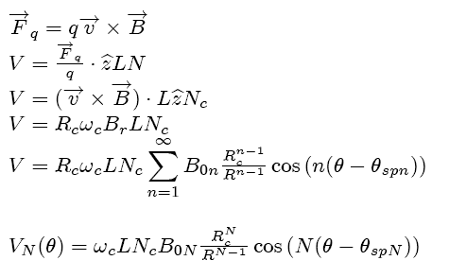
Voltage From A Rotating Coil
Main harmonic

Slide 13
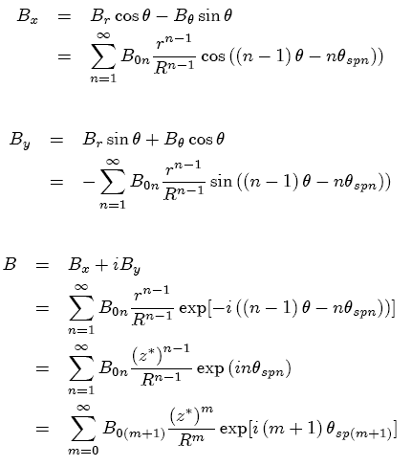

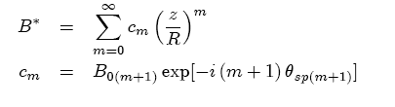


Translations Of The Coil Relative To the Magnet Center Are Best Studied In Cartesian Coordinates
We could have started here
since B* is analytic, but we
would have lost the connection
to the field strength and south
pole angle.

Slide 14
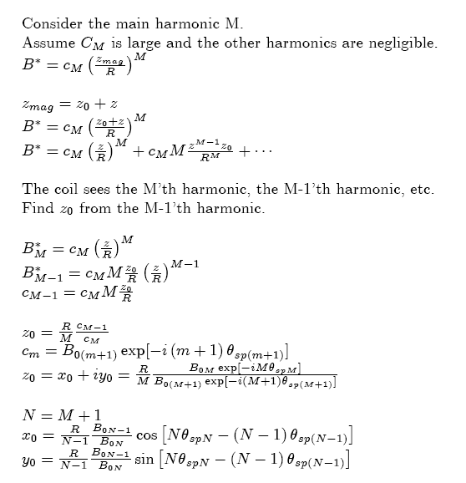
Magnetic Center Relative To The Coil Rotation Axis
Harmonics measured by the coil

Slide 15
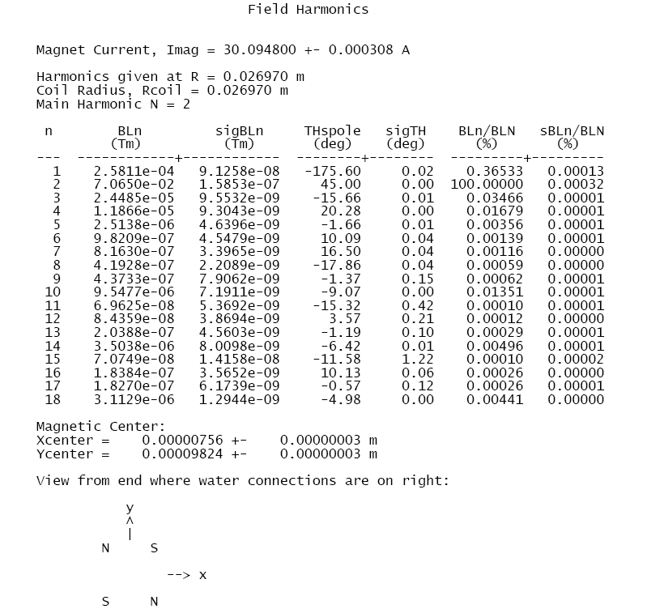

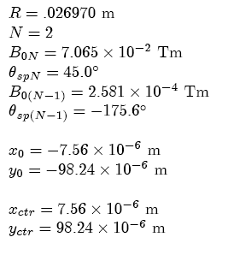
Example: Harmonics Measurement Of A Quadrupole

Slide 16
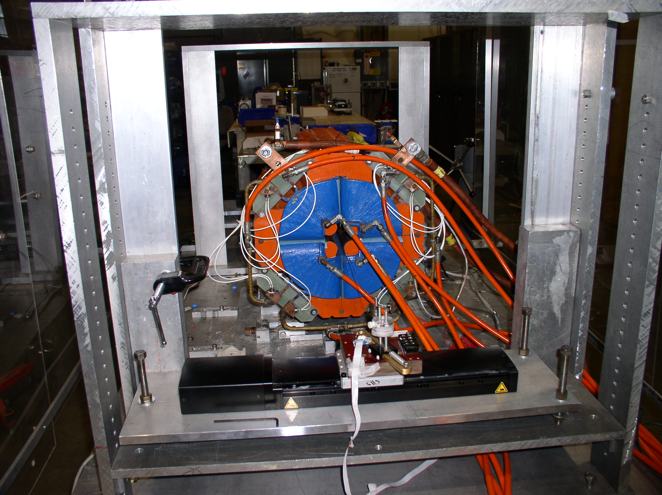
Moving Wire Fiducialization
Quadrupole:
B_{x} = G y
B_{y} = G x
Move the wire to the location where ∫B_{y} dz = 0 and ∫B_{x} dz = 0.
Locate the wire relative to the tooling balls.
(May need to take out pitch and yaw for some applications.)
Quadrupole center position accuracy estimate: ~10 µTm / 100 T = small.
Accuracy dominated by locating wire and locating tooling balls.

Slide 17
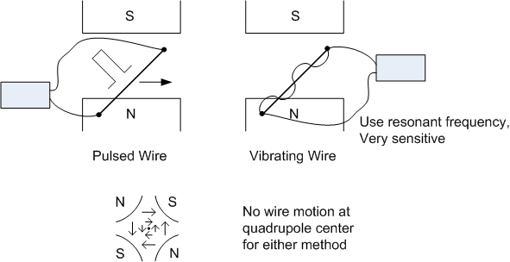
Pulsed Wire, Vibrating Wire
The wire has a force on it and moves when a current flows through
the wire in the presence of a magnetic field.
*

Slide 18
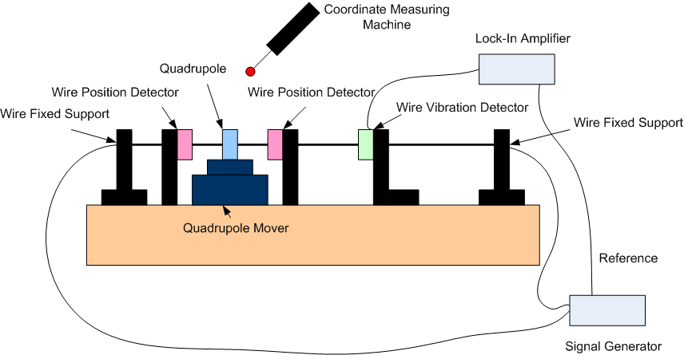
Quadrupoles And Higher Multipoles Vibrating Wire

Slide 19
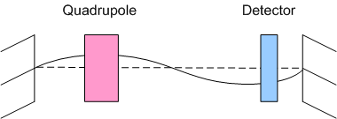
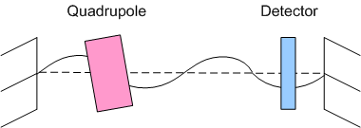
Vibrating Wire
If the ac current carrying wire goes
through a magnetic field, the force
excites a mechanical vibration of
the wire.
An optical detector gives
a signal that the wire is vibrating.
The vibration stops when the wire
is at the center of the quadrupole.
This method can also detect pitch and
yaw of the quadrupole.

Slide 20
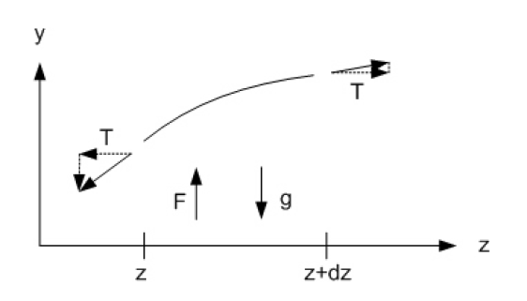







Vibrating Wire
Equation of motion of the wire
Solution for the wire motion
Vibration at ω_{n} goes to zero
when B_{xn} goes to zero.

Slide 21
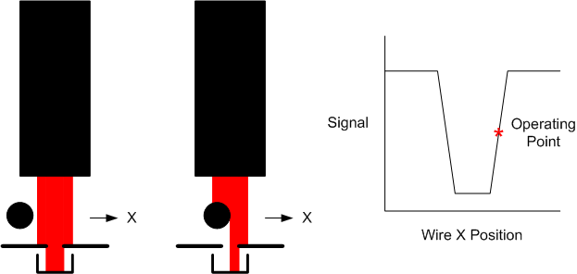
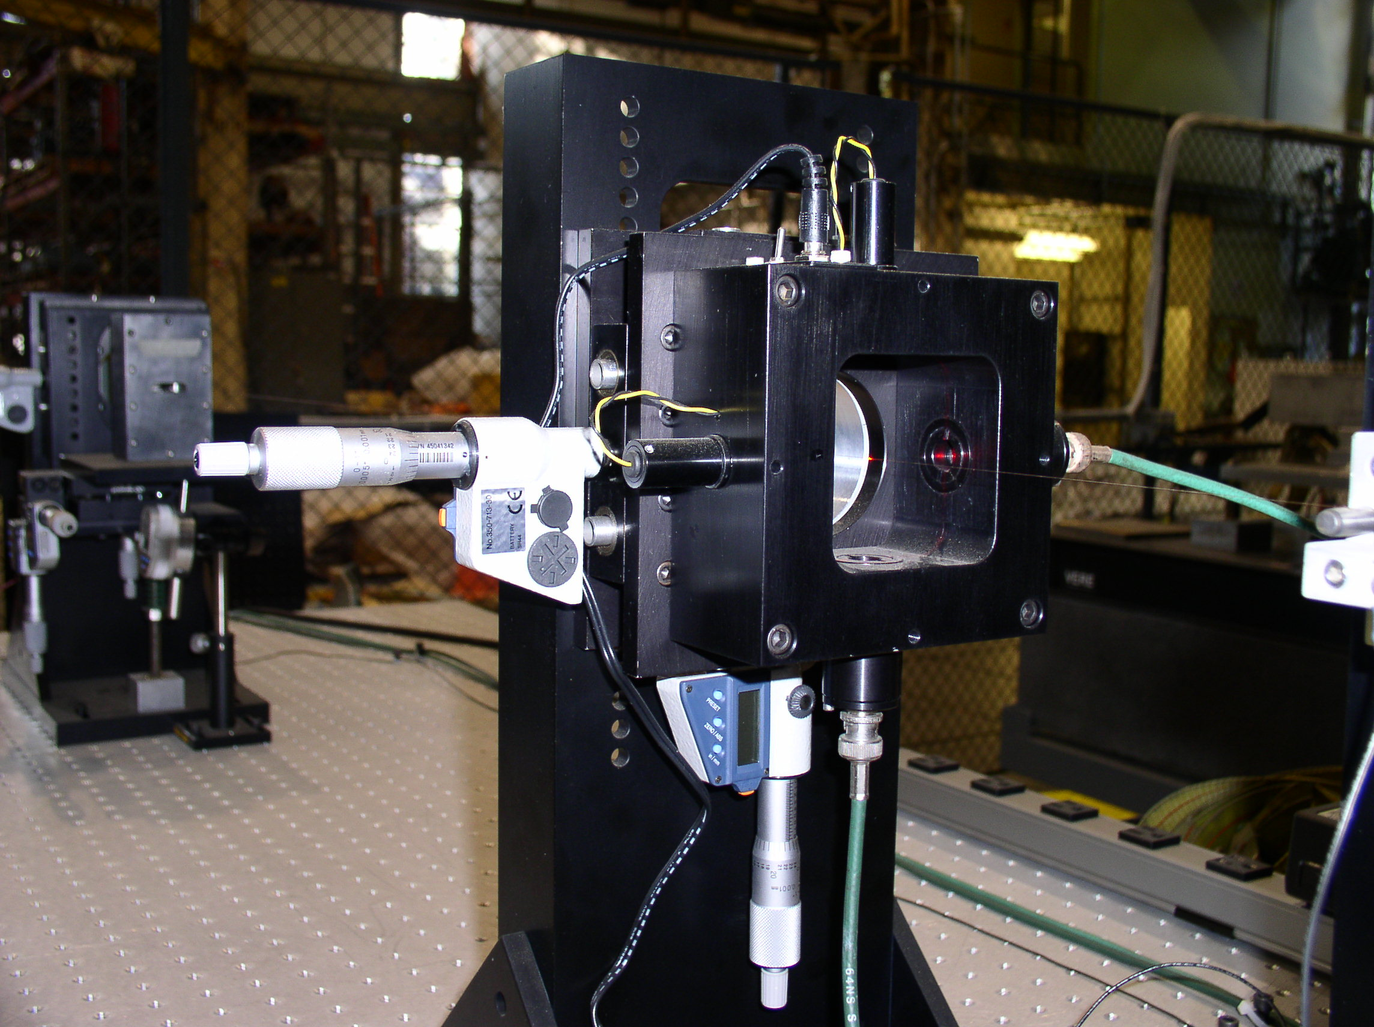
Wire Vibration Detector
Optical sensors
detect wire vibration.

Slide 22
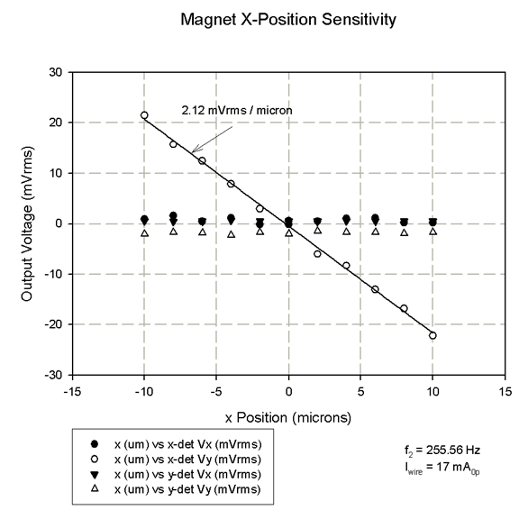
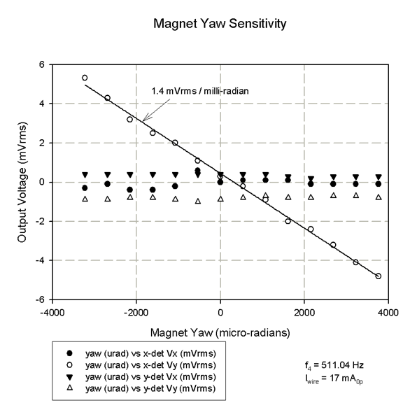
Vibrating Wire Signals
Examples:
Amplitude of signal from wire vibration sensor vs quadrupole x-position
and quadrupole yaw.

Slide 23
How To Locate A Wire Touching A Wire Moves The Wire
Example:
T = 9 N
L = 2 m
Δx = 50 µm
F = 9 x 10⁻⁴ N
Need a better method.

Slide 24
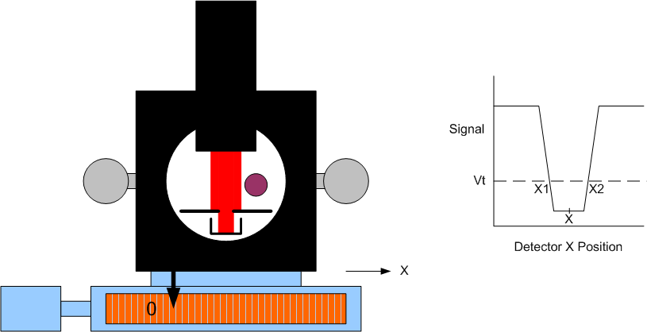
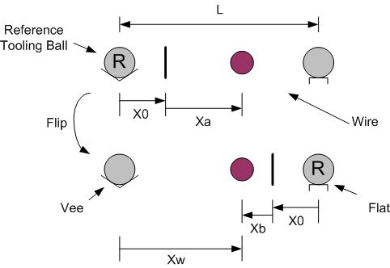
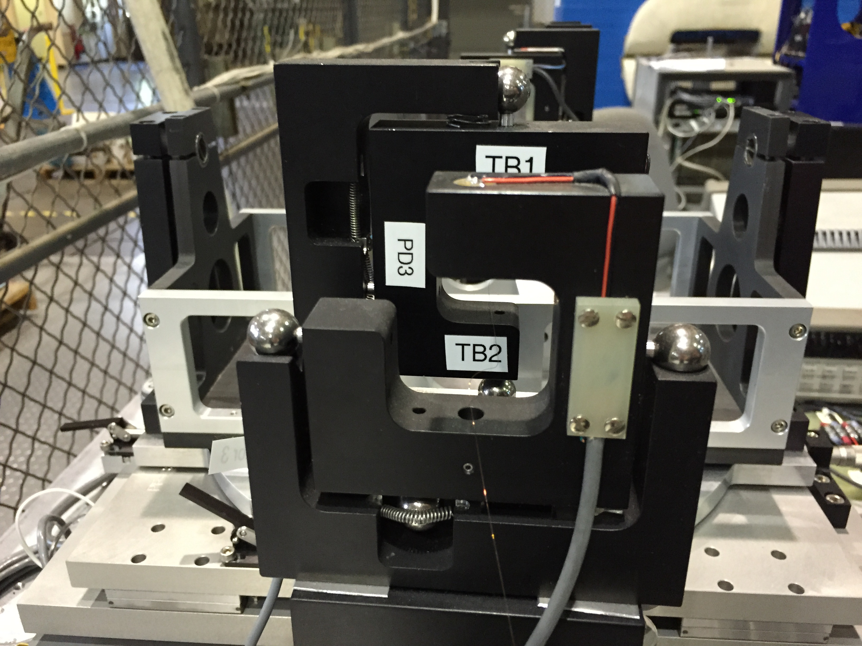
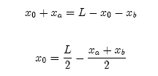
How To Locate A Wire
Find the center of the wire by
finding its edges.
Calibrate the scale offset by
flipping the detector in a
kinematic mount.

Slide 25
Wire Sag
Sag Correction
(earlier slide)
The wire position is not at
the end position because
of sag.
There are two ways to deal
with this:
Measure the wire position
near the magnet. The
previous slide illustrated this.
2) Correct for sag.
Measure at different tensions.
Extrapolate to infinite tension.
At infinite tension, the stage
position gives the wire position
at the magnet.

Slide 26
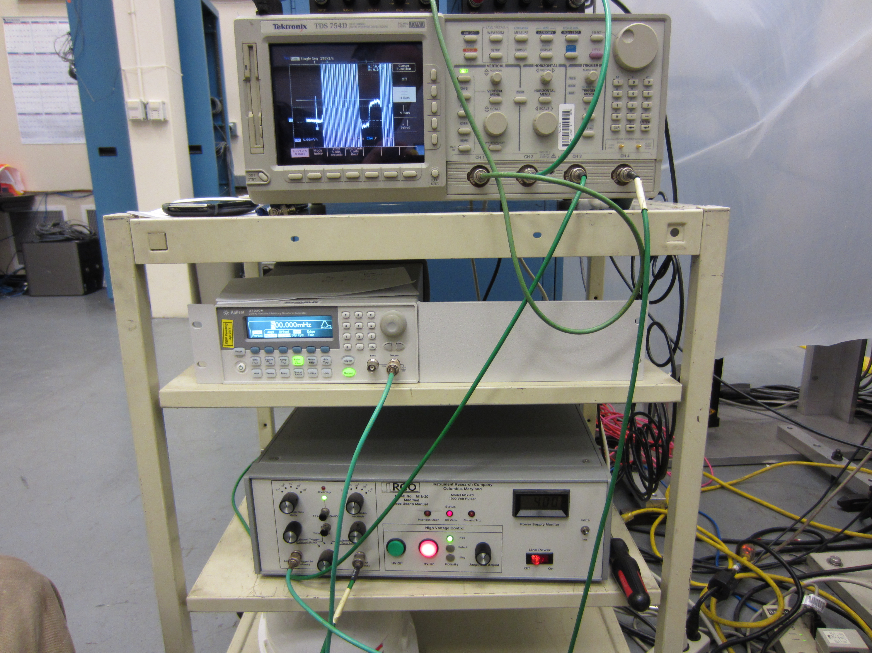
Pulsed Wire Measurements
Pulsed wire example:
Signal from wire motion of a
pulsed wire in an undulator.
Calibration magnet puts in
step at the end.
When the wave hits the
end of the wire, it reflects.
In a multipole magnet,
move the magnet or the
wire until there is no
field along the wire, so there
is no signal from the wire
motion detector.
Fiducialize the magnet so
the beam axis is along the
wire.
S. Anderson

Slide 27











Pulsed Wire
Initial impulse
Travelling wave
Derivative of wire position
signal gives field

Slide 28
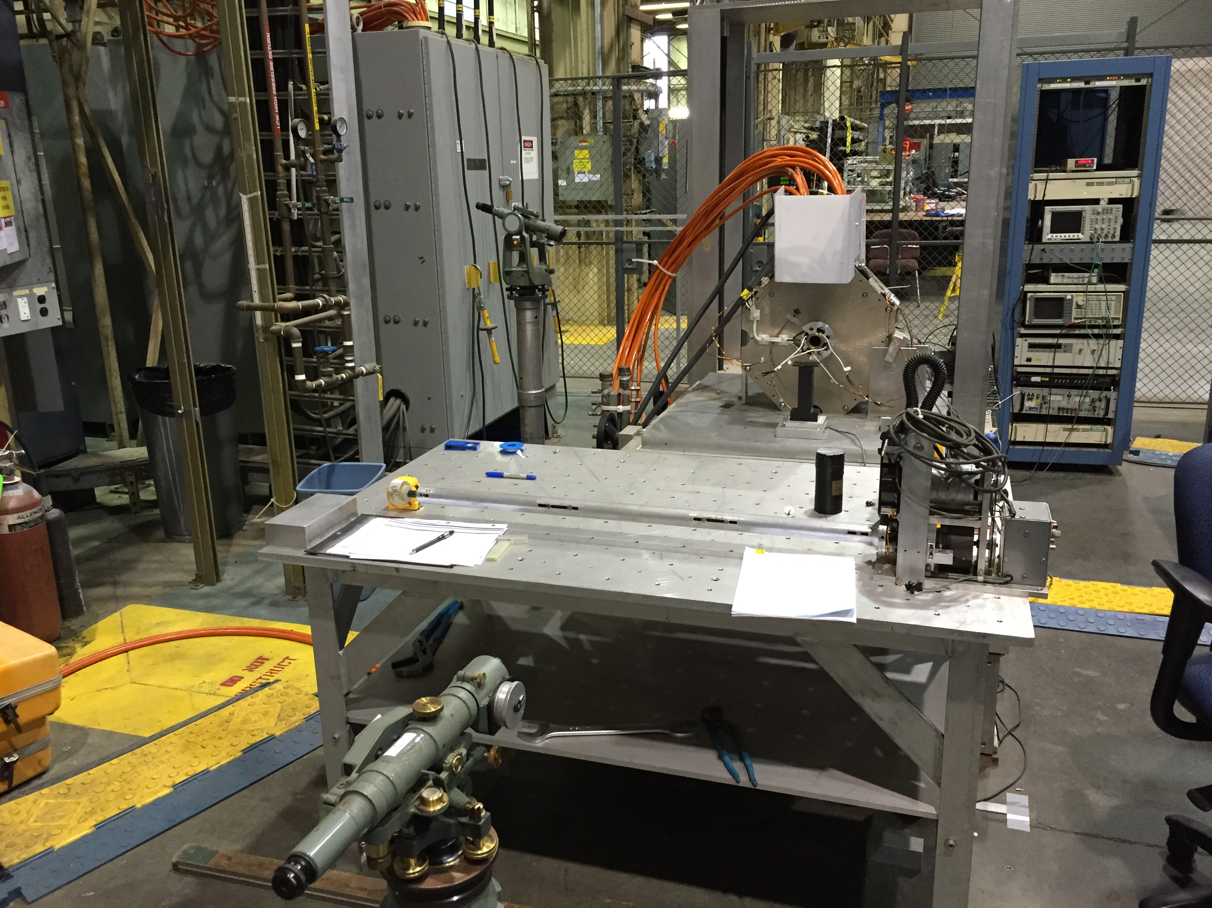
Solenoid Fiducialization Pitch and Yaw
A small rotating coil in the center of
the solenoid can be used to align the
field to the axis of rotation.

Slide 29
Solenoid Fiducialization X and Y
At the end of the solenoid, the rotating coil gives
zero voltage out when the axis of rotation is on
the magnetic center line.

Slide 30
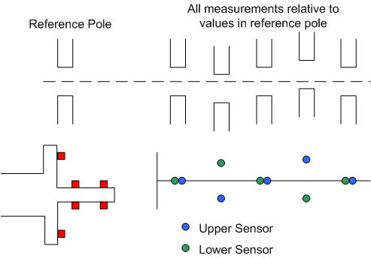
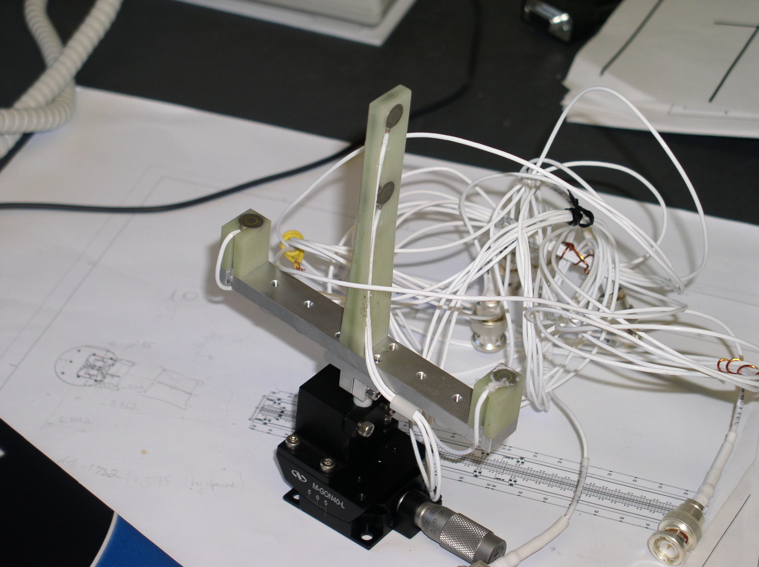
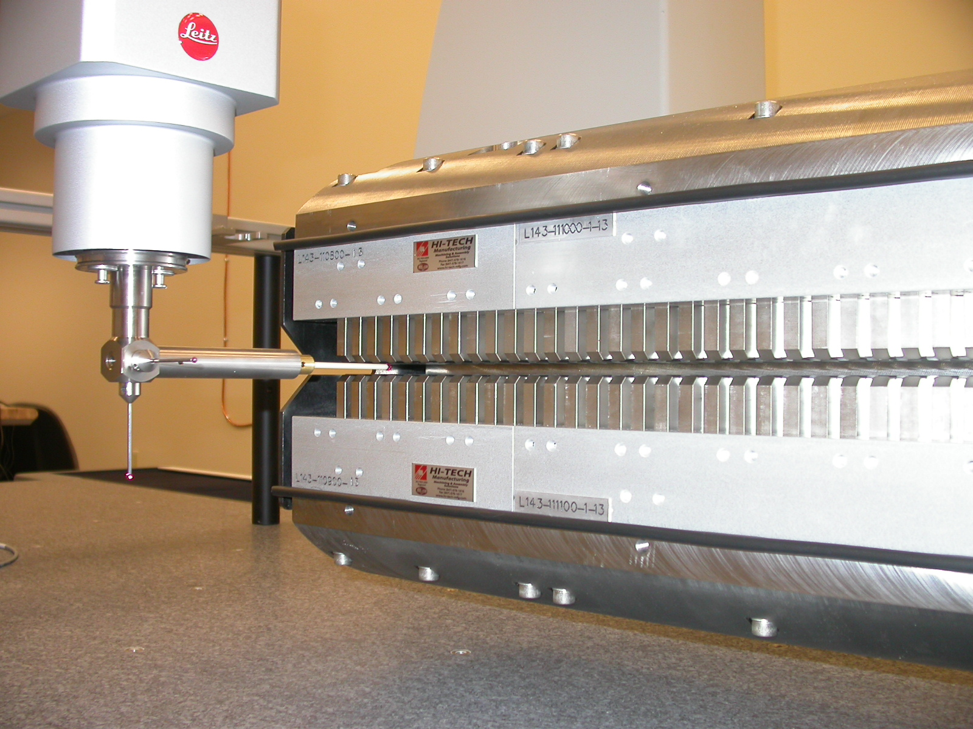
Undulator Fiducialization Mechanical Measurements
Capacitive sensors can be used to mechanically align a hybrid undulator
to a reference pole. Alternatively, a CMM can be used.

Slide 31
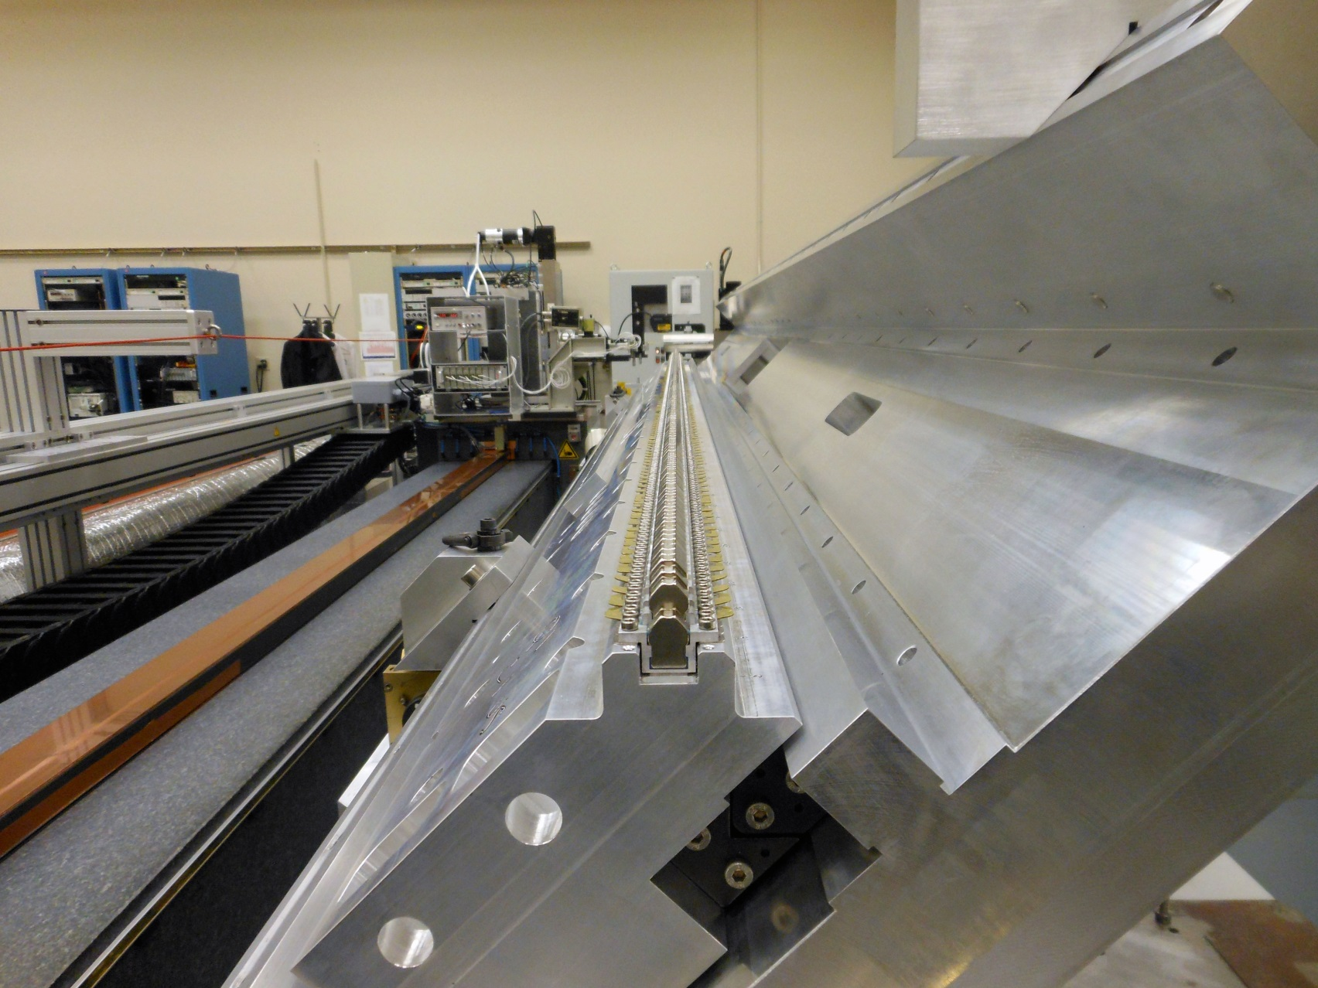
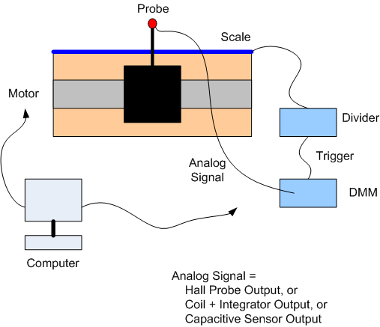
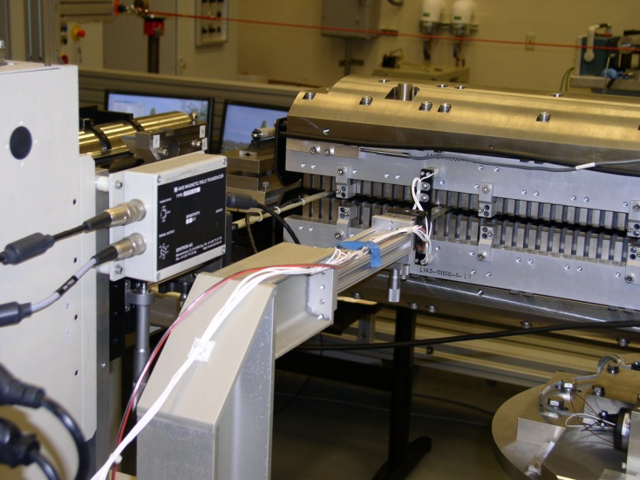
Undulator Fiducialization Hall Probe Measurements
Delta undulator quadrant
LCLS undulator

Slide 32
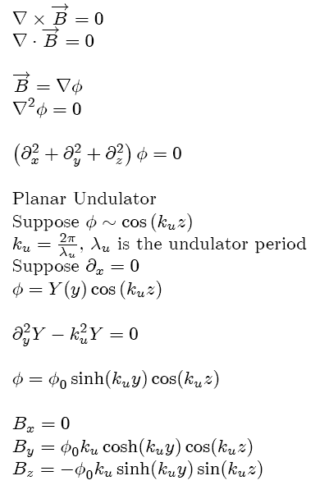
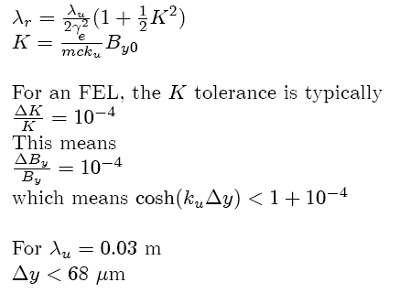
Undulator Fiducialization Tolerance Estimate
This is the tolerance installed in the
tunnel. The fiducialization tolerance
is smaller, around 40 microns.

Slide 33
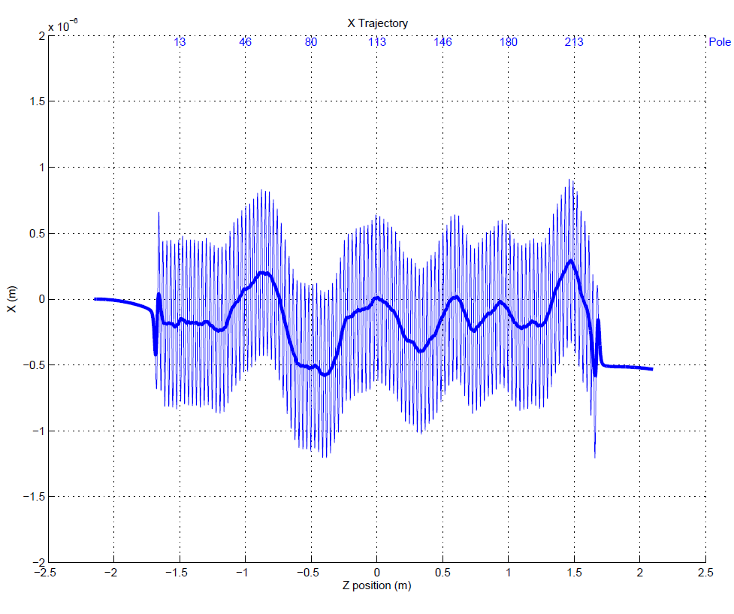
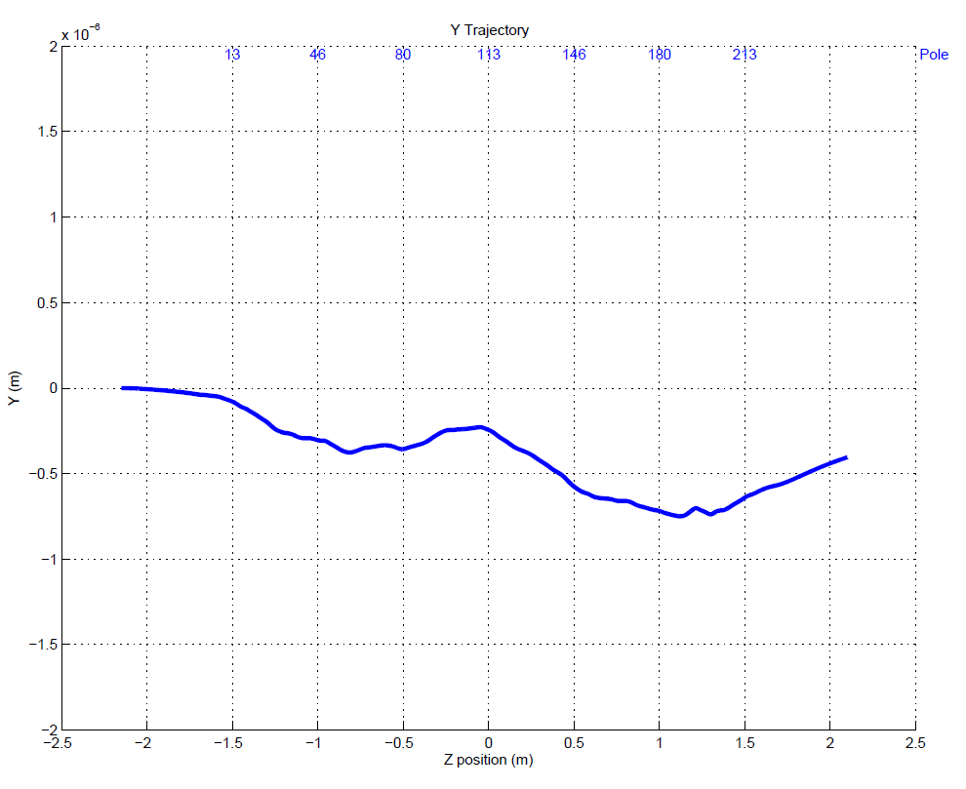
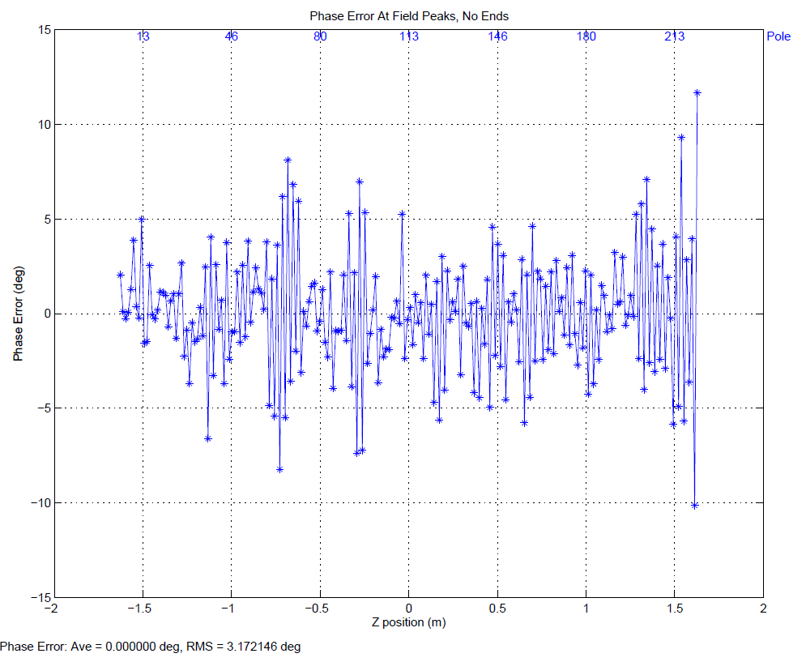
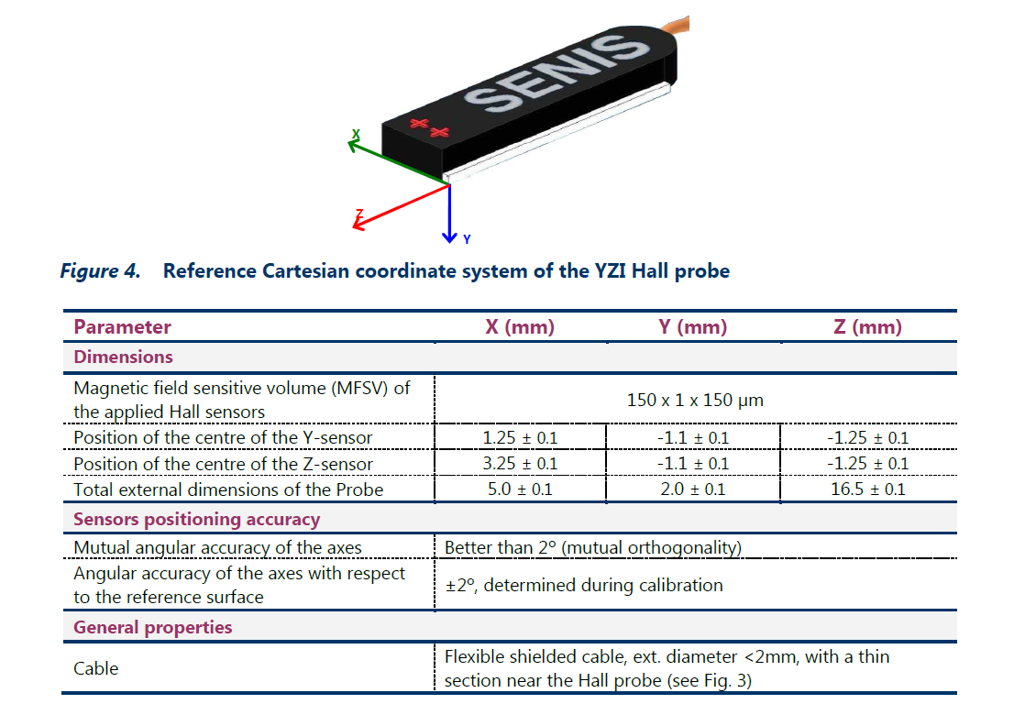
Undulator Magnetic Alignment
Fiducialization tolerance
40 microns.
Probe position given to
100 microns in specs.
After undulator is tuned:
X trajectory good.
Y trajectory good.
Phase errors good.
Want the beam to go where
the Hall probe is measuring.
But where is the Hall probe
actually measuring?

Slide 34
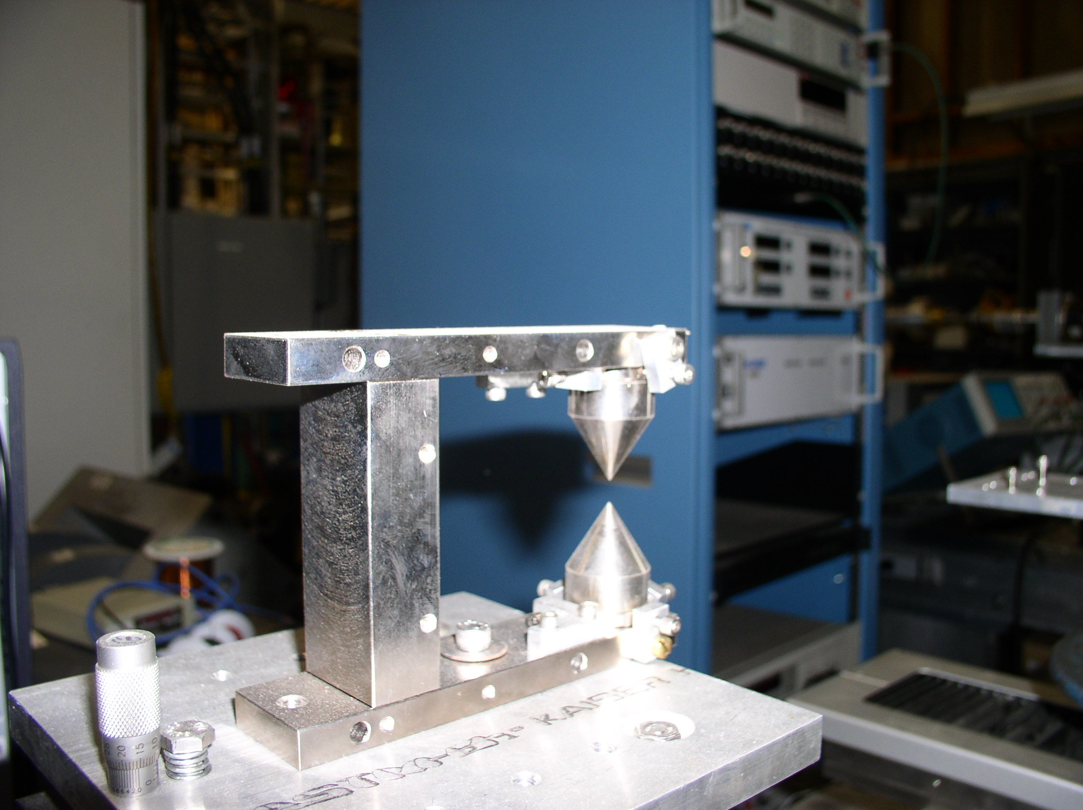
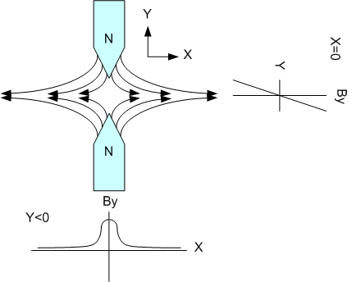
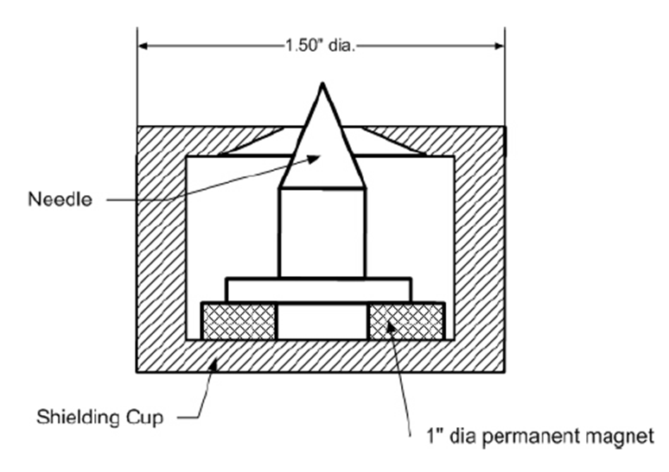

Where is the Hall probe measuring?
Pointed magnets give a magnetic location that can be found
repeatably at the 2 micron level.
Attach to undulator ends, measure offsets

Slide 35
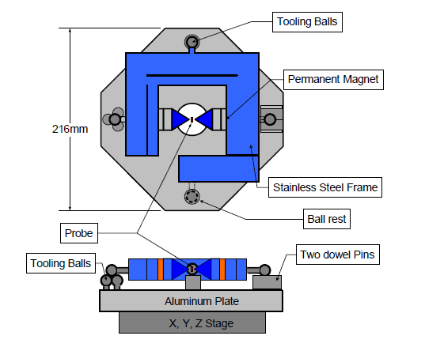
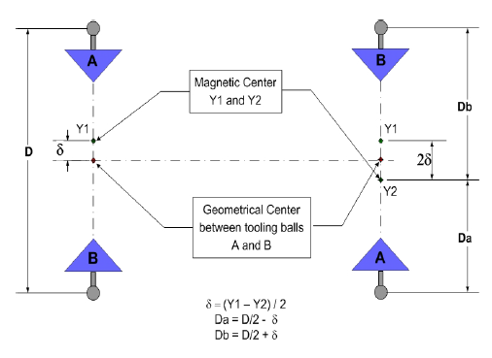
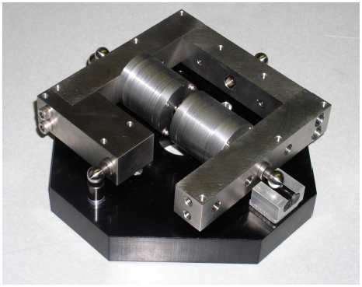
Pointed Magnet Calibration
Flip magnet in fixture. Distance zero field
point moves gives zero field position
relative to tooling balls.
Yurii Levashov

Slide 36
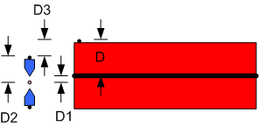
Undulator Fiducialization
Want D
D1 : Magnetic Measurement
D2 : Calibration
D3 : CMM
D = D1 + D2 + D3

Slide 37
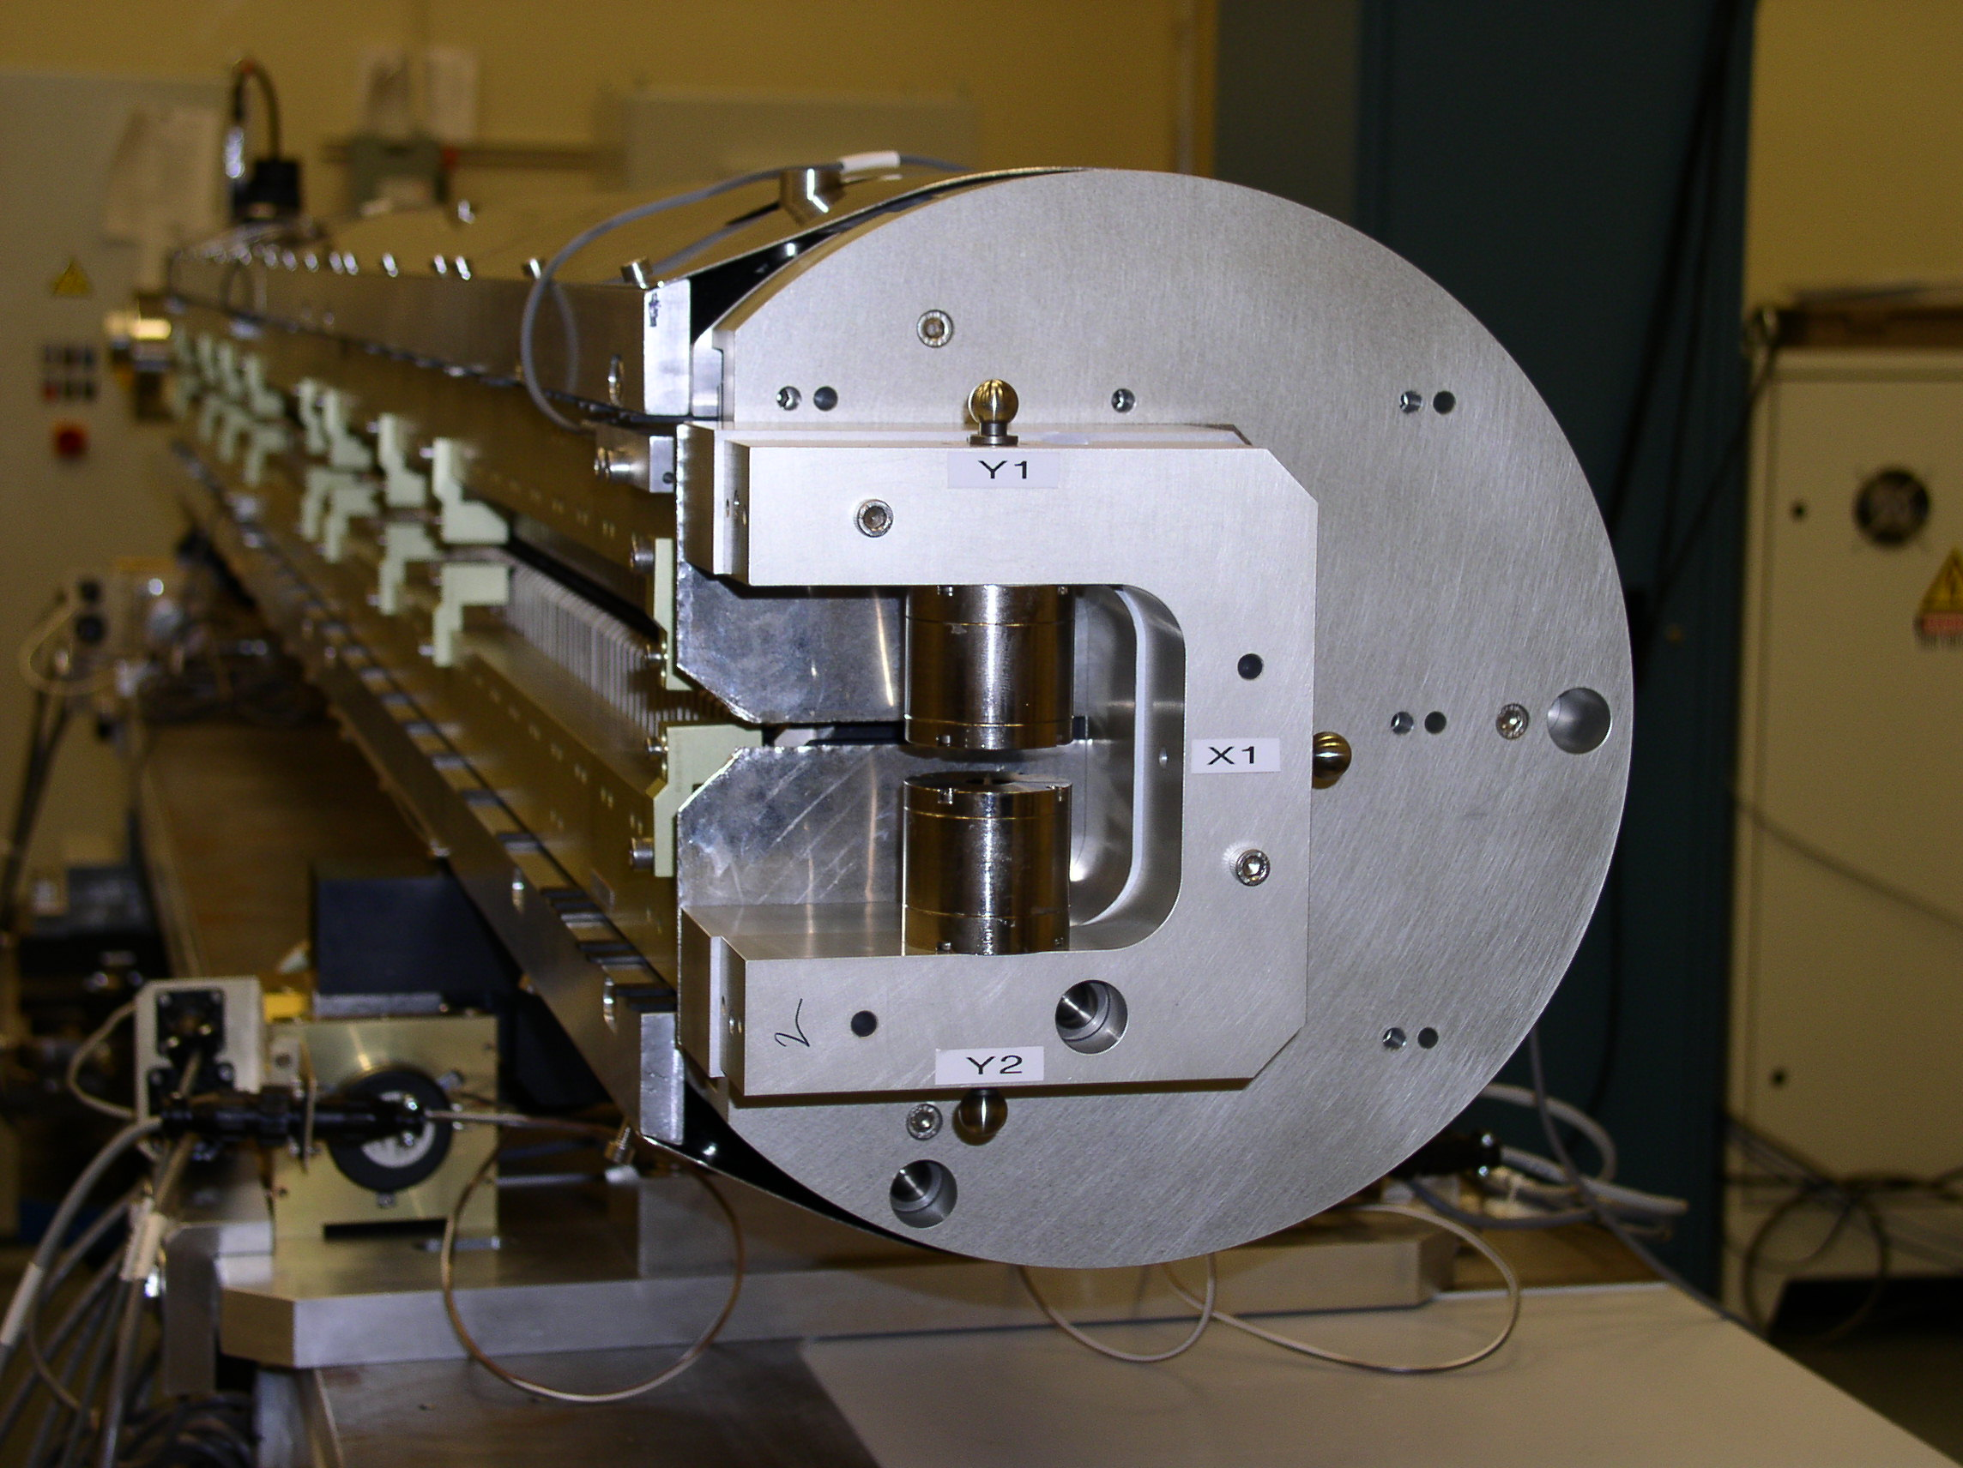
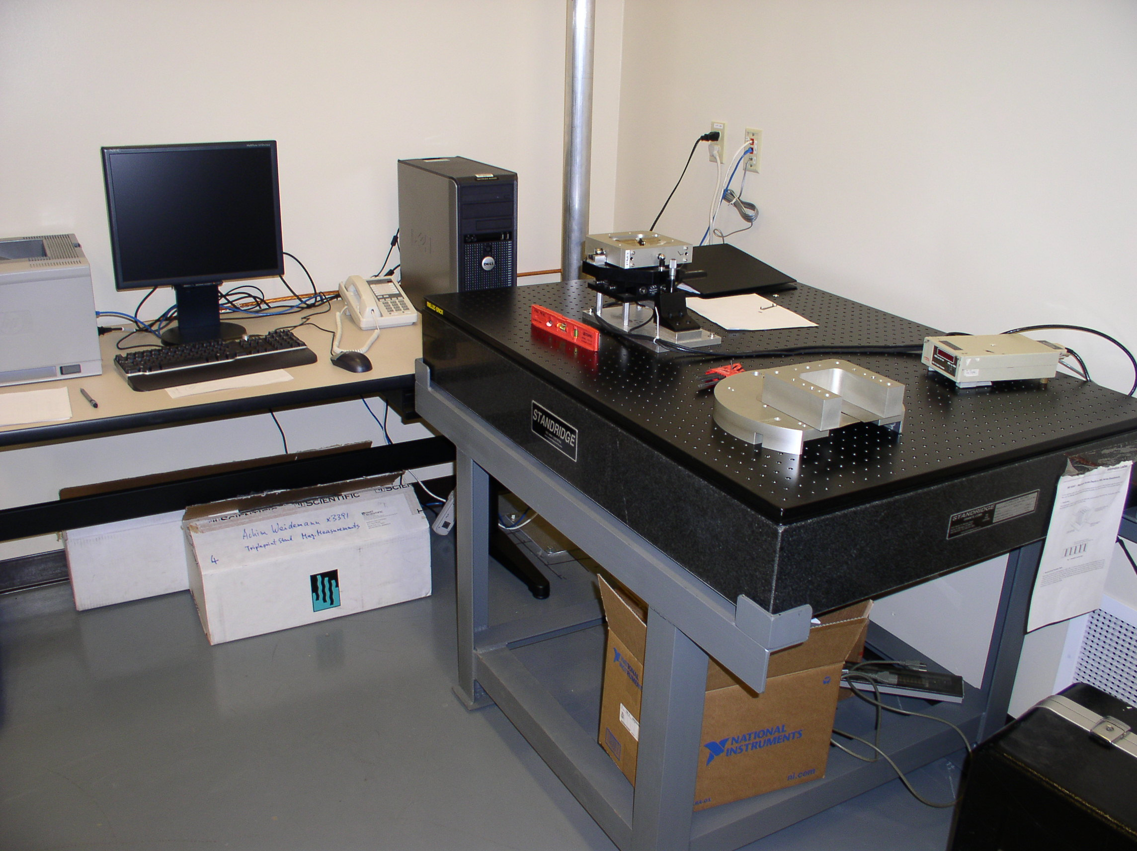
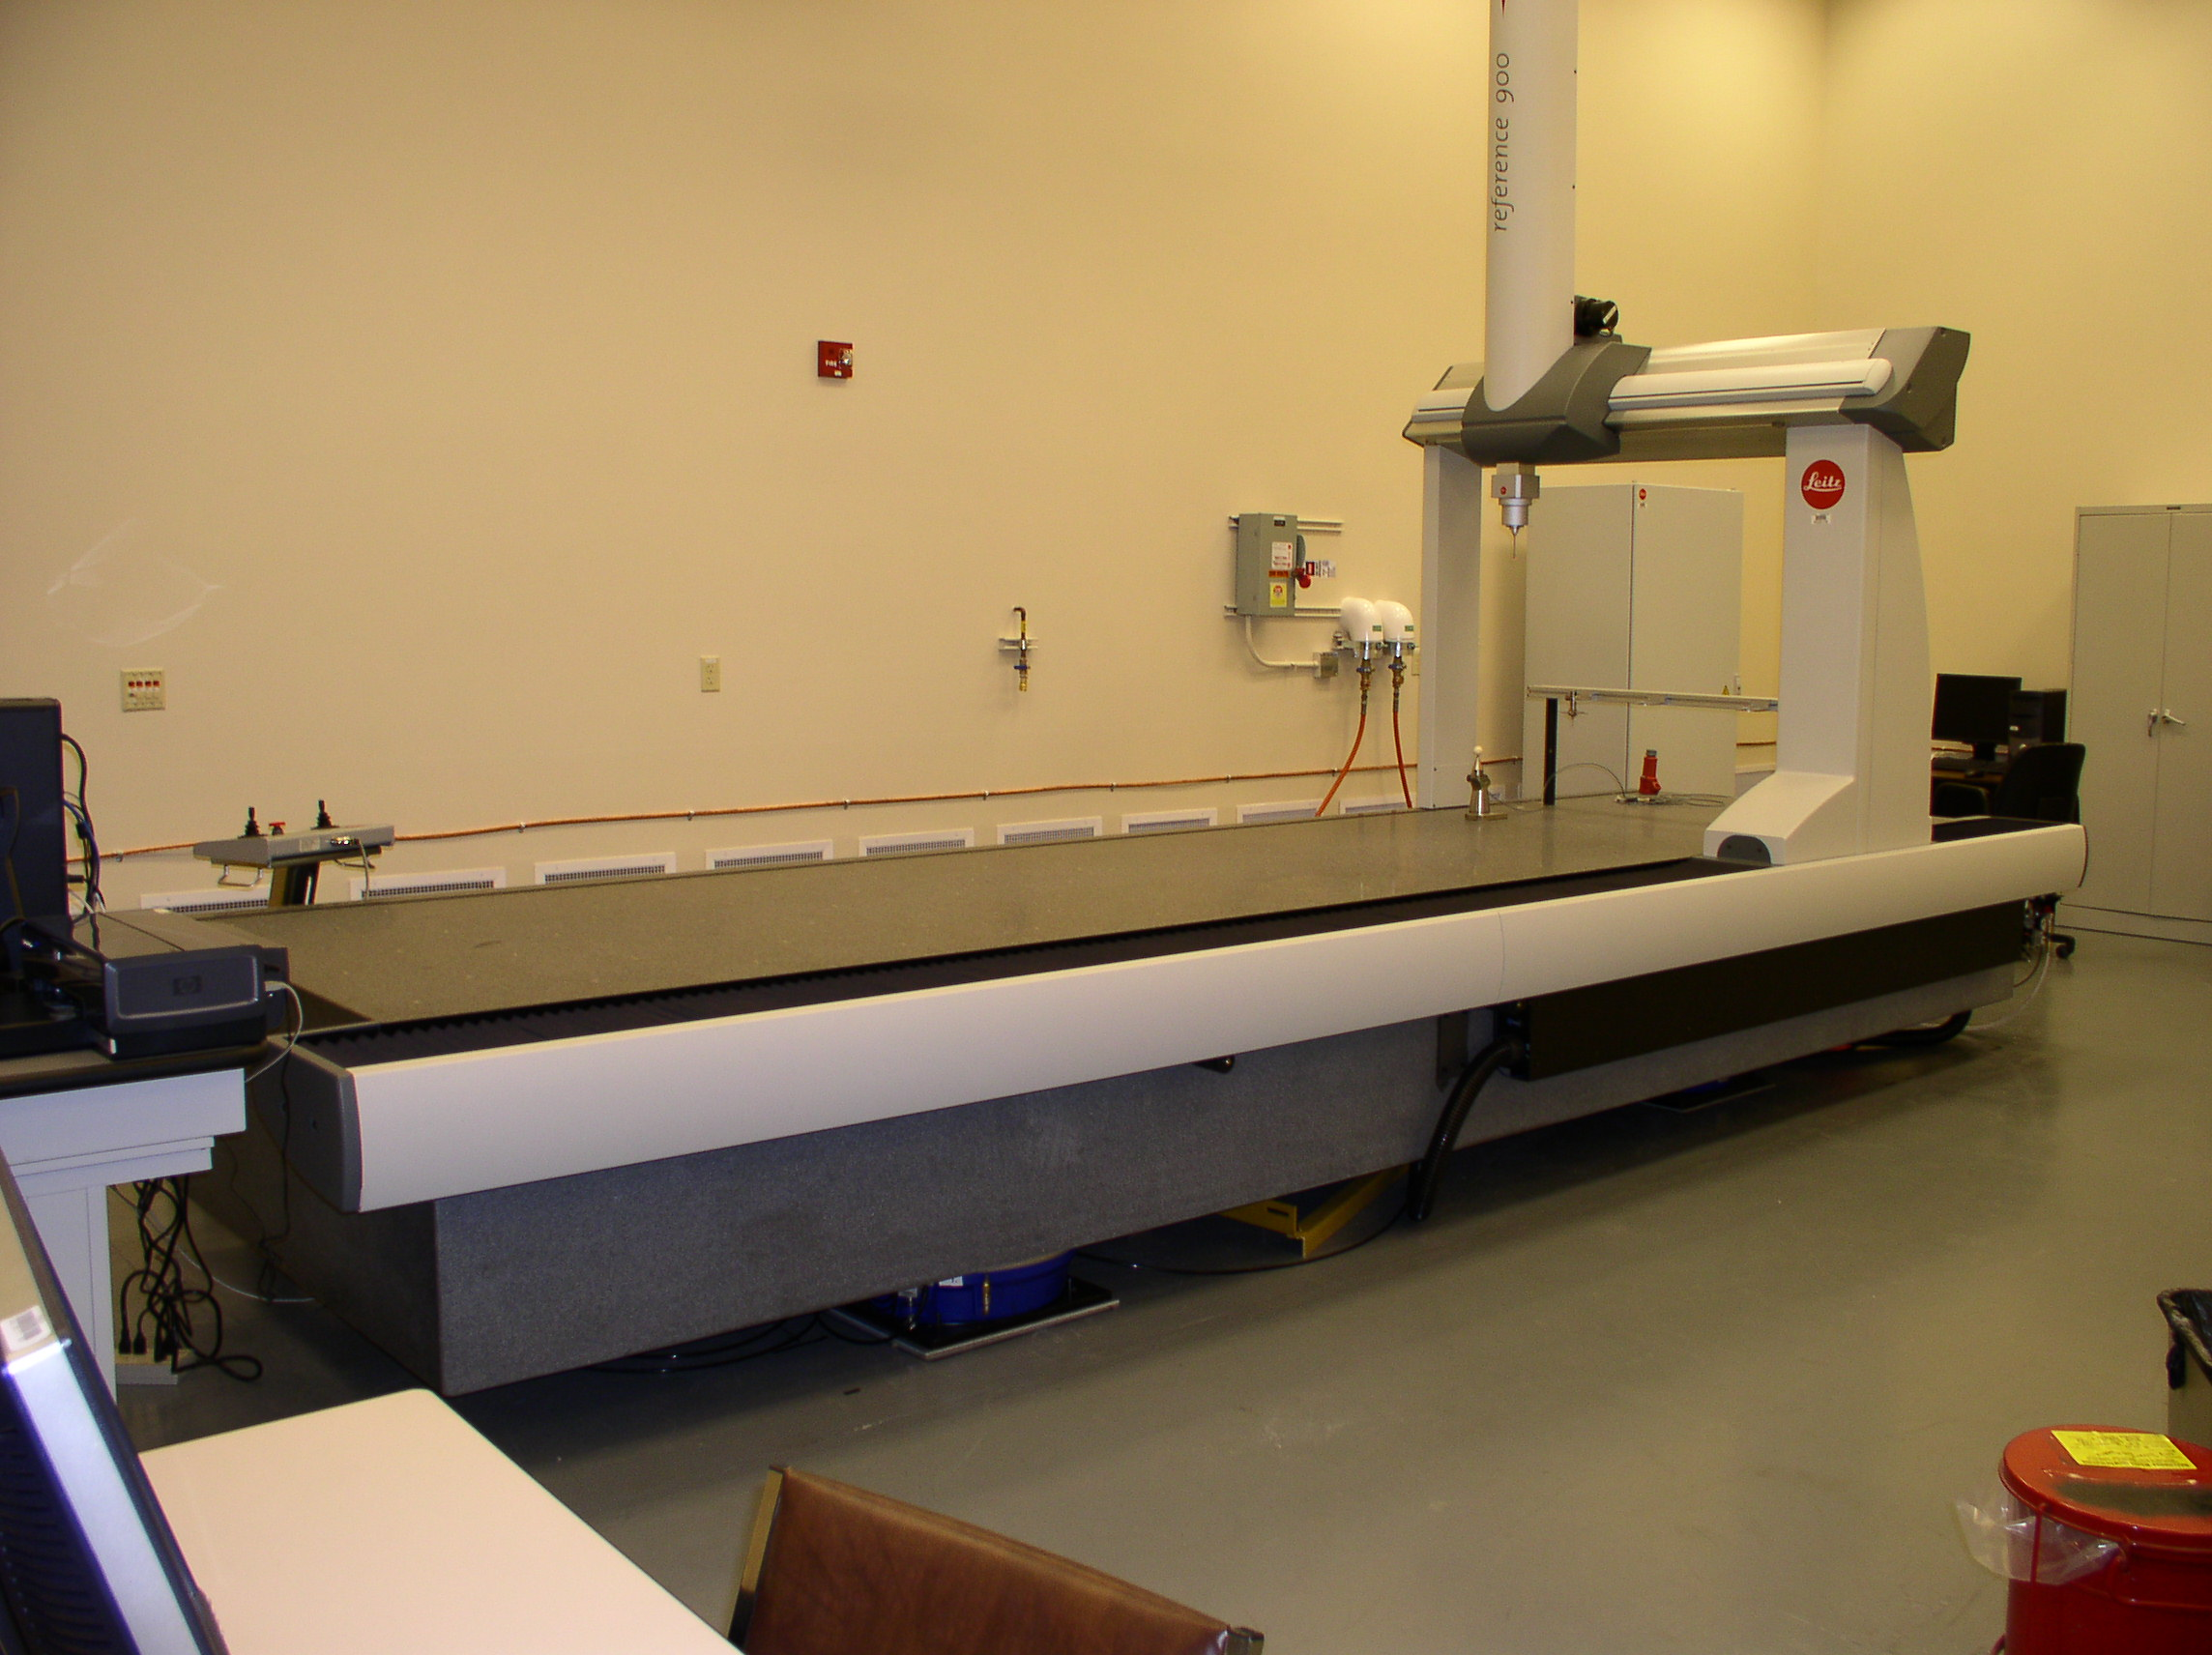

Undulator Fiducialization

Slide 38




Check Fiducialization With Simple Techniques
Check fiducialization.
Use telescopes, pointed magnets,
optical sensor to locate Hall probe

Slide 39

End

