Slide 1
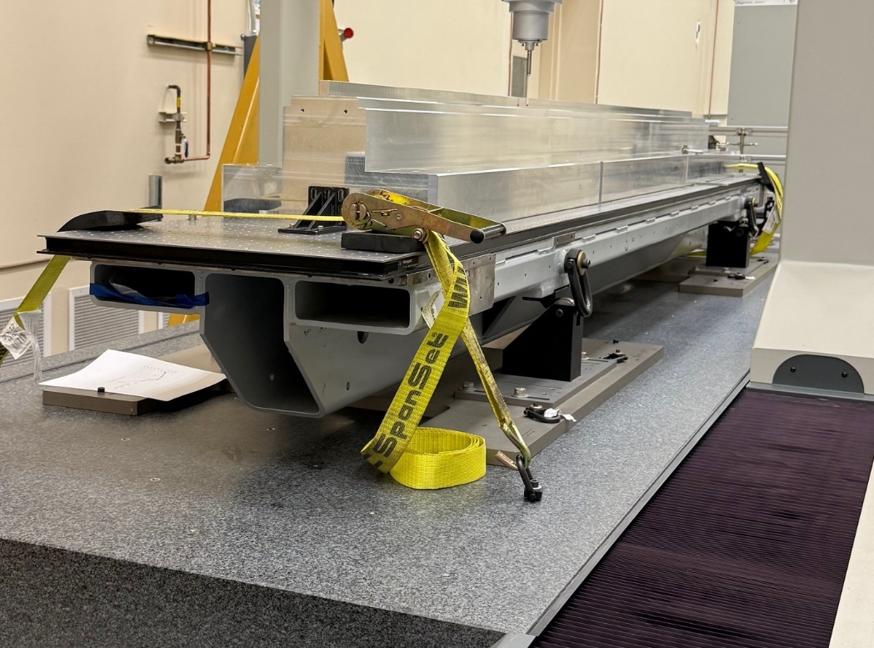
Reference surfaces
Y
Z
X

Slide 2
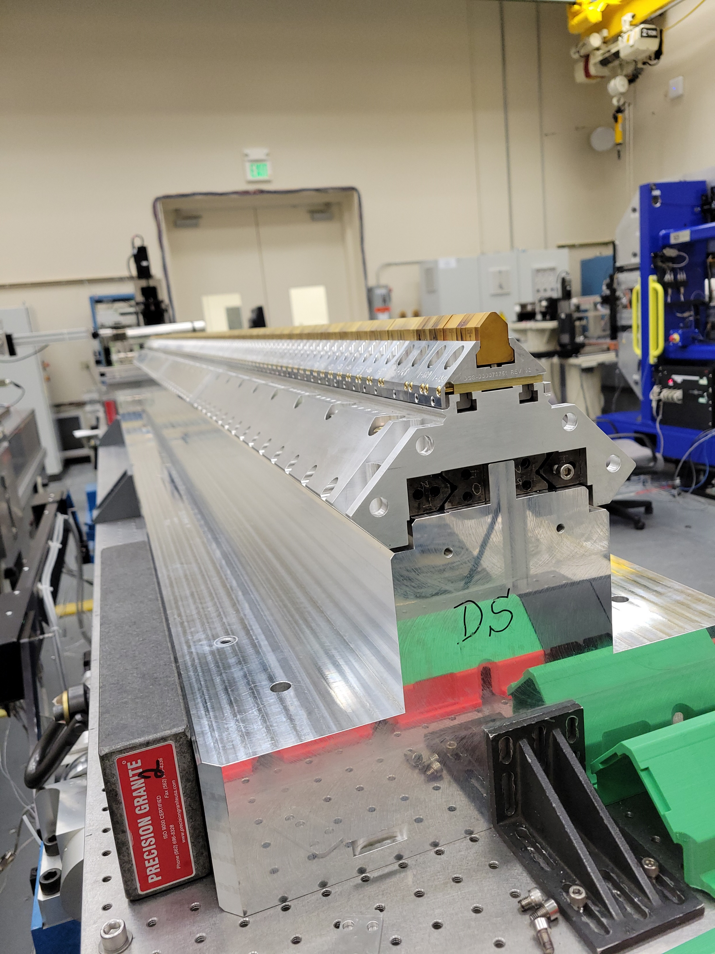
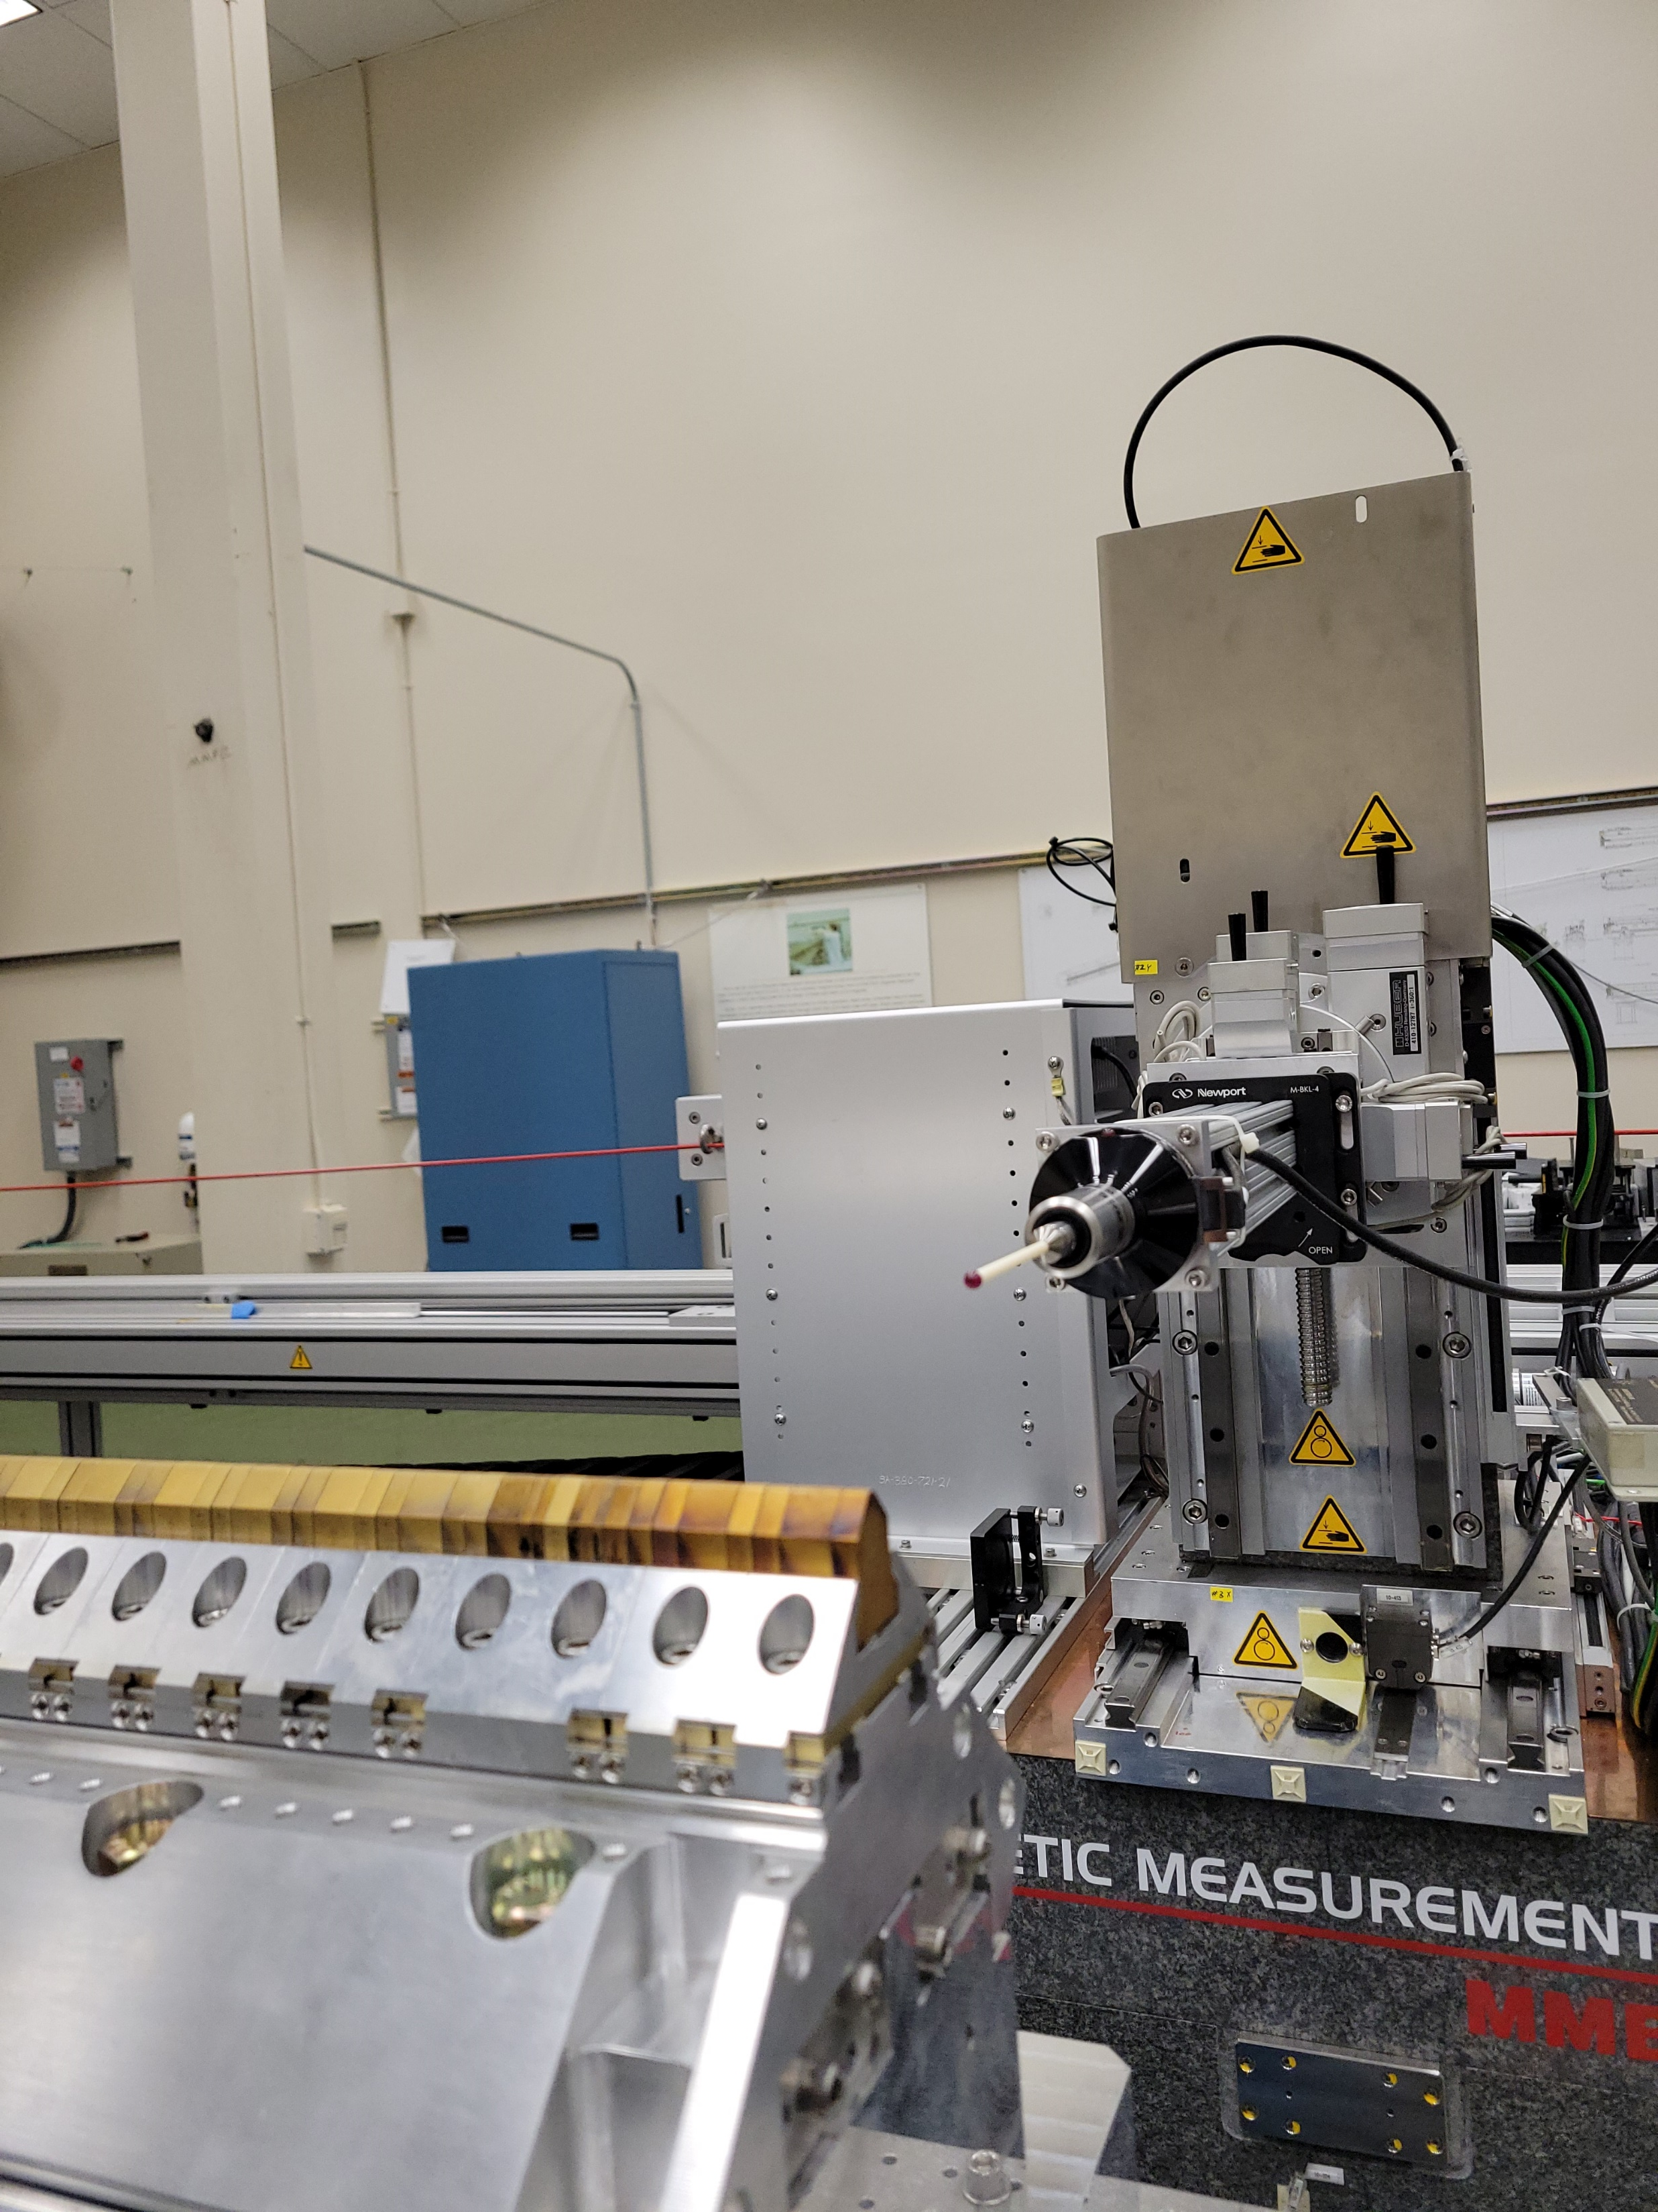
X
Y

Slide 3
Carrier
Tuning fixture

Slide 4
Carrier
Tuning fixture

Slide 5
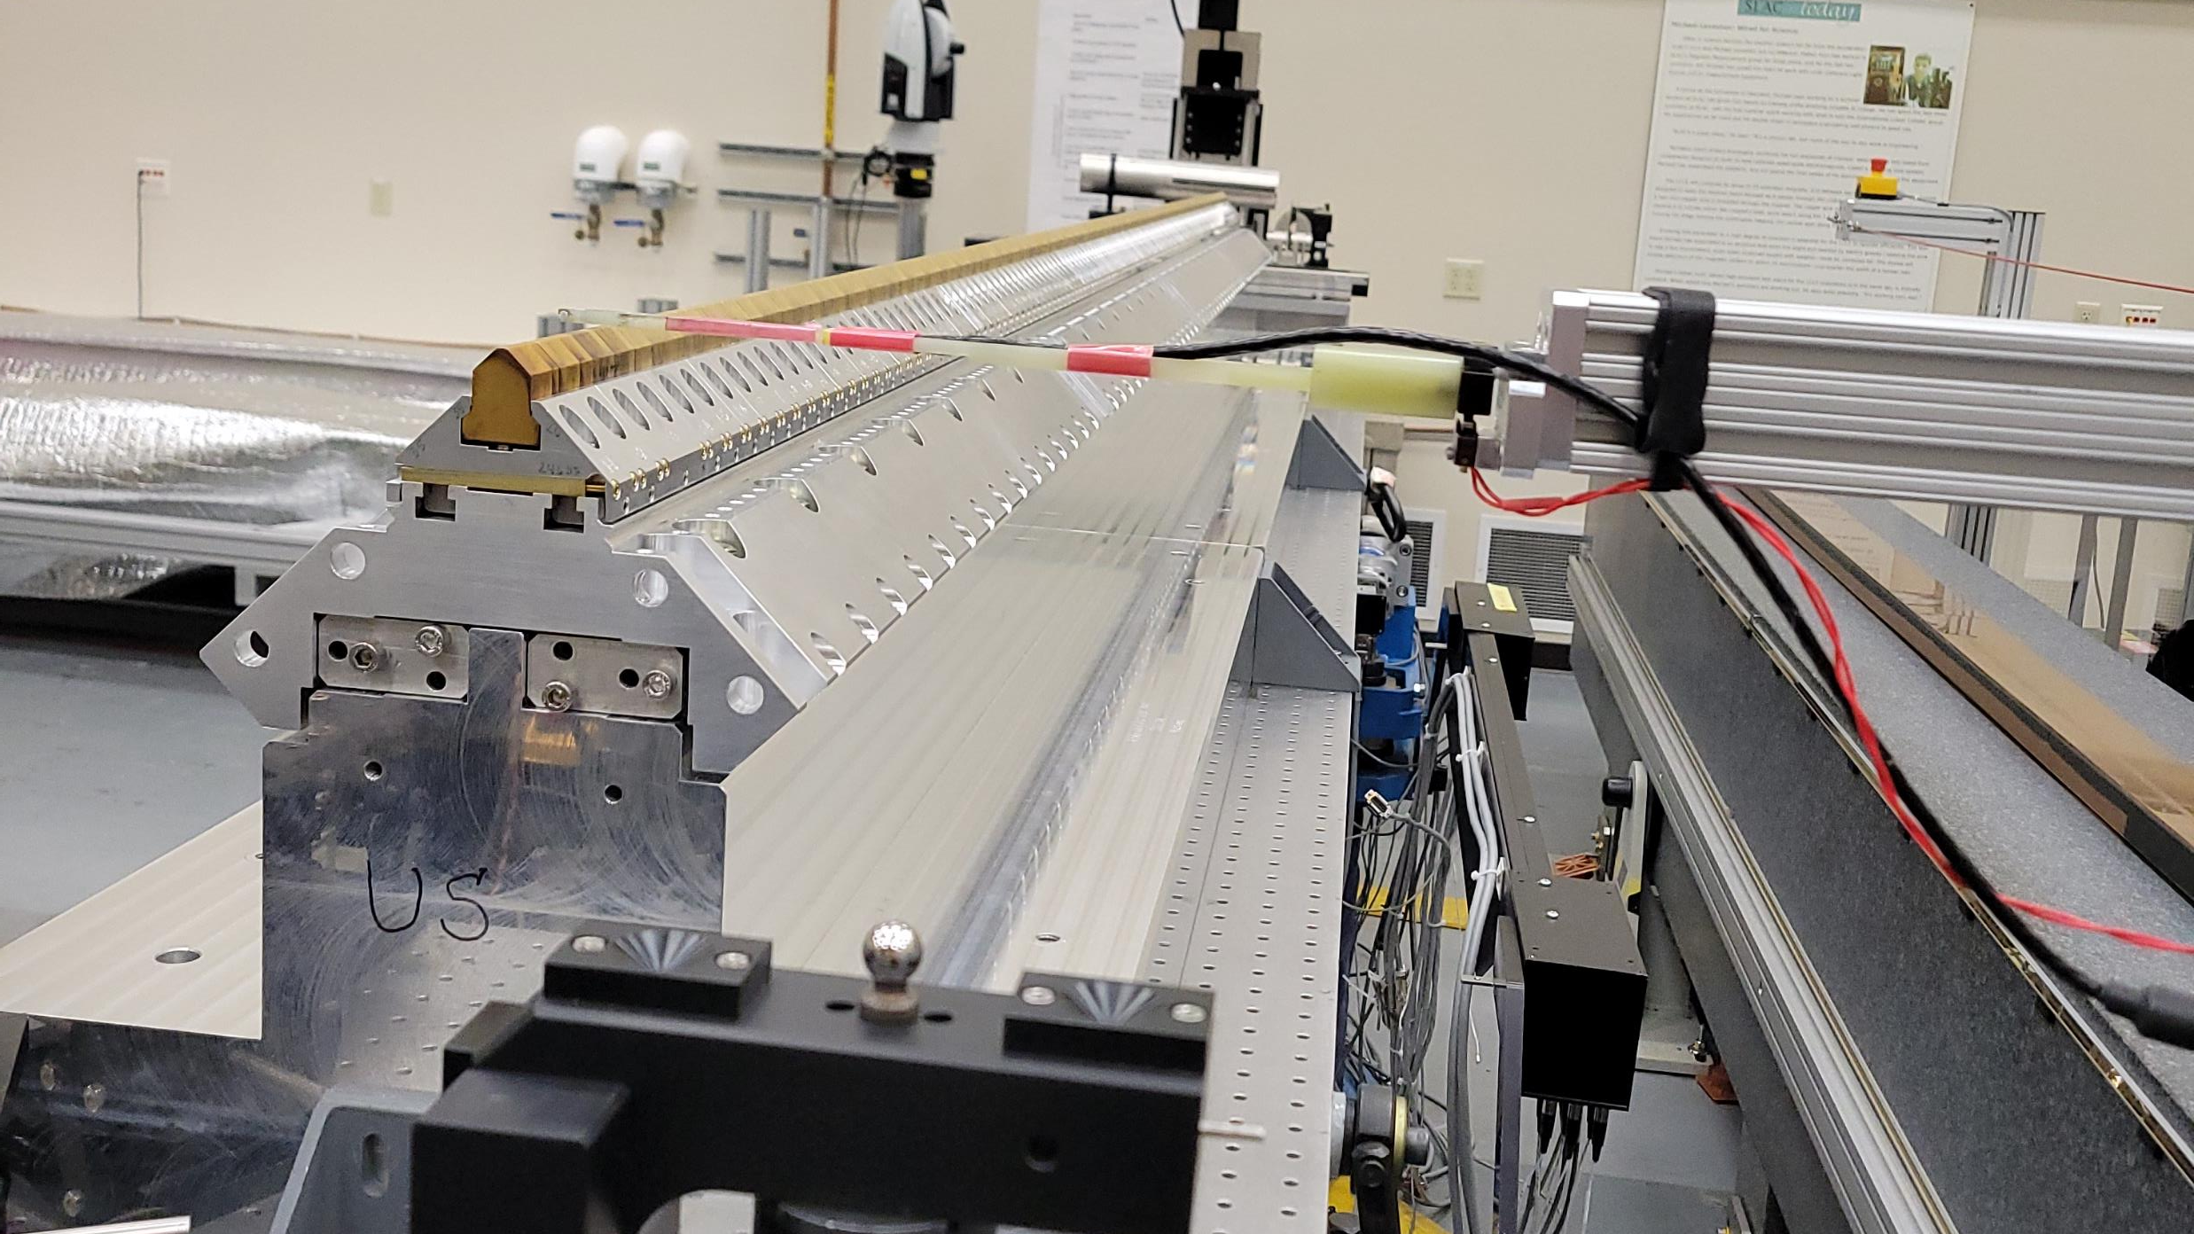

Slide 6
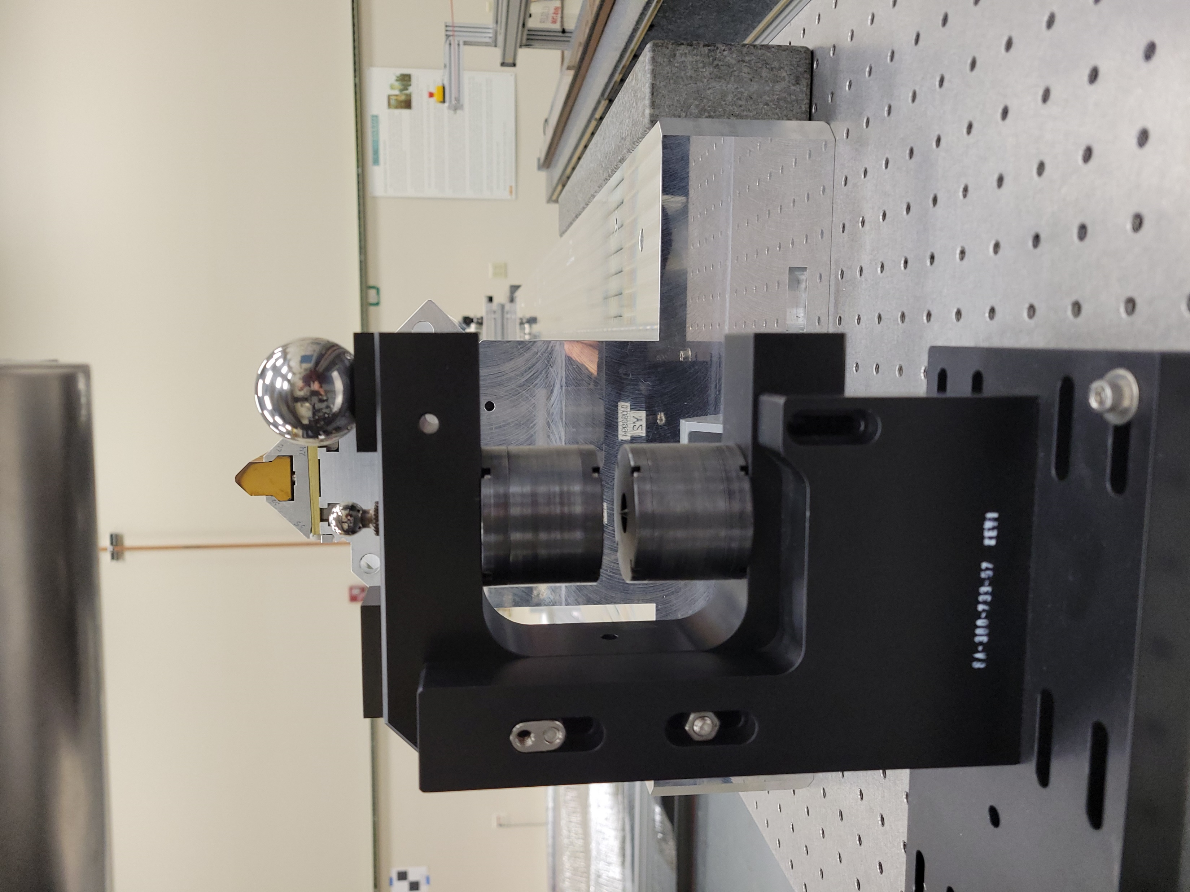
3.4mm
MA
“0” Kugler (HP)
HPpm
“0”TP
TPmag
TPpm
“0” Fixture (TP)
MA = Tpmag +3.4-TPpm-HPpm

Slide 7
 |  |  | MA calc.
TP Meas. |  |  |  |  |  | HP Meas.
Magnets |  |  | Sphere |  |  | PM |  |  | MC to Sph.
x | y |  | x | y |  | x | y |  | x | y
-0.7366 | 236.9007 |  | 17.505 | 159.2437 |  | 85.573 | 182.94 |  | 45.58 | 104.709
 |  |  |  |  |  | 85.615 | 182.955
Calculations
Date | 2/5/26 | 2/6/26
MAy = | 1.811 | 1.826
MAx = | 100.03 | 99.988

