Slide 1
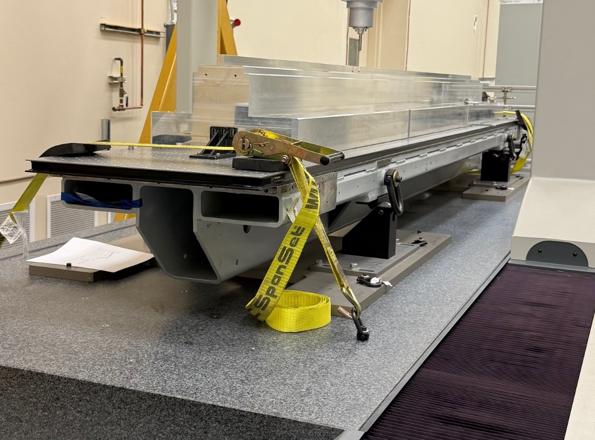
Rails’ reference surfaces
Y
Z
X

Slide 2
Carrier
Tuning fixture

Slide 3
Carrier
Tuning fixture

Slide 4
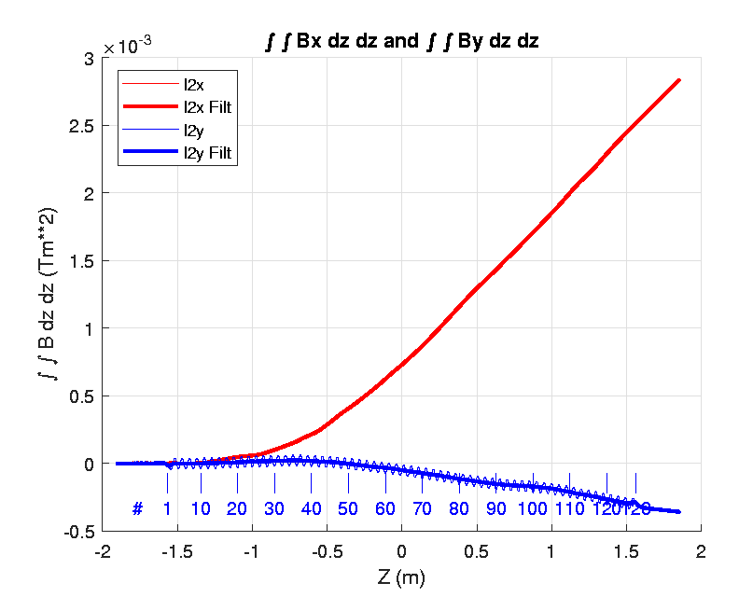
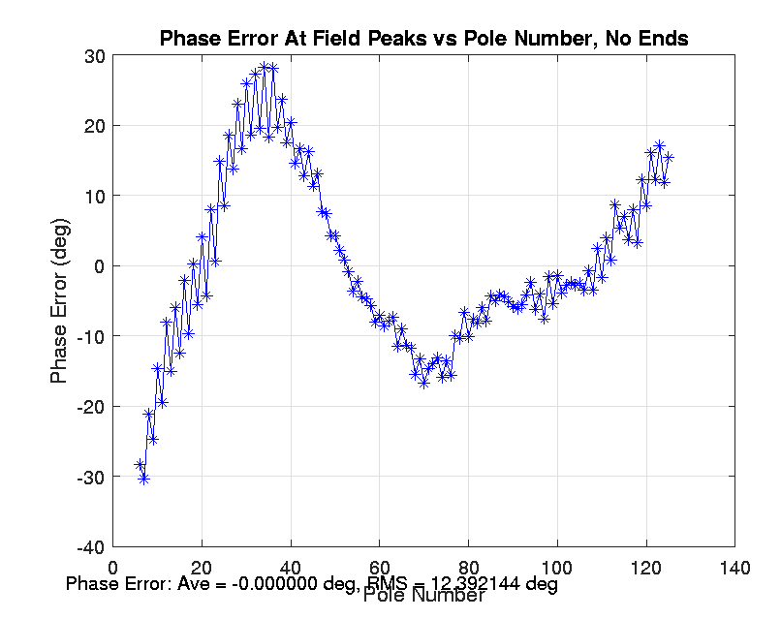

Slide 5
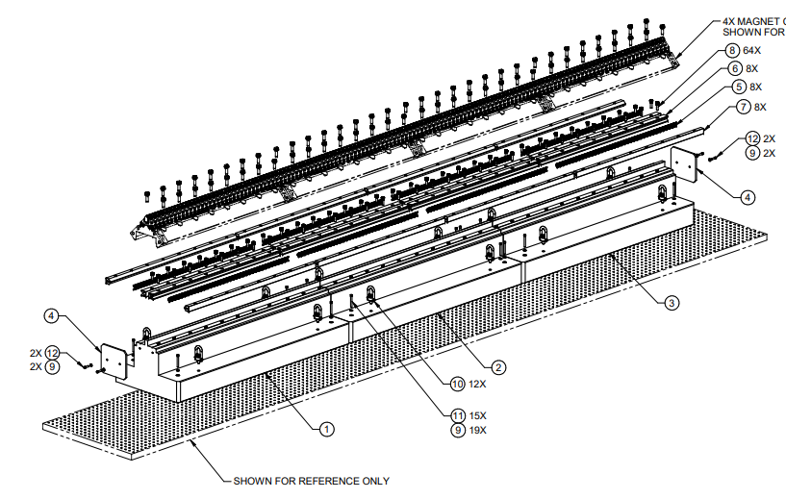

Slide 6
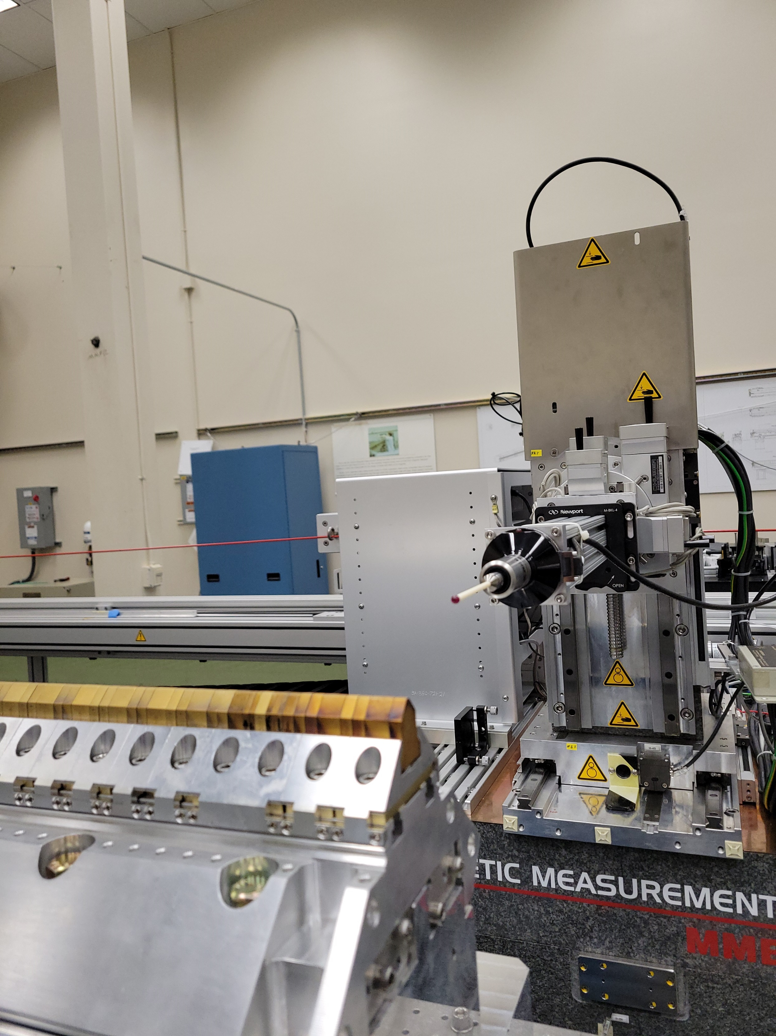
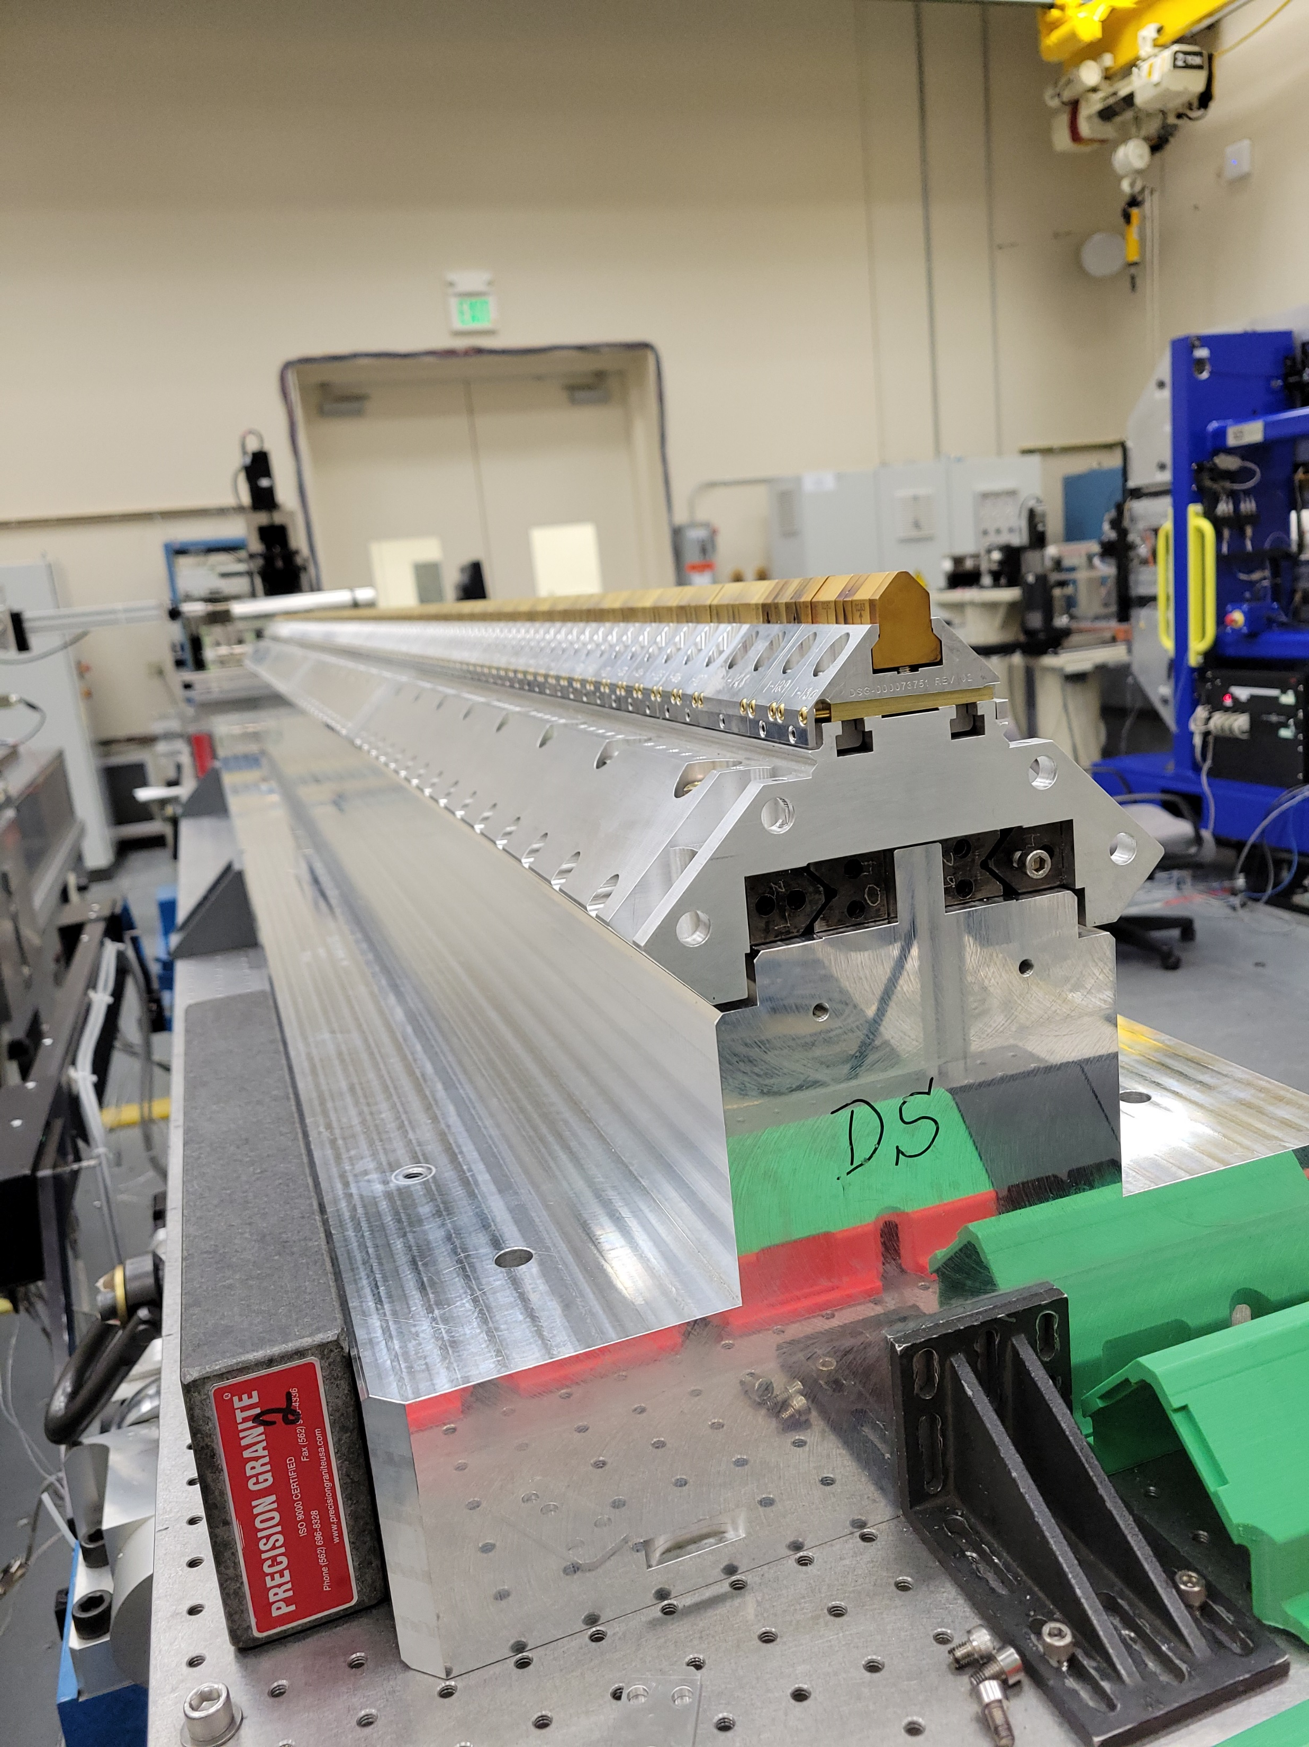
Y
X

Slide 8
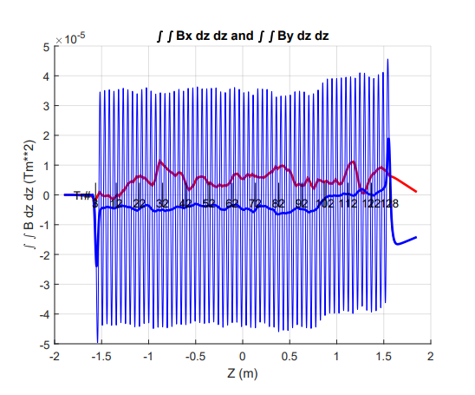
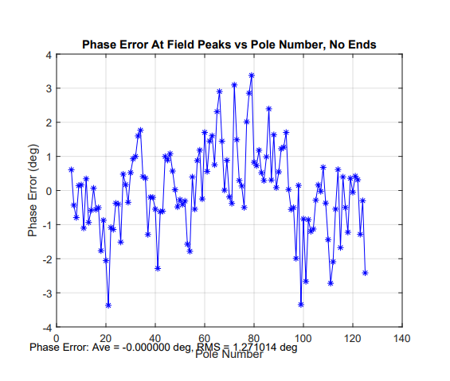
K = 2.944046
Ypos = 1.812 mm

Slide 9
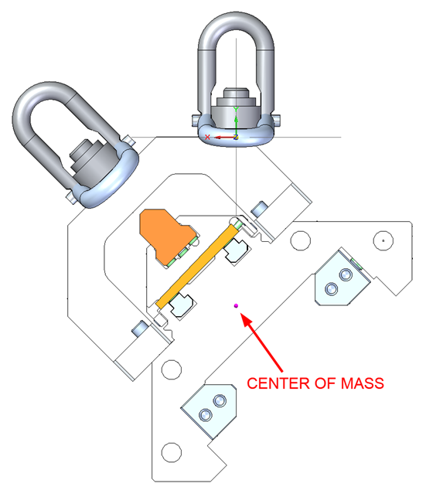
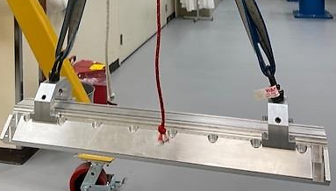

Slide 11
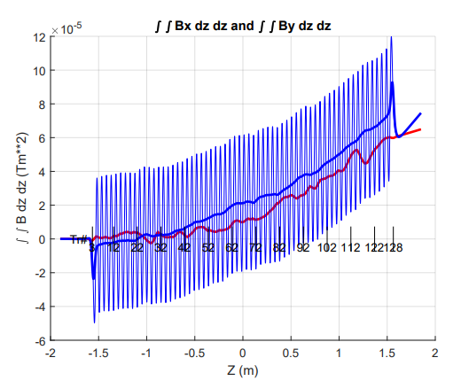
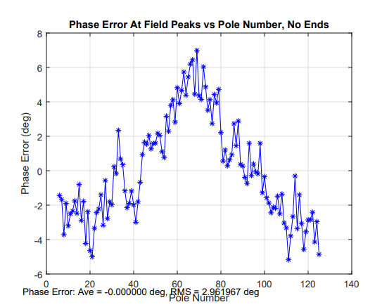

Slide 12
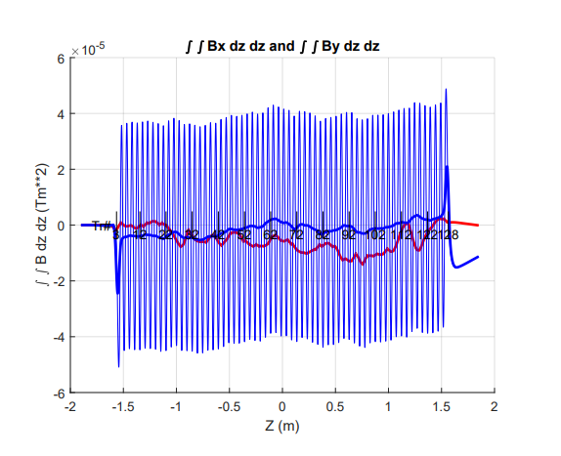
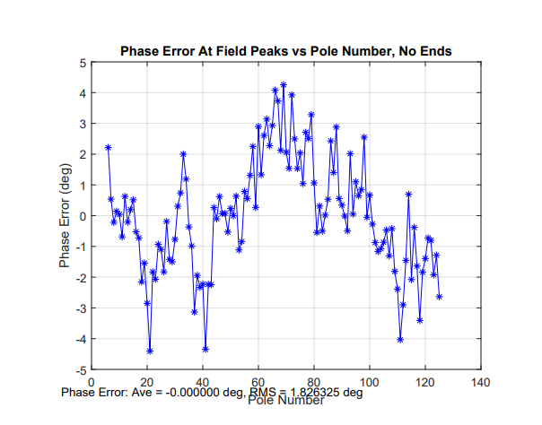
K = 3.001455
Ypos = 1.729mm

Slide 13
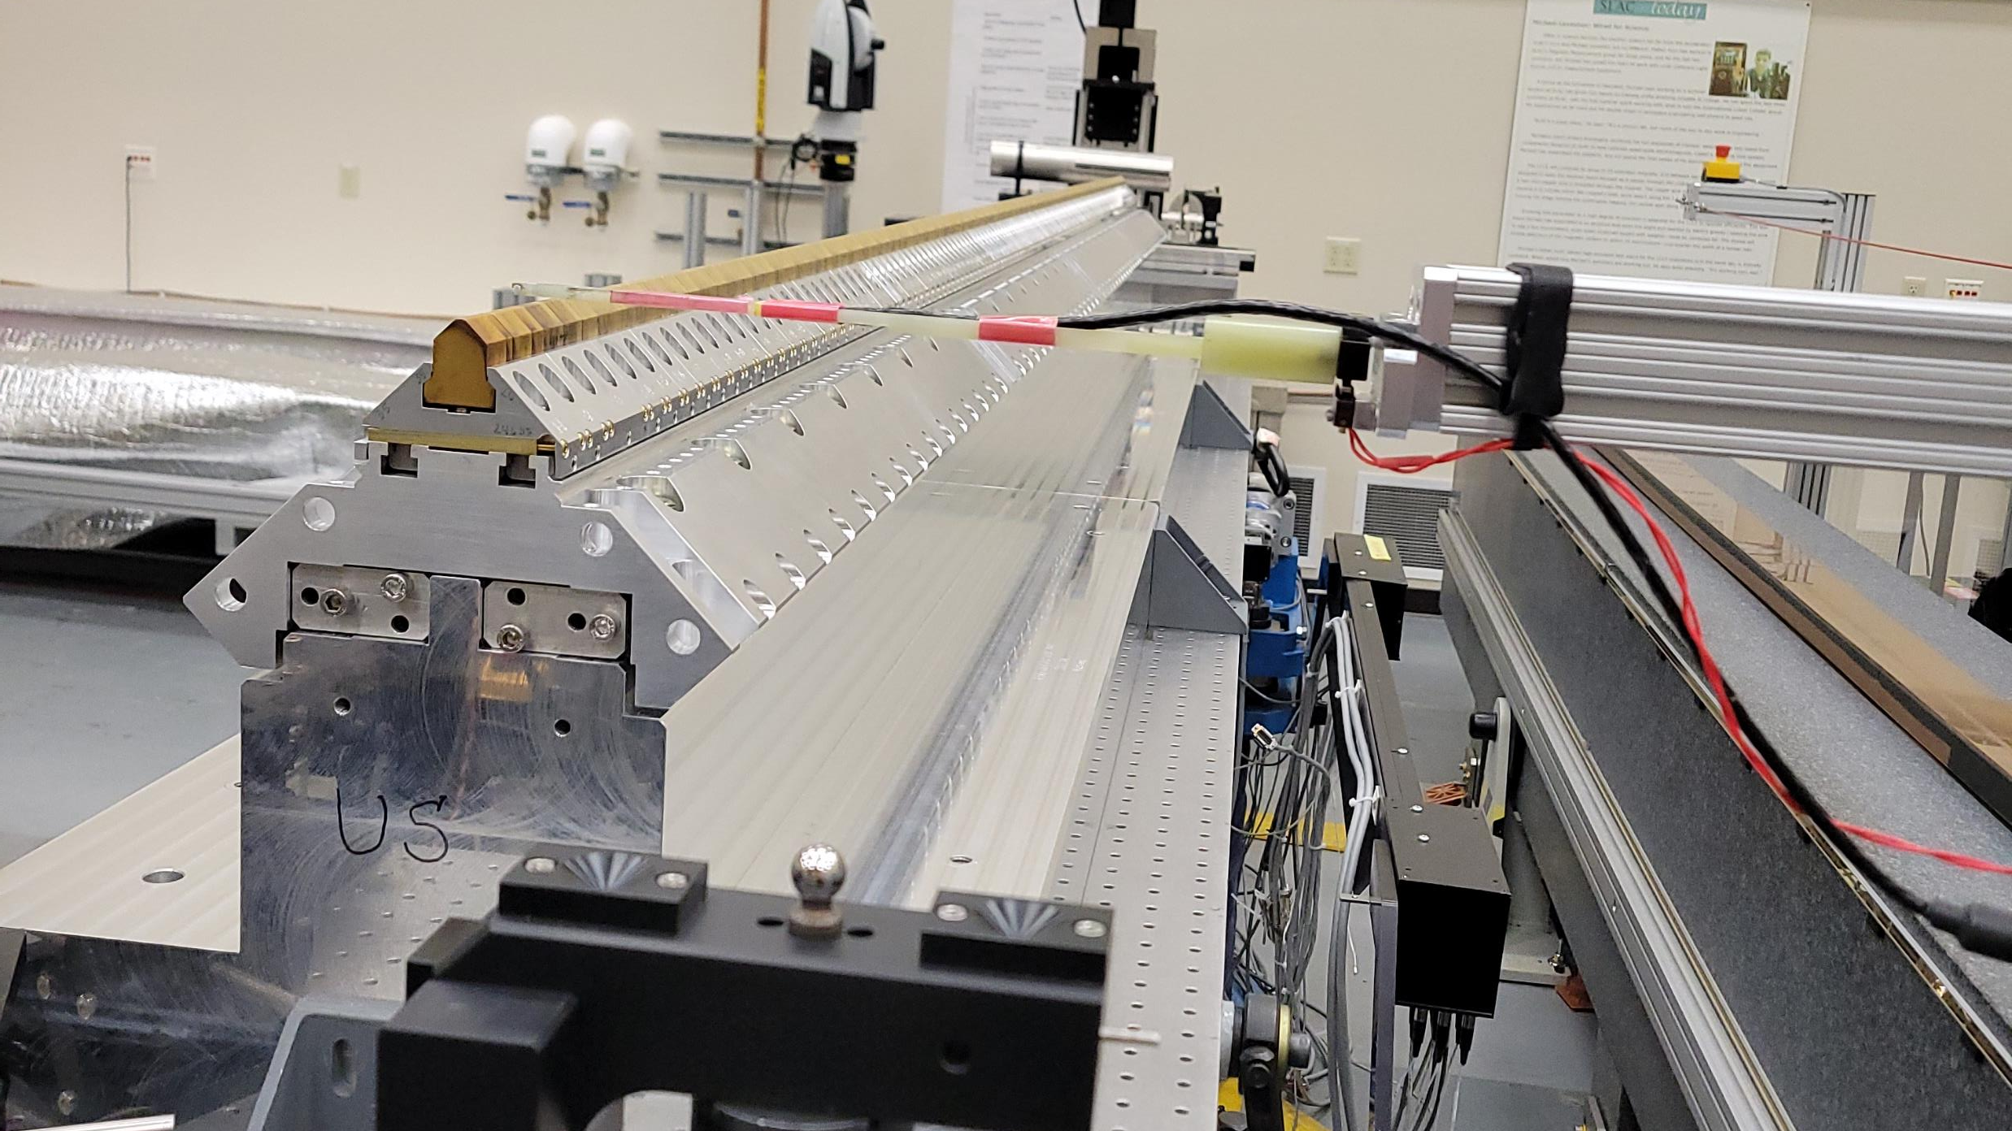

Slide 14
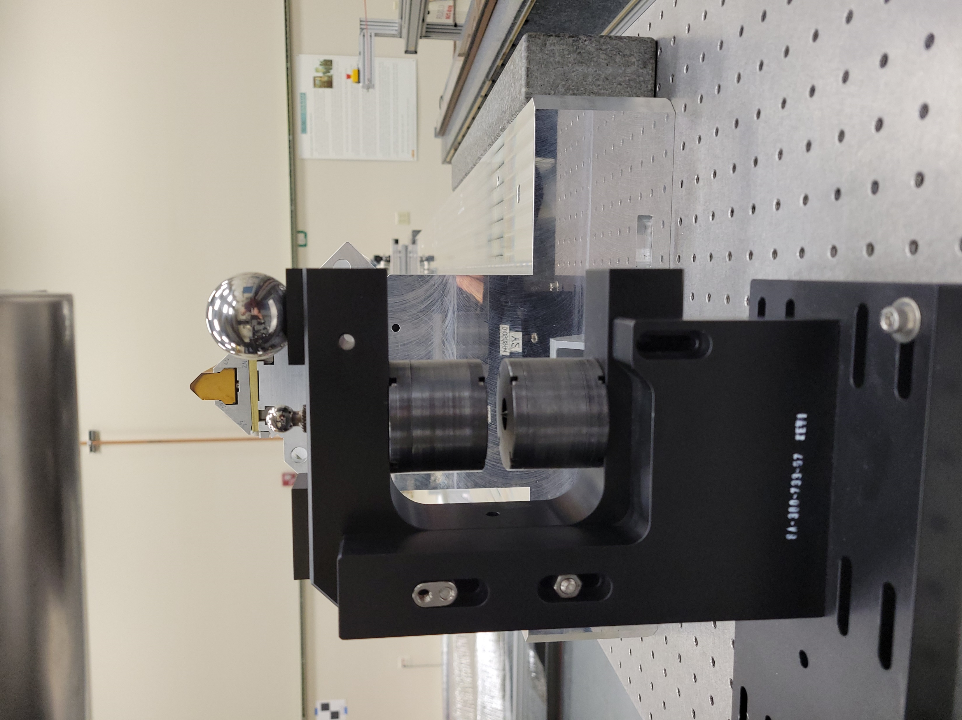
3.3mm
MA
“0” Kugler (HP)
HPpm
“0”TP
TPmag
pmS
TPpm
“0” Fixture (TP)
MA = 3.3+Tpmag -TPpm+pmS-HPpm

Slide 15
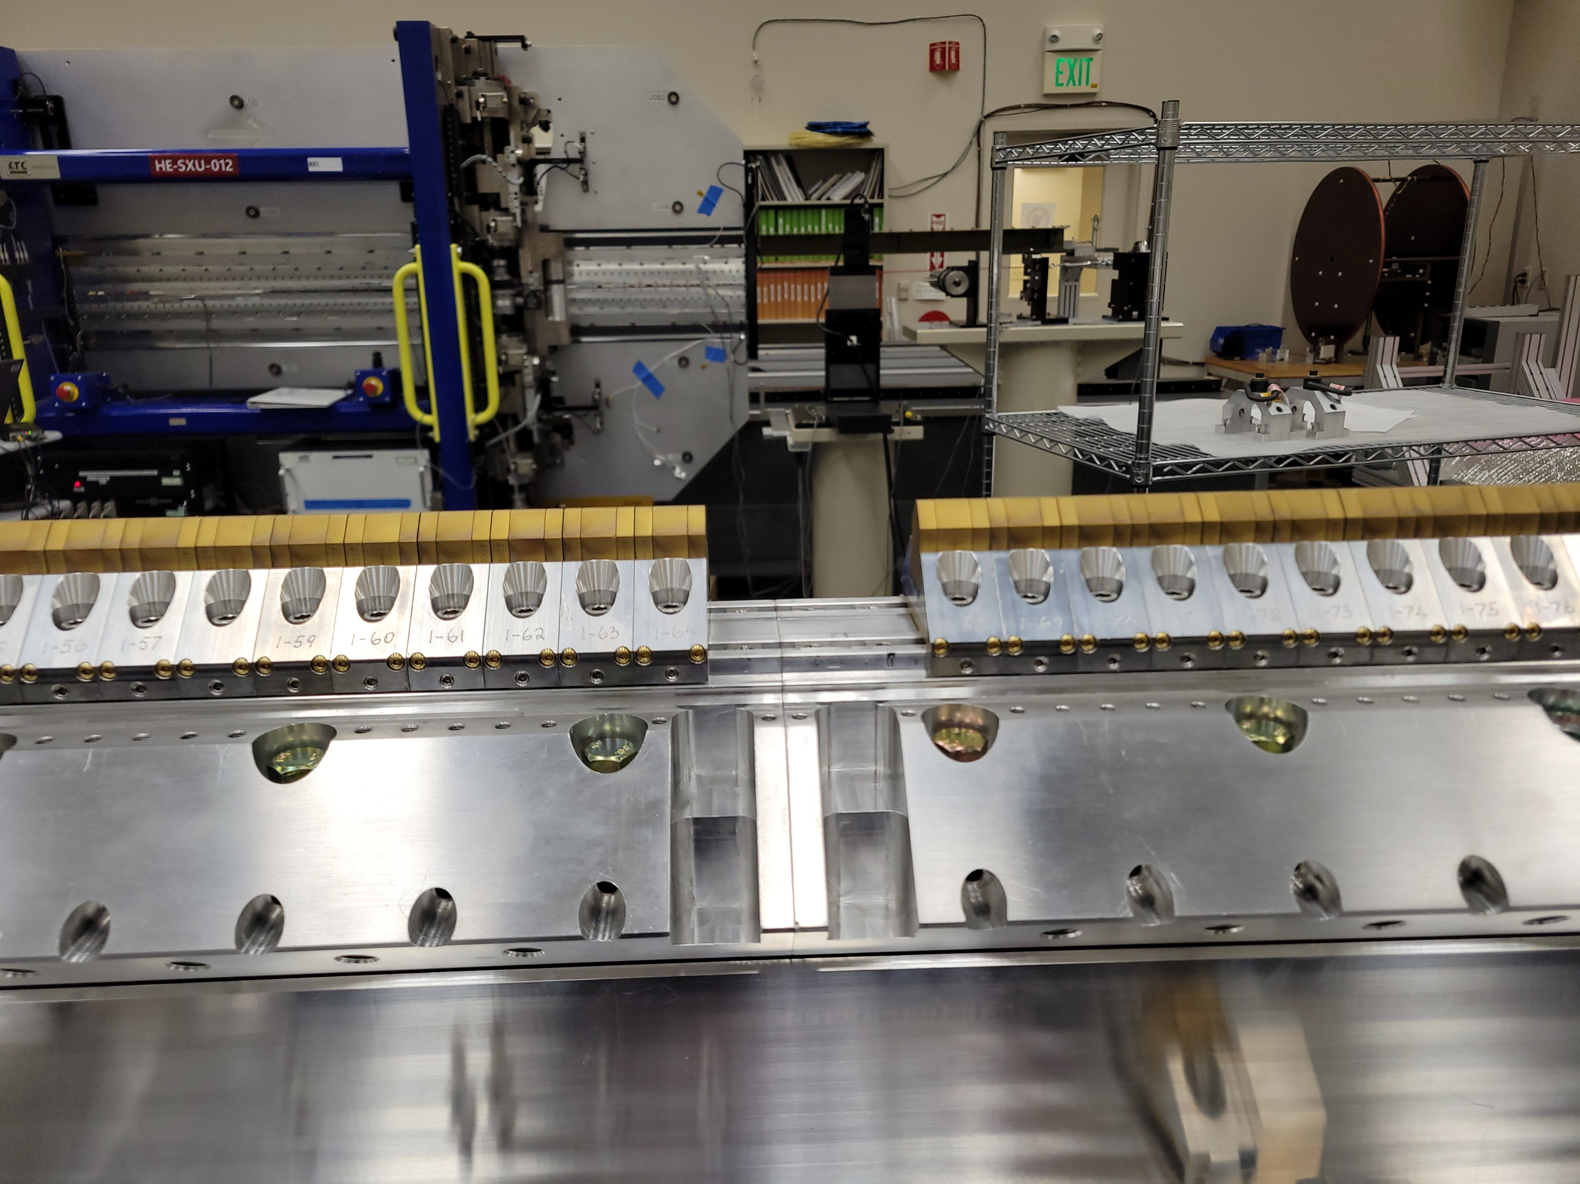

Slide 16
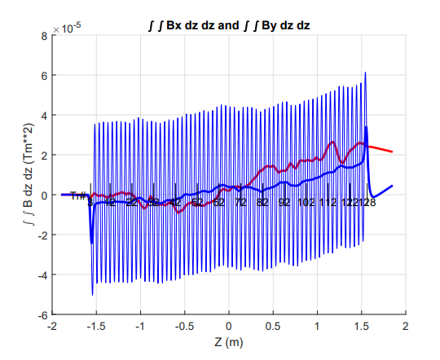
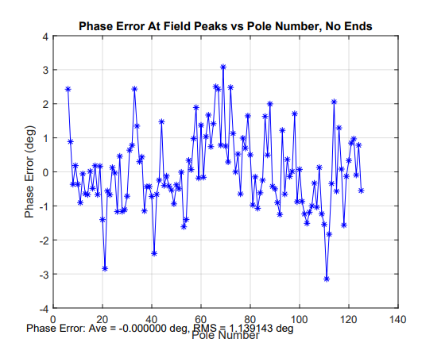
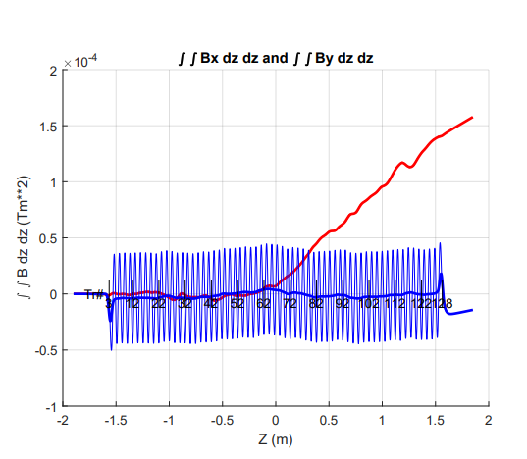
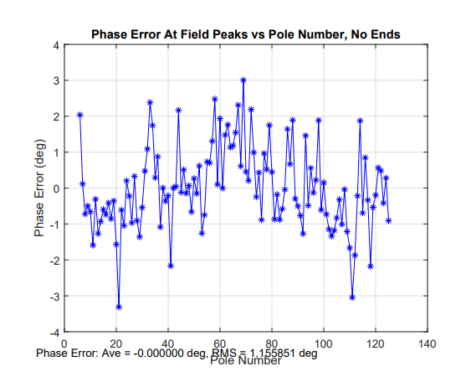

Slide 17
 |  |  |  | Y center |  |  |  |  |  |  |  |  | Calculations
 | TP Meas. |  |  |  |  |  | HP Meas.
 | Magnets |  |  | Sphere |  |  | PM |  |  | MC to Sph. |  |  | MAy | MAx
Date: | x | y |  | x | y |  | x | y |  | x | y
6-Feb | -0.7366 | 236.9007 |  | 17.505 | 159.2437 |  | 85.573 | 182.94 |  | 45.58 | 104.709 |  | 1.711 | 99.988
10-Feb | -0.7336 | 236.8977 |  |  |  |  | 85.615 | 182.955 |  |  |  |  | 1.708 | 99.9798
11-Feb | -0.663 | 236.923 |  | 17.5002 | 159.2407 |  | 85.56 | 182.958 |  |  |  |  | 1.7087 | 99.9848
24-Feb | -0.595 | 236.932 |  | 17.503 | 159.244 |  | 85.565 | 182.954 |  |  |  |  | 1.711 | 99.983
24-Mar | -0.595 | 236.932 |  | 17.601 | 159.255 |  | 85.566 | 182.966 |  |  |  |  | 1.684 | 99.886
30-Mar | -0.592 | 236.92 |  | 17.515 | 159.256 |  | 85.567 | 182.993 |  |  |  |  | 1.68 | 99.972
22-Apr | -0.584 | 236.919 |  | 17.495 | 159.253 |  | 85.576 | 182.946 |  |  |  |  | 1.729 | 100.001

