Slide 1
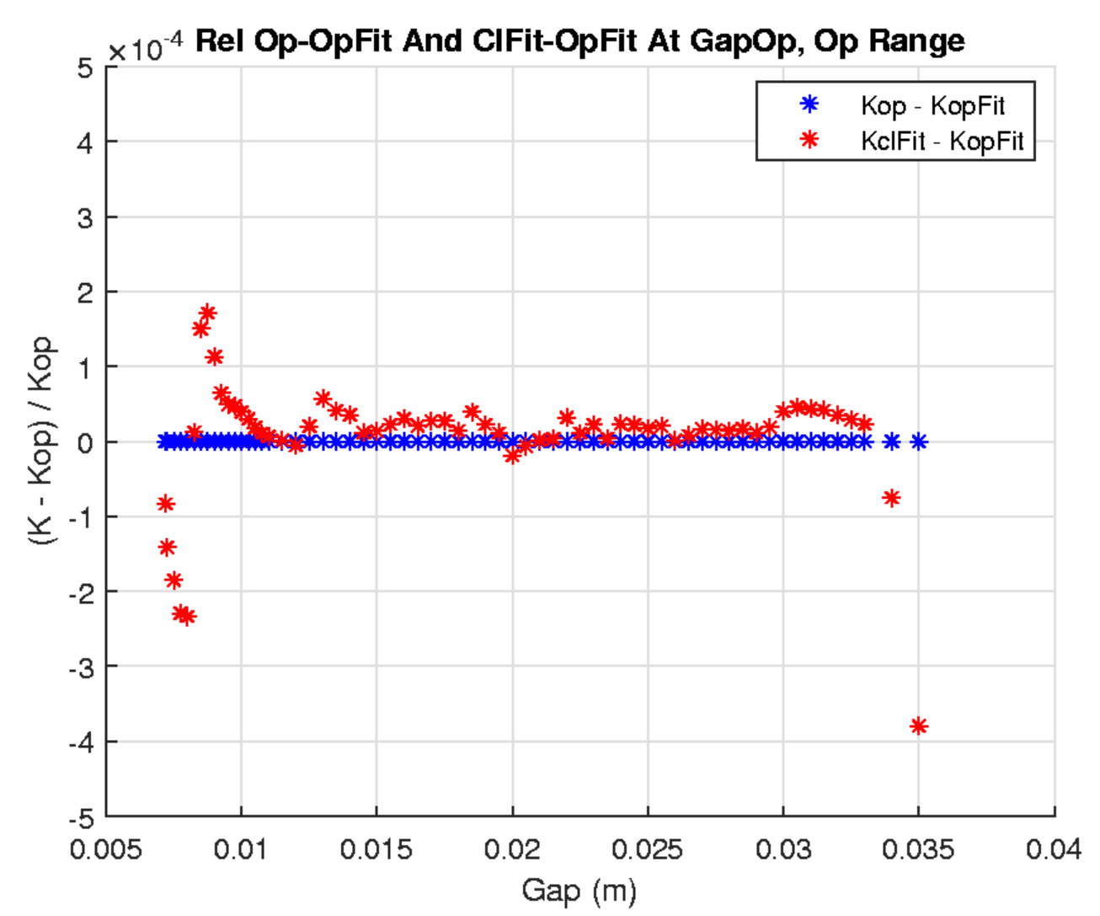
HE-SXU-022 on-axis final meas.:
K-value hysteresis (1st meas.)

Slide 2
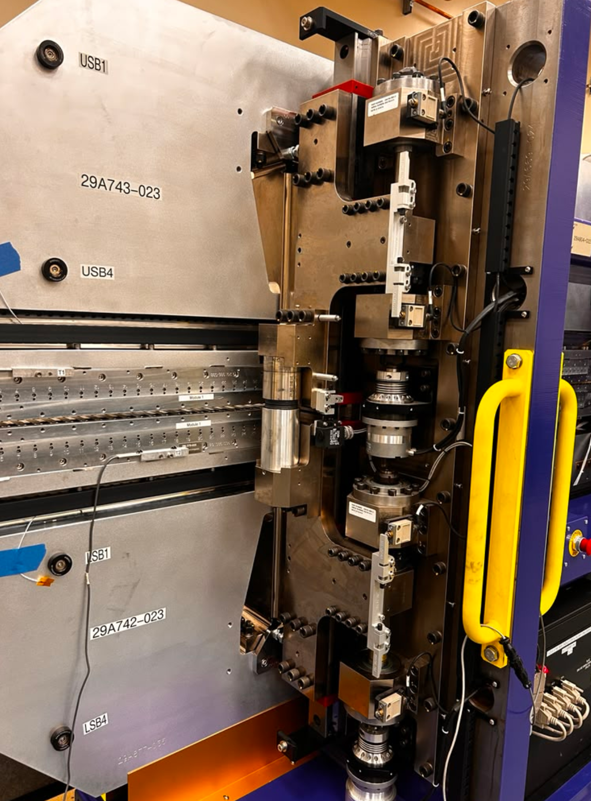

Slide 3
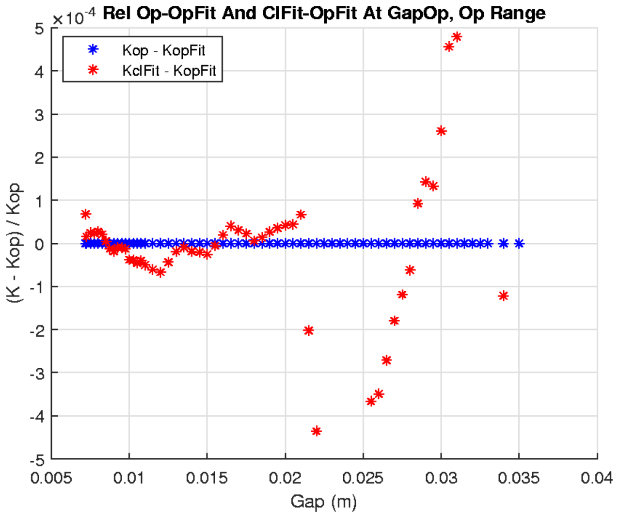
HE-SXU-022 on-axis final meas.:
K-value hysteresis (2nd meas)

Slide 4
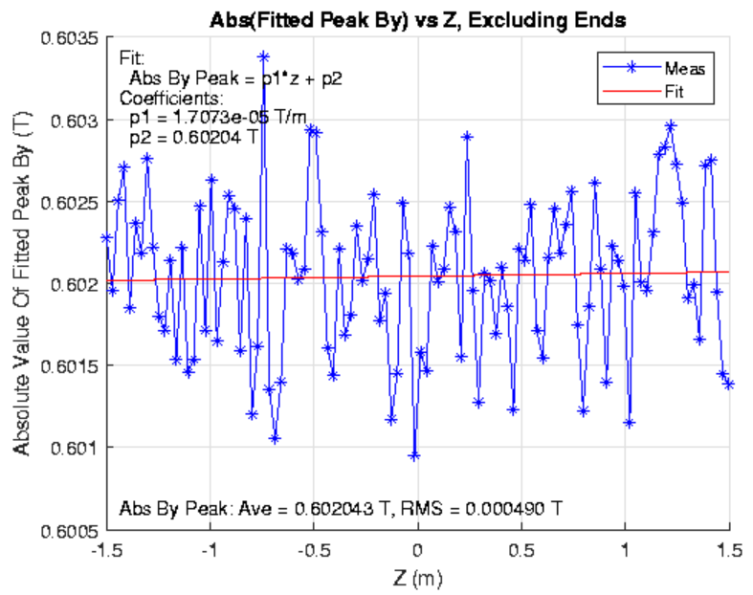
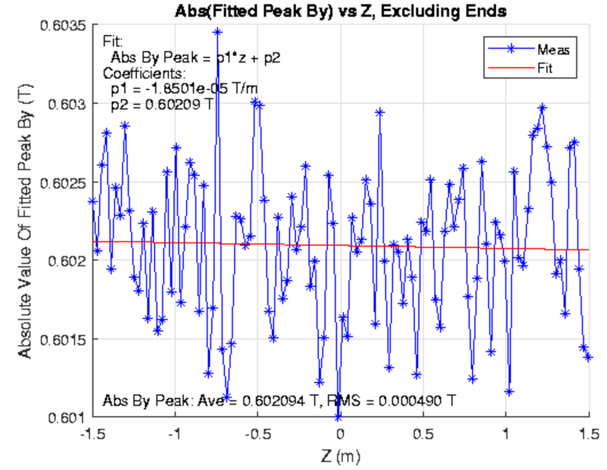
Peak fields and taper @ 21mm gap
21mm opening
21mm closing

Slide 5
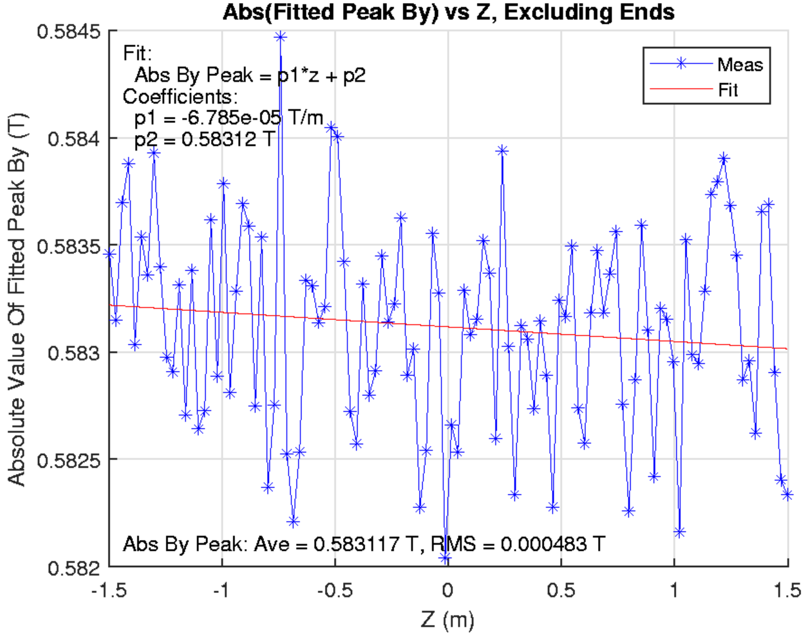
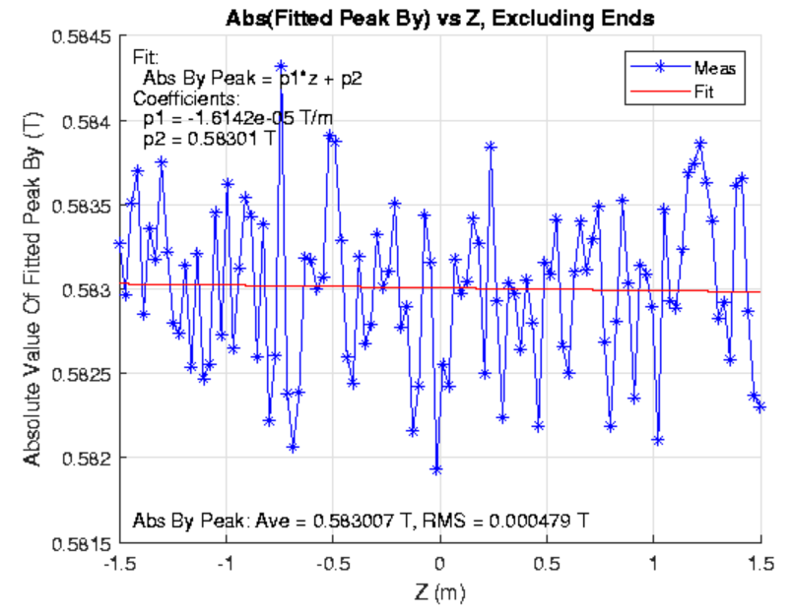
Peak fields and taper @ 21.5mm gap
21.5mm opening
21.5mm closing

Slide 6
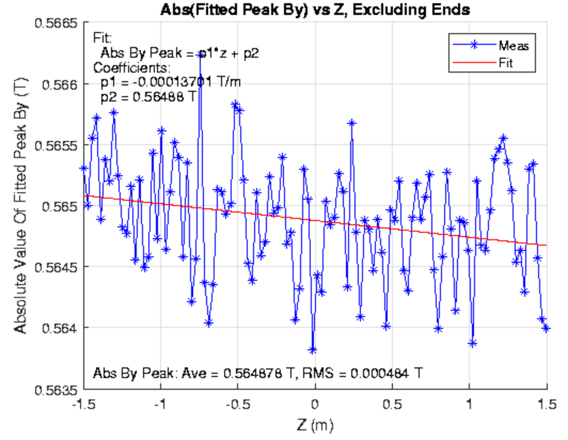
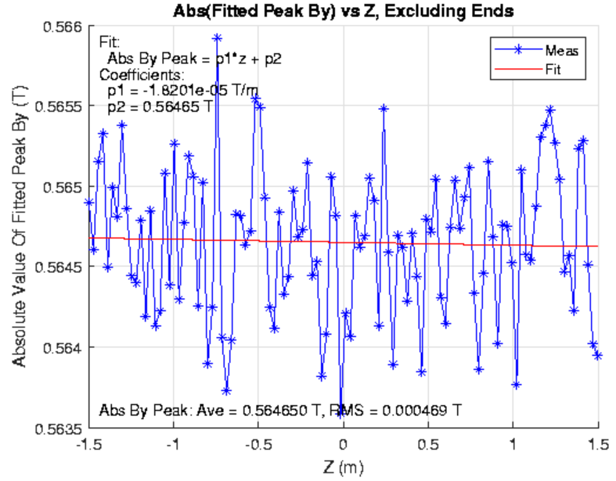
Peak fields and taper @ 22mm gap
22mm opening
22mm closing

Slide 7
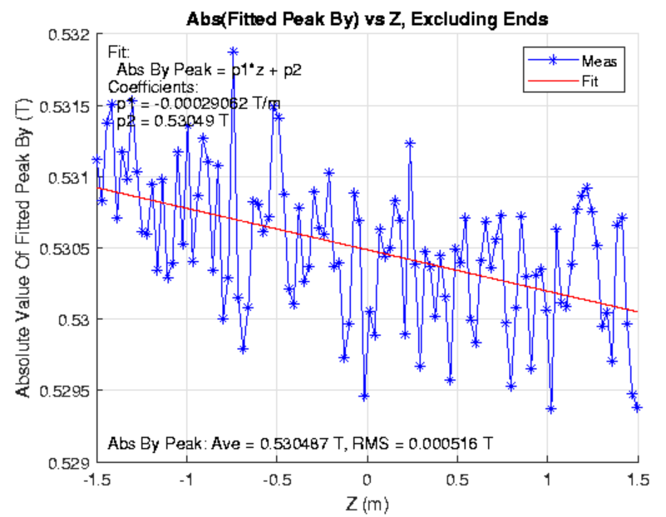
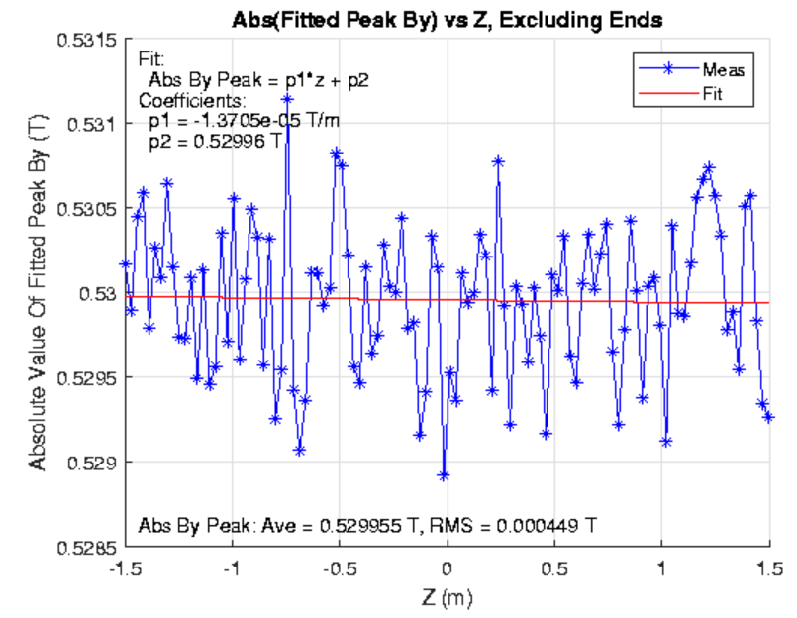
Peak fields and taper @ 23mm gap
23mm opening
23mm closing

Slide 8
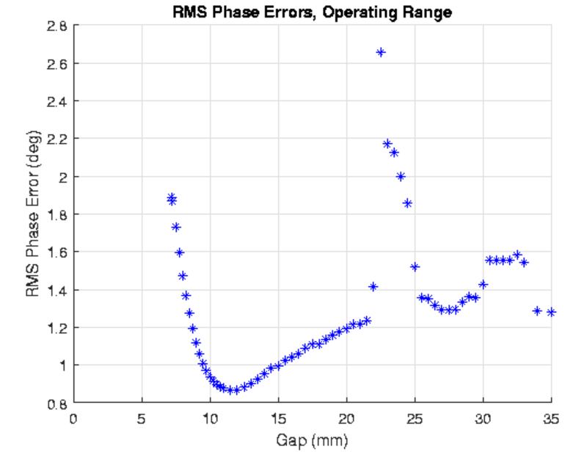
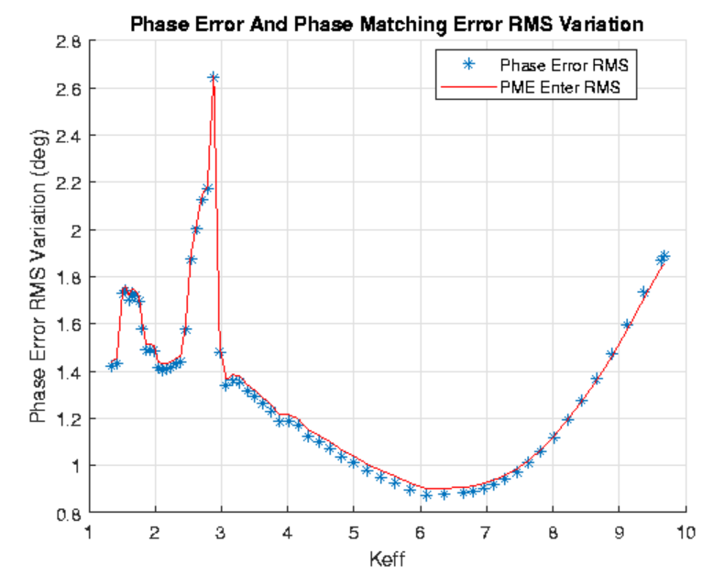
Phase error and phase matching

Slide 9
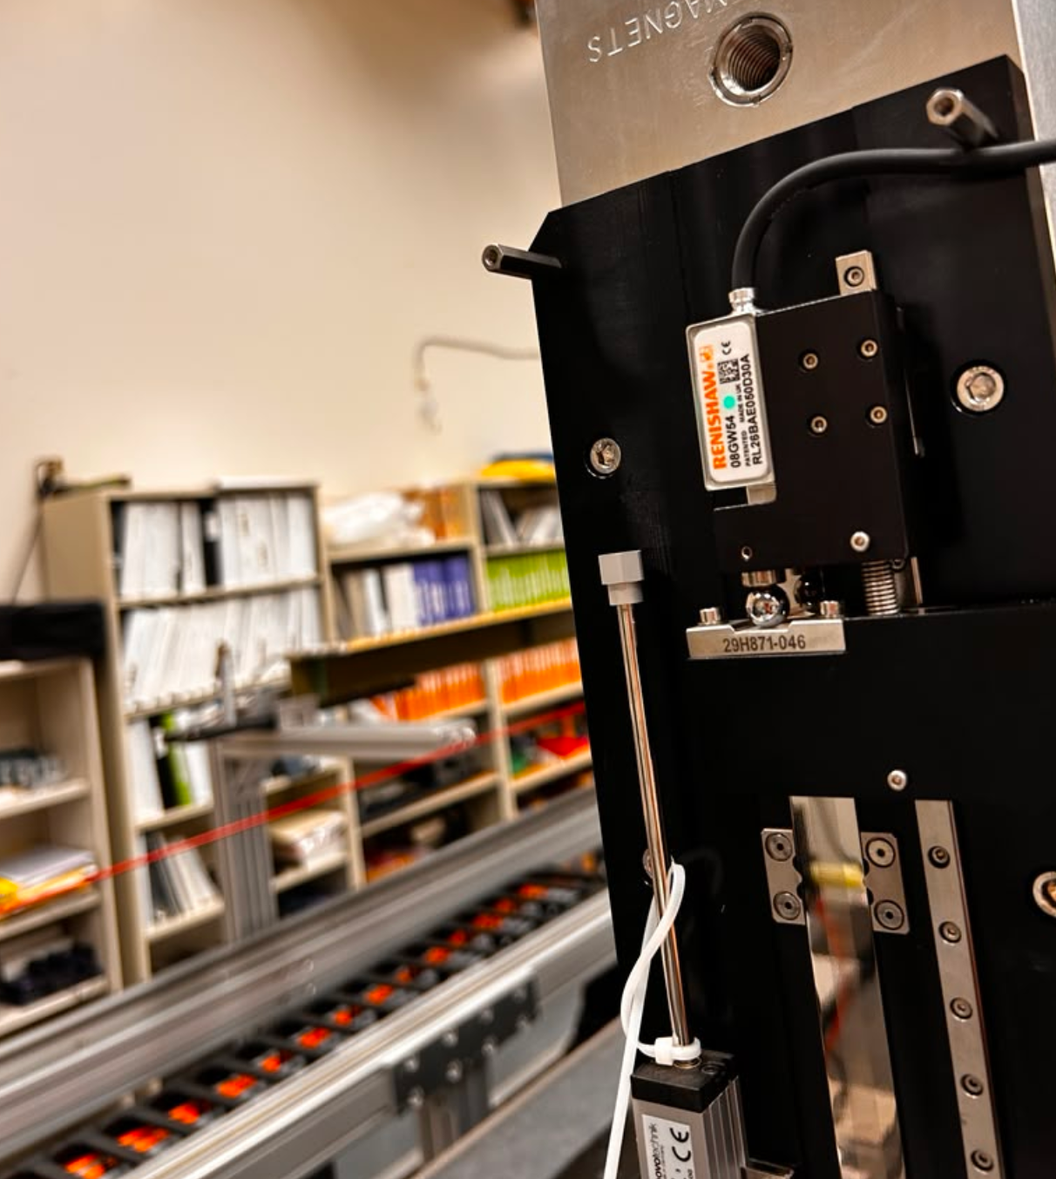

Slide 10
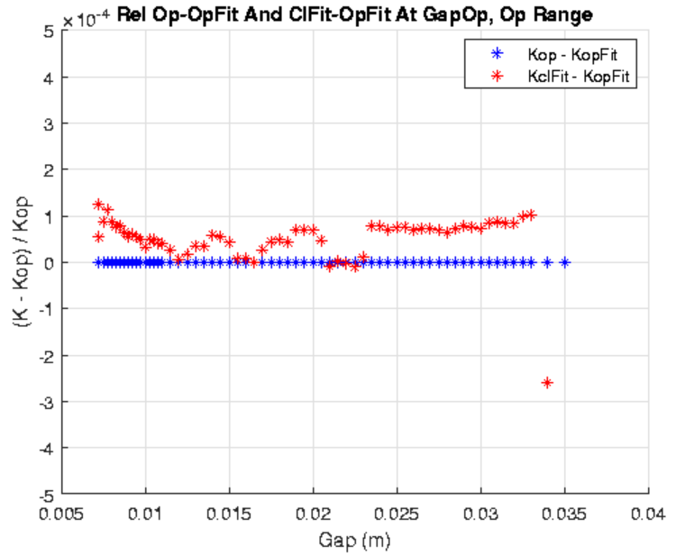
HE-SXU-022 on-axis final meas.:
K-value hysteresis (3rd meas.)

Slide 11
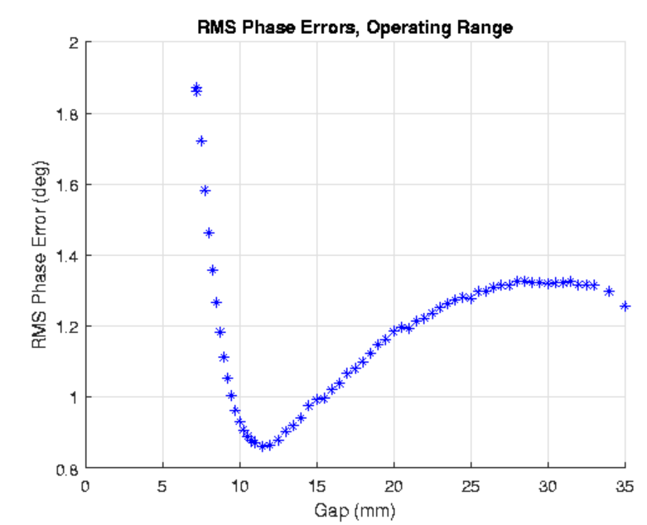
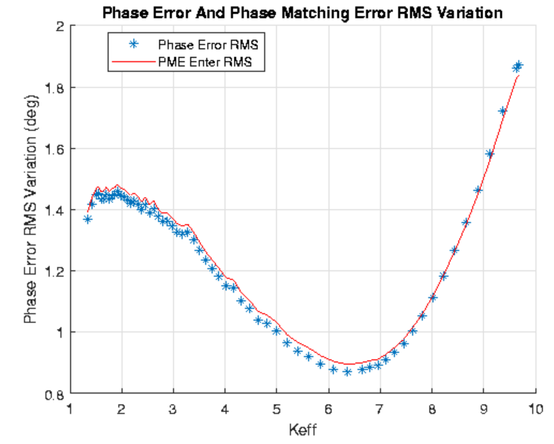
Phase error and phase matching

Slide 12
Next
All final measurements were concluded
All data for creating the traveler available
Scheduled HE-SXU-022 move: next Tuesday
A second final on-axis measurement is being taken (started today at noon)
Estimated time to conclude the meas.: 6:30 am tomorrow
Do we want to analyze the second on-axis final before creating the traveler?

