Slide 1
HGVPU final tuning results
I. Vasserman, N. Strelnikov, J. Xu
March 17, 2016

Slide 2
Outline
HGVPU:
3.4m full length device with progressive conical spring force compensation mechanism.
Revised pole height from 1.2mm to 0.5mm elevation above the surface of magnets.
Re-calibrated spring cages.
New aluminum girder.

Slide 3
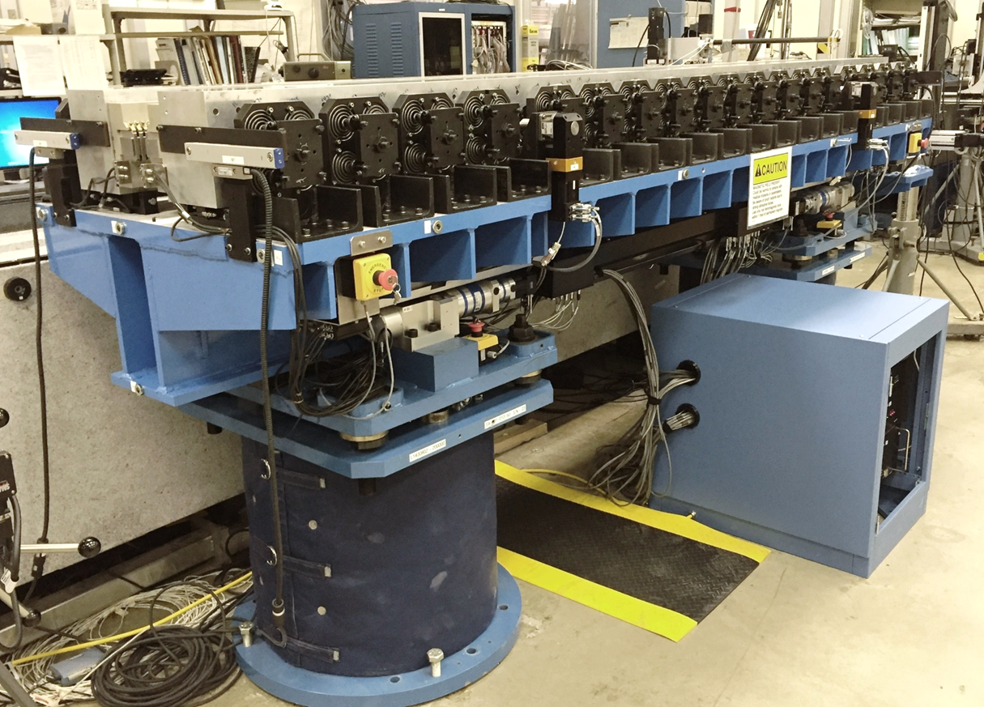
HGVPU in MM1

Slide 4
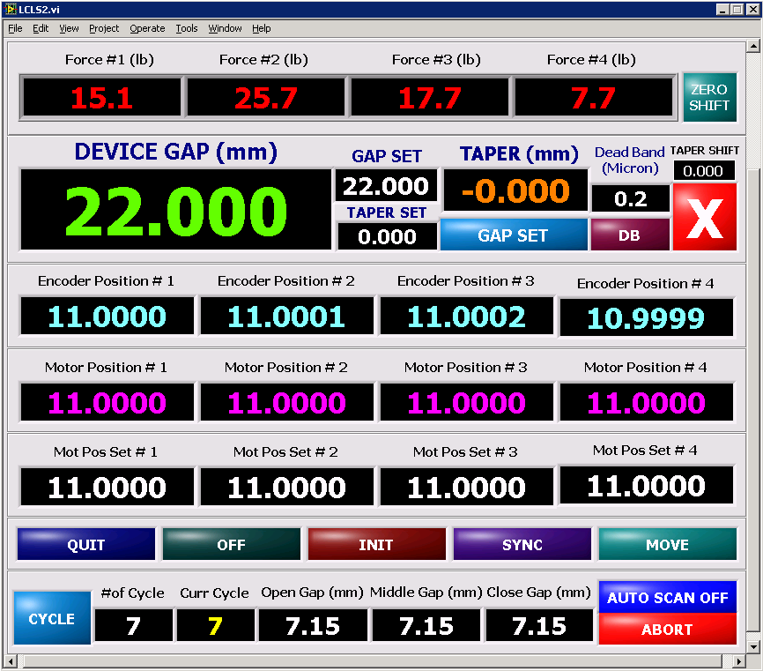
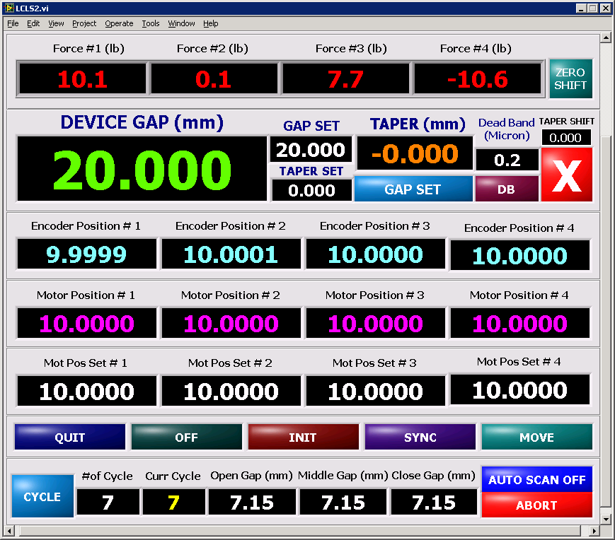
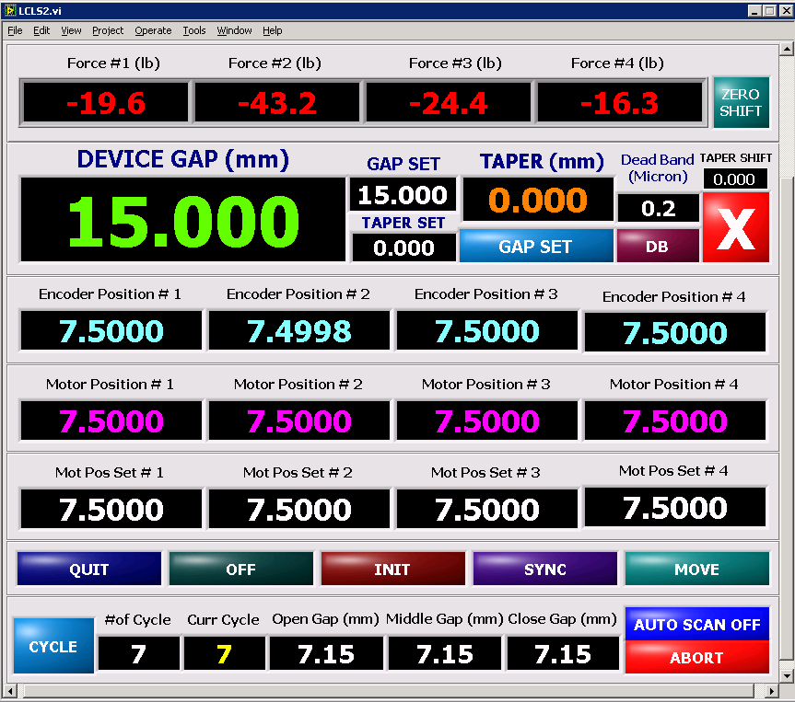
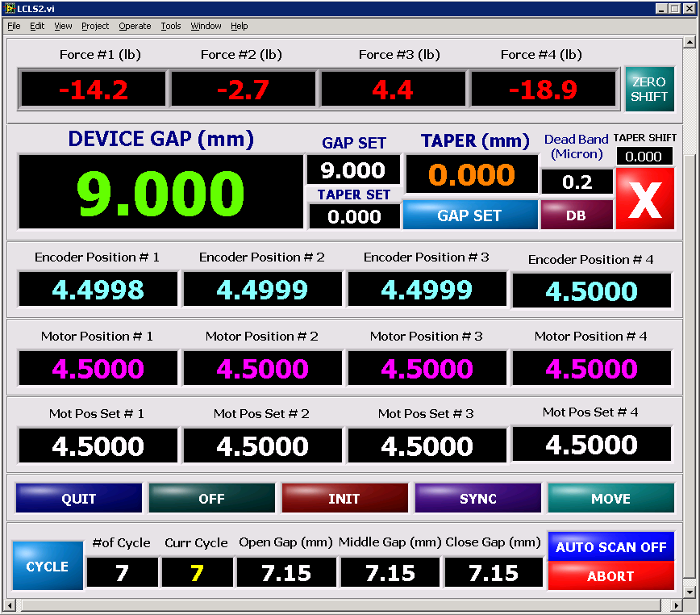
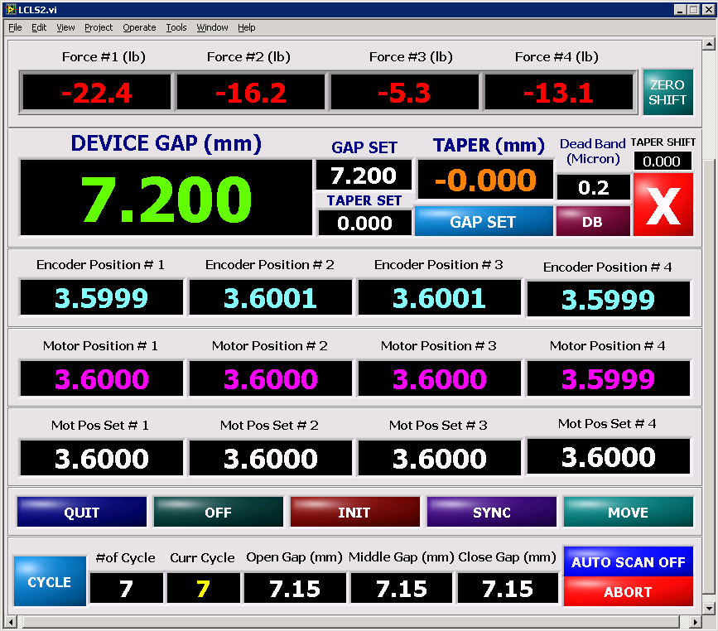
Forces on the actuators < +/-30 lbs across the gaps.

Slide 5
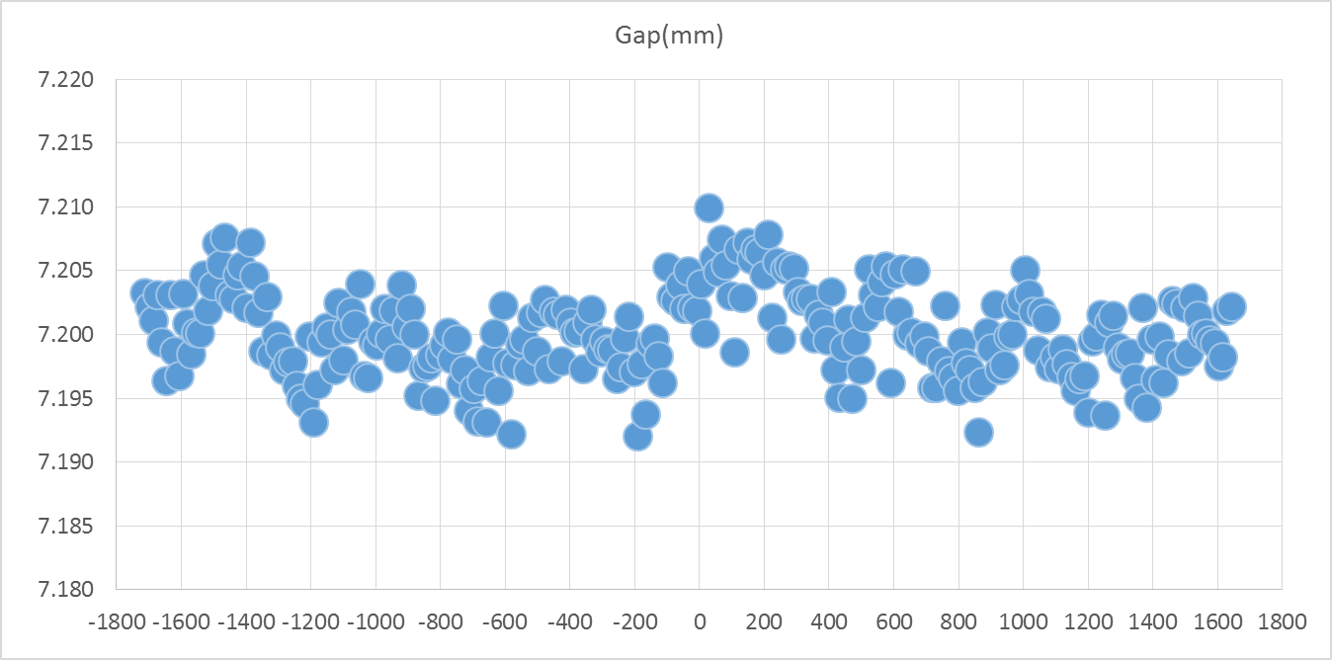
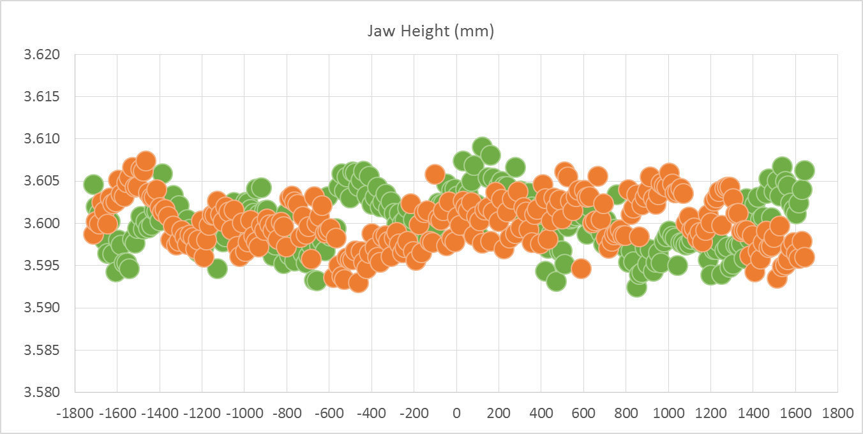
The straightness of the poles and the gap <+/- 10 microns at gap of 7.2mm

Slide 6
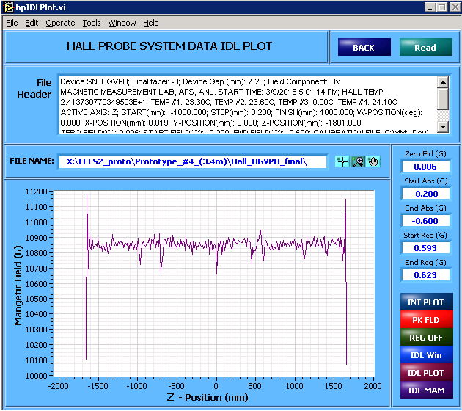
Peak field distribution in Z at the gaps of 7.2mm and 9mm

Slide 7
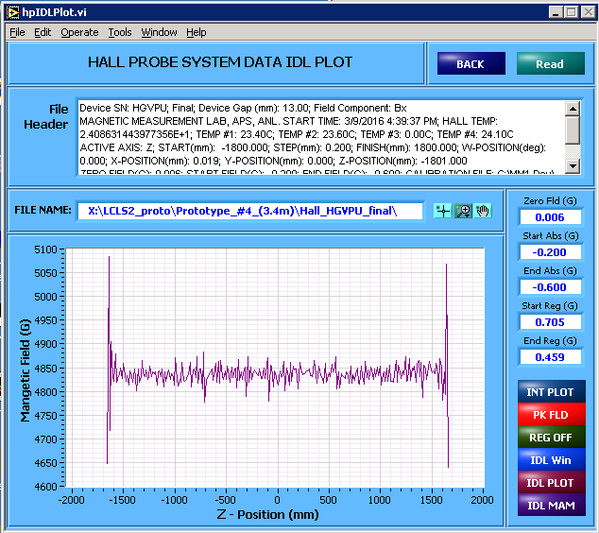
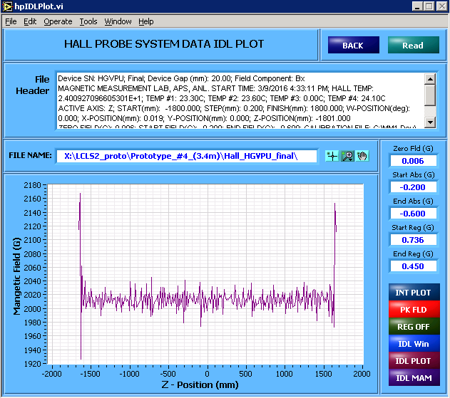
Peak field distribution in Z at the gaps of 13mm and 20mm

Slide 8
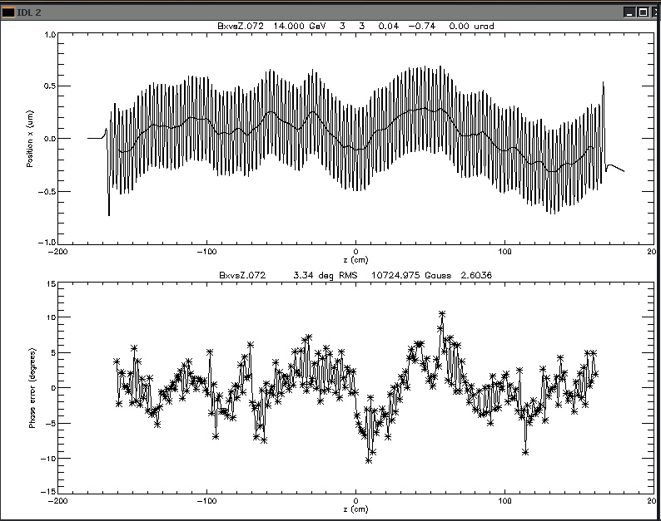
Magnetic field tuning results

Slide 9
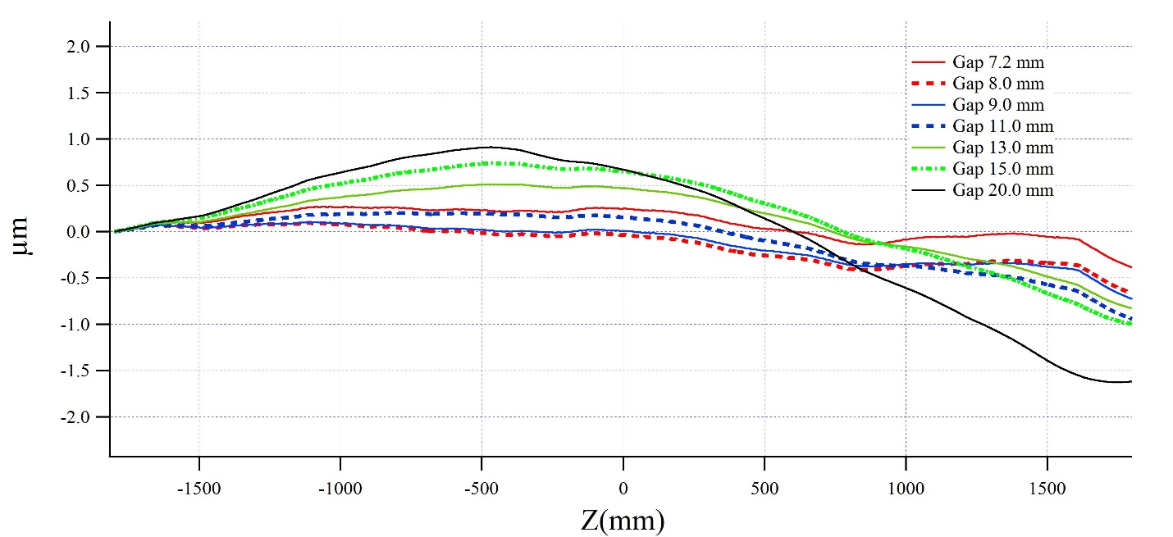
Gap dependent horizontal trajectories

Slide 10
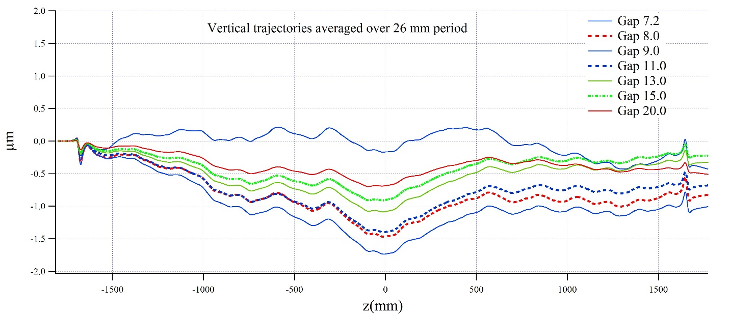
Gap dependent vertical trajectories

Slide 11
Gap dependent RMS phase errors

Slide 12
Gap dependent effective fields and RMS phase errors
Gap (mm) | RMS Phase Err (deg) | Beff (G)
20 | 1.42 | 2019
15 | 2.33 | 3747
13 | 2.72 | 4831
11 | 3.21 | 6280
9 | 3.33 | 8273
8 | 3.16 | 9555
7.2 | 3.34 | 10725
Req | < 4.00 | >10100@7.2

Slide 13
Gap dependent integrals and multipoles
Gap | J1x | J1y | J2x | J2y | a1 | a2 | a3 | b1 | b2 | b3
20 | 35 | -25 | 8.1 | 4.7 | 68 | 23 | -39 | 26 | 25 | -18
15 | 10 | 13 | 5.5 | 4.1 | 24 | 25 | 39 | 59 | -16 | -50
13 | -2 | 20 | 4.4 | 2.5 | 10 | 12 | -71 | 6 | -4 | -32
11 | -17 | 22 | 3.4 | 0.4 | -15 | 12 | -82 | 6 | -17 | -32
9 | -33 | 22 | 2.4 | -0.4 | -41 | -71 | 12 | -1 | 42 | -151
8 | -37 | 26 | 1.6 | 0.2 | -36 | -89 | 199 | -1 | 48 | -127
7.2 | 15 | 36 | -0.9 | 2.3 | -20 | -129 | 270 | -26 | 83 | -171
Req | +/- 40 | +/- 40 | +/- 15.0 | +/- 15.0 | +/- 100 | +/- 200 | +/- 400 | +/- 100 | +/- 200 | +/- 400
Units: Gap (mm); J1x (G-cm); J1y (G-cm); J2x (G-cm2); J2y (G-cm2)
a1/b1 (G); a2/b2 (G/cm); a3/b3 (G/cm2)

Slide 14
Conclusion.
Gap straightness at 7.2mm is better than +/- 10 microns.
No observable lower order deflections of the strongbacks at different operational gap settings.
RMS phase errors of the device are better than the requirement of 4 degrees.
Effective field is over 1.07 T at the gap of 7.2mm, that is better than the requirement of 1.01 T.
First and second integrals and multipoles are also better than the requirements.
Reproducibility and environment test results show no changes to the device performance. The difference in RMS phase errors are better than 0.1 degree, that is less than 2 micron changes in taper.

Slide 15
Magnetic shim map
P146
P131
P124
P78/P77
P76
P62
P57/P56/P55
P5/ P4/ P3
Left Jaw
from front
(near side)
2mm Side x1
30mm 0.2 trj x2
4mm Side x1
Phase x1
4mm Side x1
4mm Side x1
Phase x1
4mm Side x1
40mm 0.2 x1
5mm 0.2mm x1
Flat 0.2mm x1
P146
P131
P124
P78/P77
P76
P62
P57/P56/P55
P5/ P4/ P3
Right Jaw
from back
(far side)
2mm Side x1
30mm 0.2 trj x2
4mm Side x1
Phase x1
4mm Side x1
4mm Side x1
Phase x1
4mm Side x1
40mm 0.2 x1
5mm 0.2mm x1
Flat 0.2mm x1
P258/P257/P256/P255/P254/P253/P252/P251/P250
P239
P215
P177
P169/P168/P167/P166
P165
P162
Left Jaw
from front
(near side)
2mm Side x2
20mm 0.2 x4
4mm Side x4
4mm Side x1
2mm Side x1
2mm Side x1
2mm Side x1
40mm 0.2 x1
2mm Side x1
15mm 0.2 x1
8mm Side x1
P258/P257/P256/P255/P254/P253/P252/P251/P250
P239
P215
P177
P169/P168/P167/P166
P165
P162
Right Jaw
from back
(far side)
2mm Side x2
20mm 0.2 x4
4mm Side x4
4mm Side x1
2mm Side x1
2mm Side x1
2mm Side x1
40mm 0.2 x1
2mm Side x1
15mm 0.2 x1
8mm Side x1
Phase 0.2 x2

Slide 16
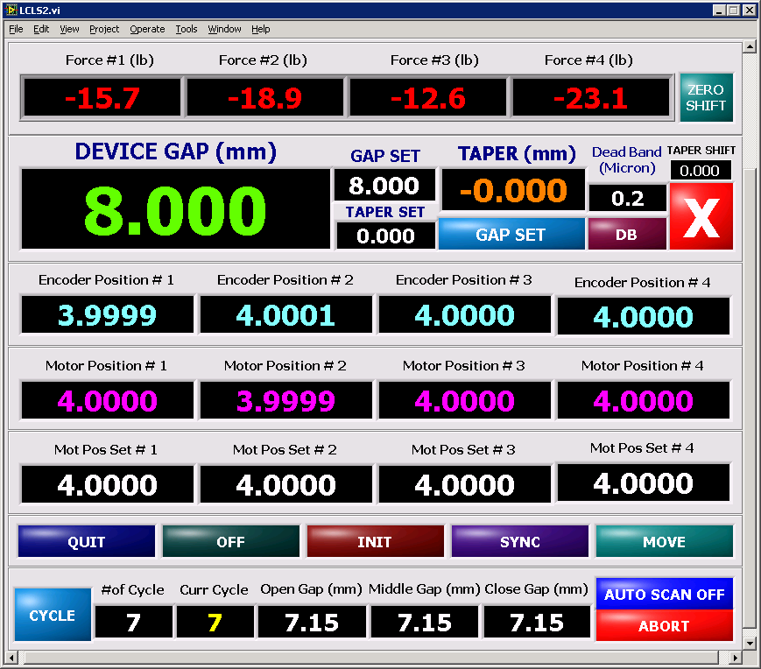
Attachments

Slide 17
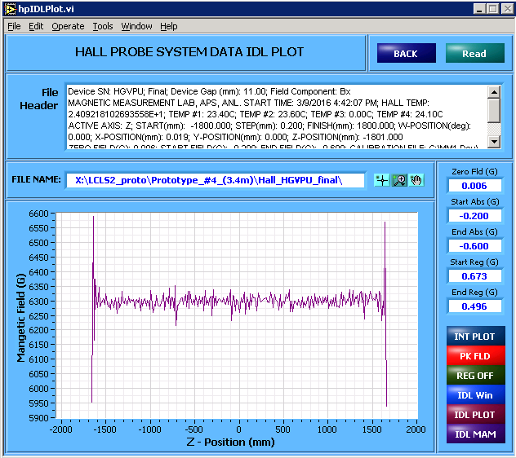
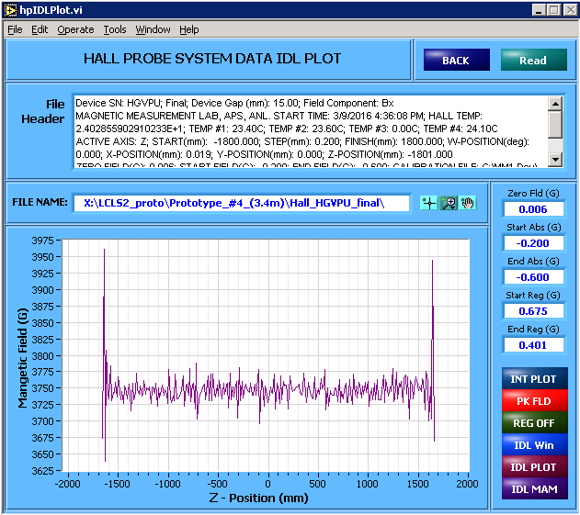
Attachments

Slide 18
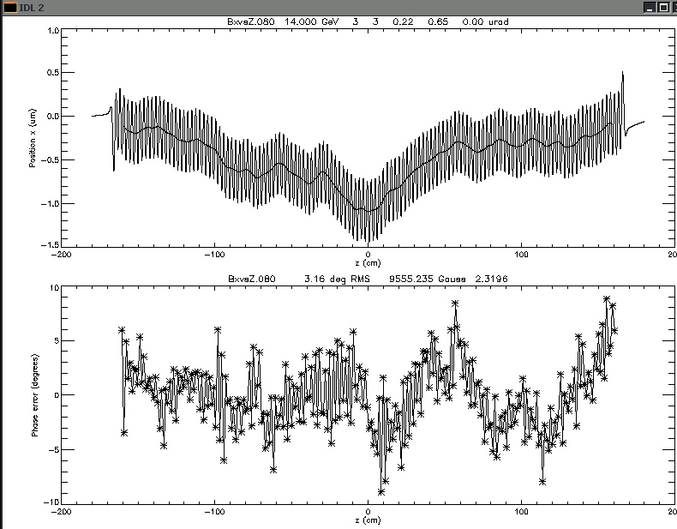
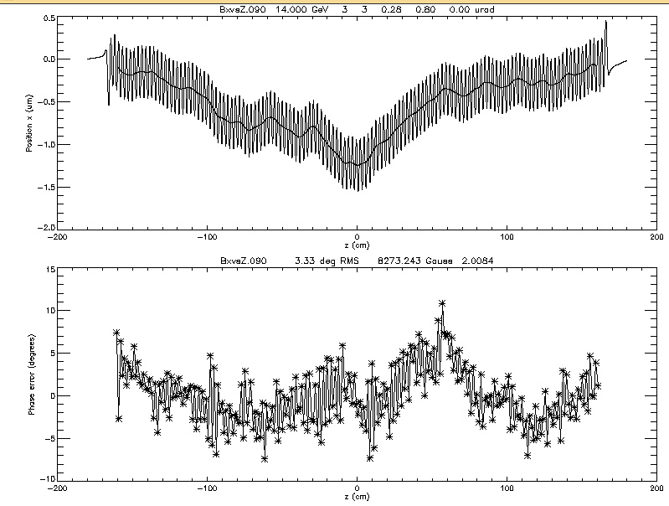
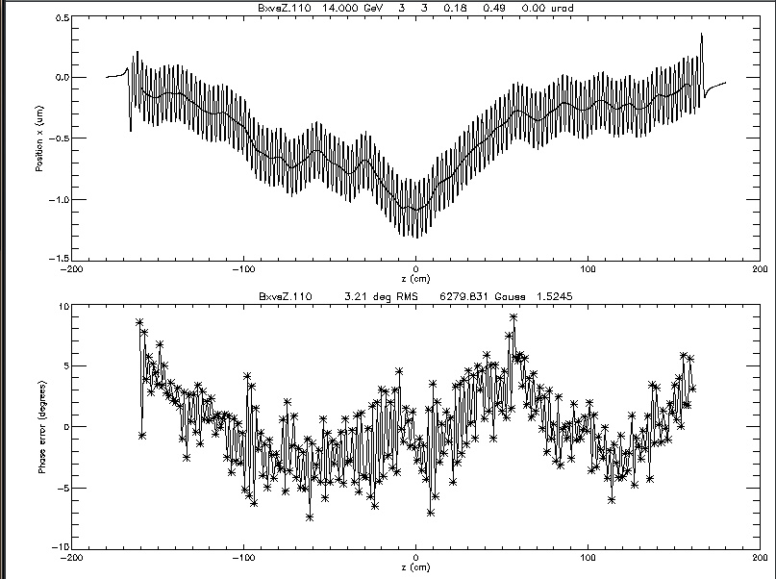
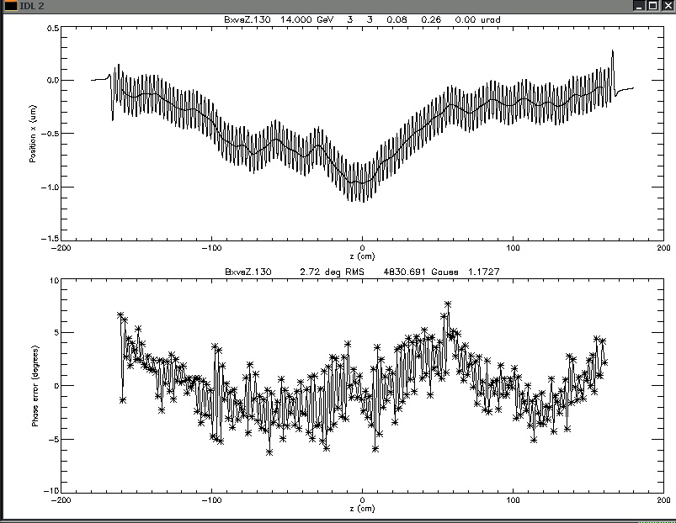
Attachments

Slide 19
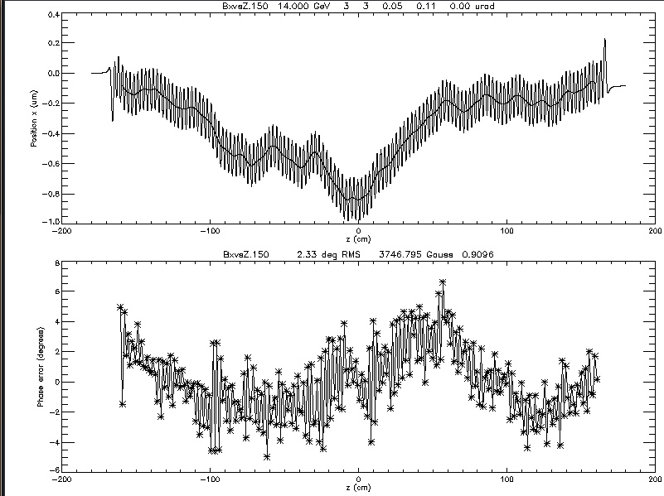
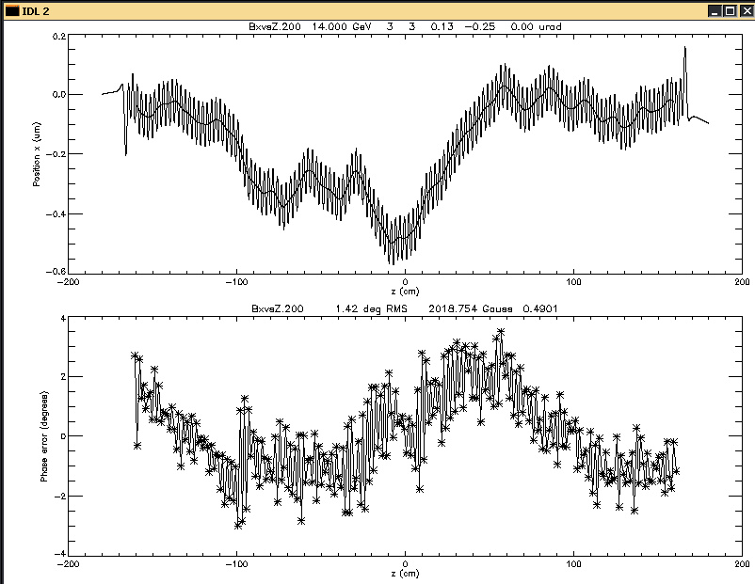
Attachments

