Slide 1
HXU32 Measurements
Zack Wolf,
Yurii Levashov
5/19/16

Slide 2
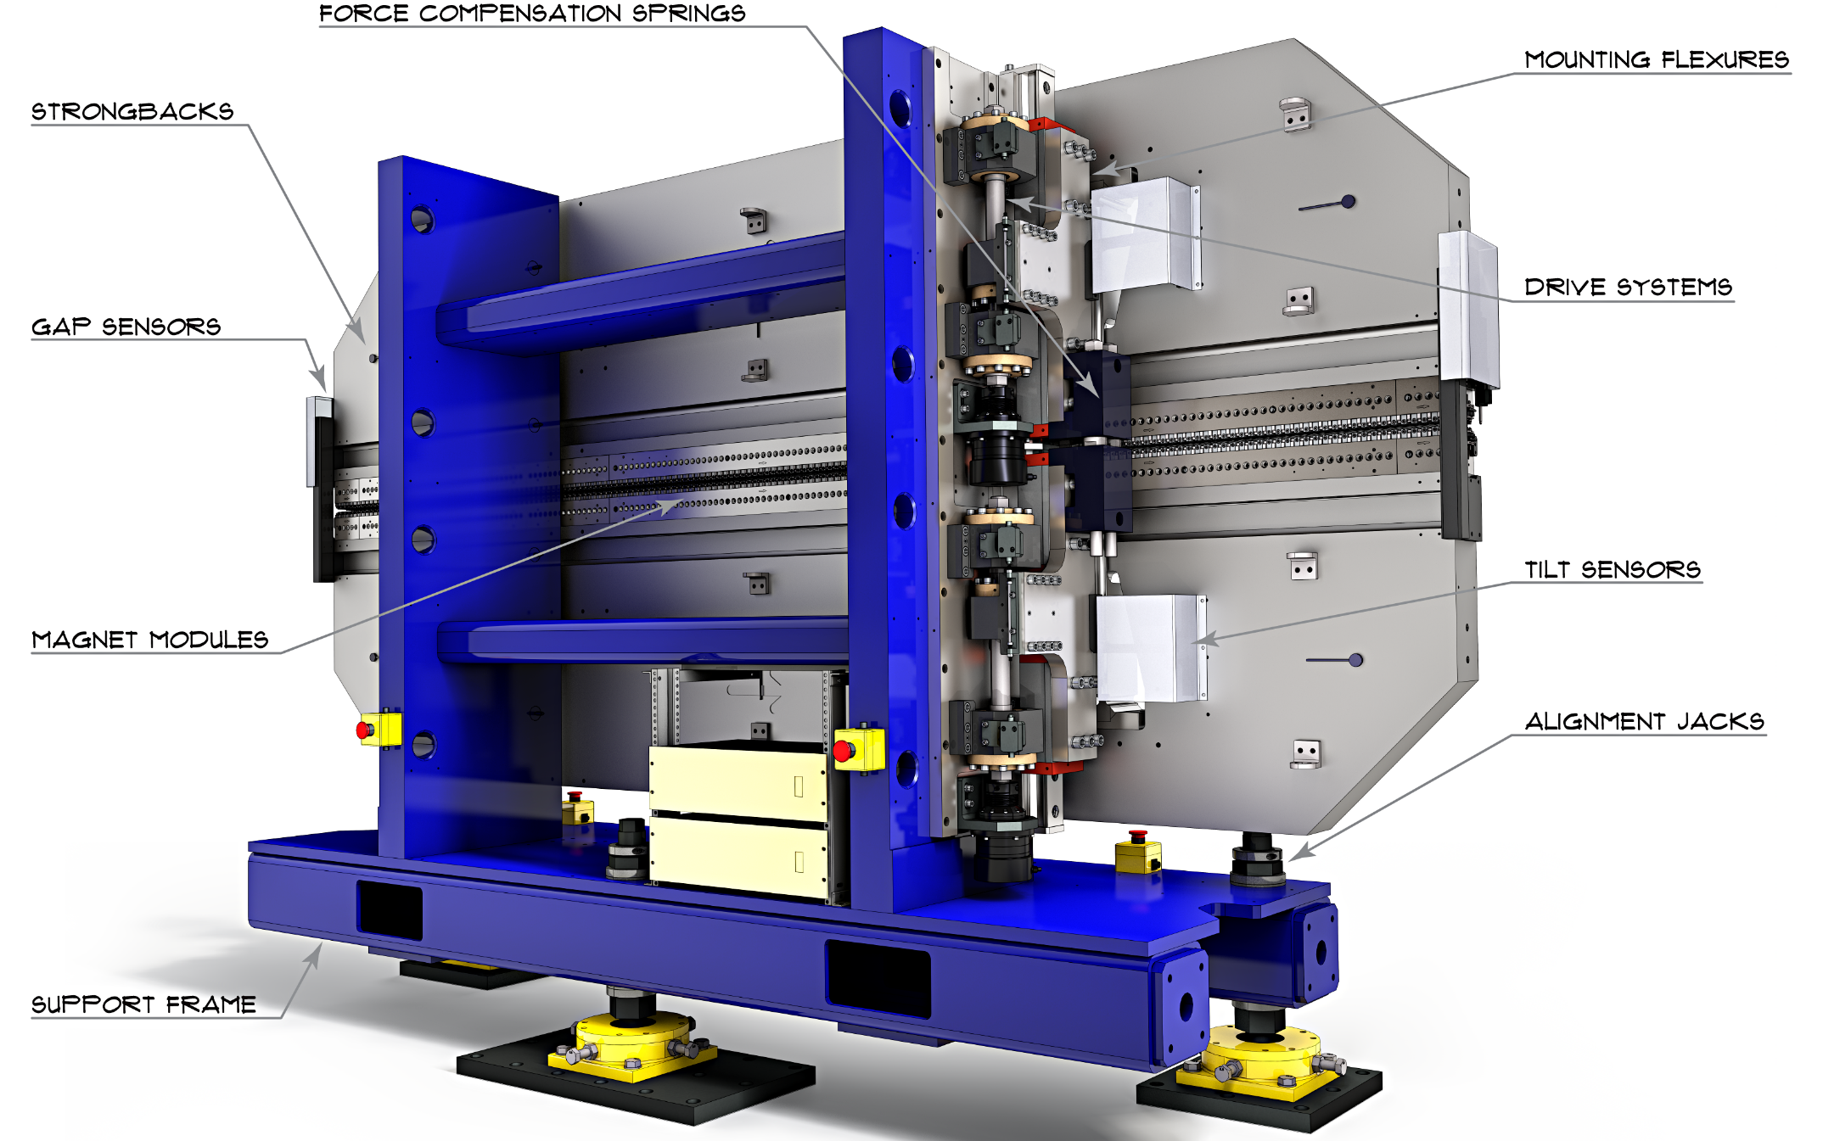
Coordinate System
Tied to undulator
HXR system in tunnel
Y
Z
X

Slide 3
Earth’s Field
Bx lbl  - Bx slac
(undulator reference frame)
LBNL
Bx = +0.126 G
By = -0.335 G
SLAC
Bx = -0.269 G
By = -0.343 G
(from background field integrals)
(from fluxgate probe measurements)

Slide 4
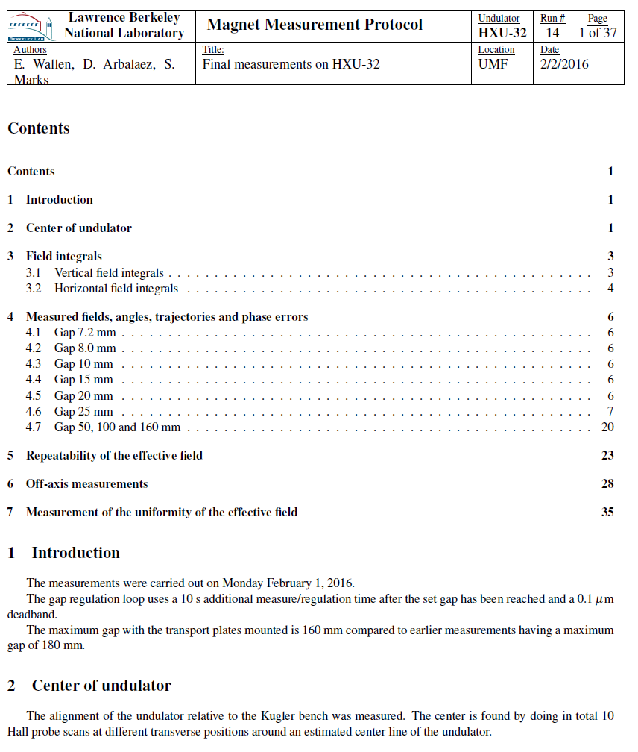
LBNL Data
The LBNL measurement data
came from this very good report.

Slide 5
Second Field Integrals, Gap = 7.2 mm
LBNL
Trajectories corrected so first field integrals agree with long coil.
SLAC

Slide 6
Use LBNL First Field Integrals For Correction , Gap = 7.2 mm
LBNL
SLAC trajectories corrected to LBNL first field integrals. The Hall probe measurements mostly agree. The required field integral is not what we measured, however.
SLAC

Slide 7
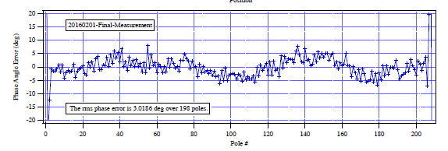
Phase Errors, Gap = 7.2 mm
LBNL
The phase error measurements agree.
SLAC

Slide 8
Peak Fields, Gap = 7.2 mm
General interest.
The peak fields are uniform to 0.3%. Most of the deviation is probably due to shims.
The peak spacing is uniform to 26 microns rms.

Slide 9
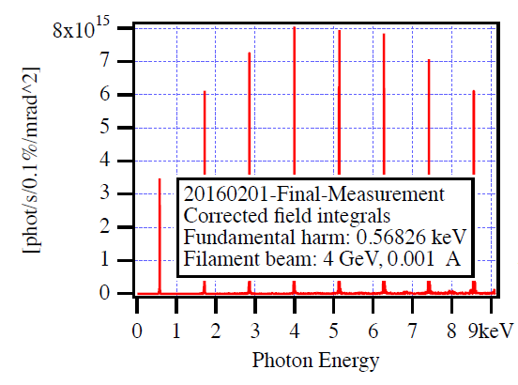
Radiation Spectrum, Gap = 7.2 mm
LBNL
SLAC
The calculated radiation spectra are the same.

Slide 10
Strength And Phase Errors At Different Gaps
 | 7.2 mm | 8 mm | 10 mm | 15 mm | 20 mm | 25 mm | 50 mm | 100 mm | 160 mm
LBNL Beff (T) | 1.2836 | 1.1605 | 0.90633 | 0.51968 | 0.31038 | 0.188 |  |  |  |  | From field harmonics
SLAC Beff (T) | 1.2821 | 1.1589 | 0.90449 | 0.51841 | 0.30959 |  |  |  |  |  | From K value
We measure the undulator strength differently. The values differ by about 0.15%. This does not affect our plan to do all the final measurements at SLAC with the same systematic errors for all the undulators.
7.2 mm | 8 mm | 10 mm | 15 mm | 20 mm | 25 mm
LBNL Phase Err (deg) | 3.02 | 2.97 | 2.88 | 2.41 | 2 | 1.74
SLAC Phase Err (deg) | 2.94 | 2.81 | 2.55 | 1.99 | 1.58
The phase error measurements agree.

Slide 11
Second Field Integrals, Gap = 15 mm
LBNL
Measurements corrected to first integrals from long coil. Rough agreement.
SLAC

Slide 12
Use LBNL First Field Integrals For Correction , Gap = 15 mm
LBNL
SLAC trajectories corrected to LBNL first field integrals. Still only rough agreement.
SLAC

Slide 13
Use LBNL First Field Integrals For Correction , Gap = 15 mm
LBNL
Added -12 μTm shim at Z = -0.4 m. Corrected to LBNL first field integrals. Good agreement. Why is a shim and a field integral addition required for agreement?
SLAC

Slide 14
Phase Errors, Gap = 15 mm
LBNL
Phase errors agree.
SLAC

Slide 15
Peak Fields, Gap = 15 mm

Slide 16
Field Integrals vs Gap
Large Gap
Earth Field Difference Over 4 m:
ΔBx = -0.395 G → ΔI1x = -158 Gcm
ΔBy = -0.008 G → ΔI1x = -3 Gcm
Difference in I1x at large gap partially explained. Difference at small gap not explained.

Slide 17
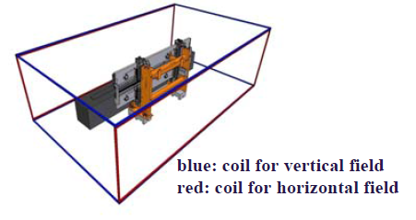
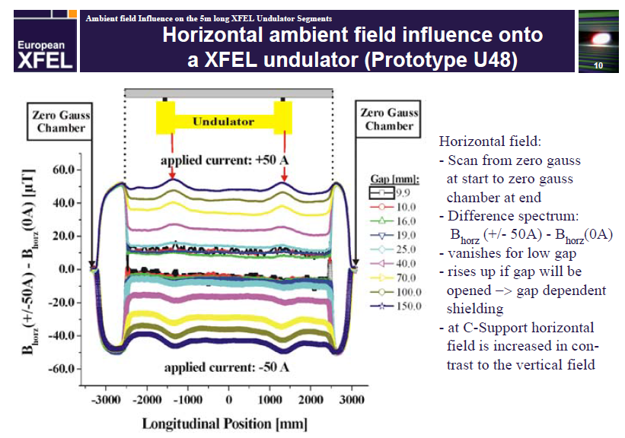
XFEL Earth Field Studies
Uwe Englisch

Slide 18
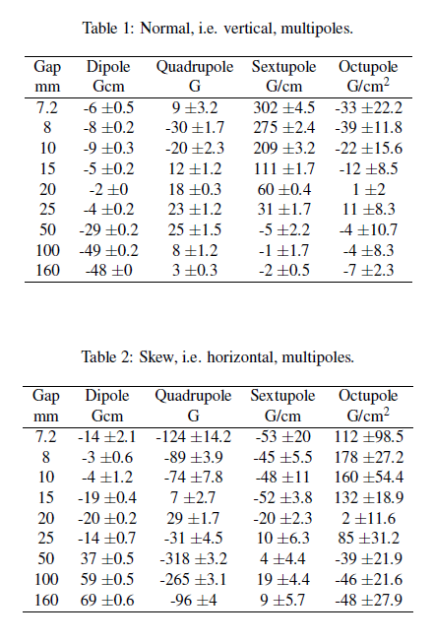
Field Integral Gradients Might Explain Small Gap Differences
Q = 124 G = 124 Gcm / cm
This implies
ΔI1x = 40 Gcm comes from measuring
at positions 3 mm apart
Perhaps this explains the I1x differences
at small gap.

Slide 19
Check Coil With Fluxgate Measurements, Gap = 180 mm
Large fields from shims even at 180 mm gap.
Gradients in the shim fields put positioning accuracy requirements on the long coil.

Slide 20
Add Fluxgate To Field Integral Plot
The SLAC long coil measurements agree with the fluxgate measurements.
Differences seem to be due to the Earth’s field and to field gradients and differences in long coil positions.

Slide 21
Different Methods For Determining The Magnetic Axis
We use different methods to find the magnetic axis. This can lead to large differences if the poles have a cant angle.
Peak B
Symmetry point
Done at 25 mm gap.
LBNL
SLAC
Done at 10 mm gap.
We need to study to see if we are measuring along different axes.

Slide 22
Conclusion
The Earth’s field orientation is different at LBNL and SLAC for SXR undulators. It is the same for HXR undulators. Only a small correction, if any, is needed to account for the difference for the HXR. This is good for HGVPU tuning.
UMF HXR
SLAC HXR
The shims have large gradients which make placing the long coil at the Hall probe position more difficult. Perhaps we can reduce the gradient.
We use different methods to determine the magnetic axis. This can lead to different tuning with the gradients.
Otherwise, the LBNL and SLAC measurements generally agree.

Slide 23
End

