Slide 1
SSRL EPU Magnetic Measurements Zachary Wolf March 15, 2013

Slide 2
Outline
Overview of SSRL EPU measurements
Field integral measurement methods
SSRL EPU field integrals - Scott
Discussion - All

Slide 3
Overview Of SSRL EPU Measurements
Danfysik measured the field integrals of the EPU
SLAC measurements with a long coil did not agree
We wanted independent measurements using another technique
We asked Diego Arbelaez of LBL to set up his pulsed wire system
SLAC was developing a single moving wire system for use in the Delta undulator
We set up the single moving wire and the pulsed wire together in the EPU
The single moving wire and the pulsed wire gave the same answer, they showed large gradients, however
SSRL found that one of the undulator jaws was not moving, fixed it
Moving wire and pulsed wire both gave the Danfysik results after the jaw was fixed
Set jaw back to broken mode, got high gradient answer
Set jaw back to fixed mode, got Danfysik answer
Setting up long coil again to repeat those measurements

Slide 4
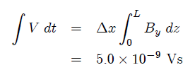
Field Integrals: Moving Wire
Samples field locally
average over 0.5 mm wire move distance
Small wire sag with CuBe wire
Straightforward measurement
know how far wire moved from stages,
numerically integrate voltage samples
Short measurement time, small drift
Small signal from single wire
I₁
I₂

Slide 5
Field Integrals: Pulsed Wire
Calibration built into measurement
Small sag with CuBe wire
Large noise
Small wire motion
5 A
20 μs
40 μTm

Slide 6
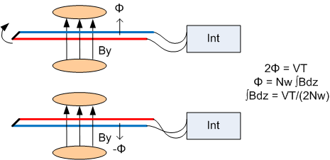
Field Integrals: Flip Coil
Averages field over coil width
Cu wires, potential sag
Many turns, large signal
Short measurement time, small offset drift
Bumps in coil can cause large errors

Slide 7
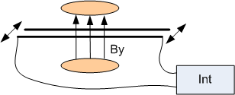
Field Integrals: Long Coil
Same as moving wire, but with many turns
Averages over volume of coil wire bundle
Coil assembly keeps wire bundle straight
Large signals
Low noise
Short measurement time, small offset drift
Small bumps in wire bundle don’t affect field integral

Slide 8
Field Integrals: Hall Probe
Hall probe samples field
Numerically integrate to get field integrals
Subtract large numbers to get small number
Small offsets in probe give large field integrals
Long measurement time, large offset drift

