Slide 1
HGVPU Preparations
Zack Wolf
4/1/16

Slide 2
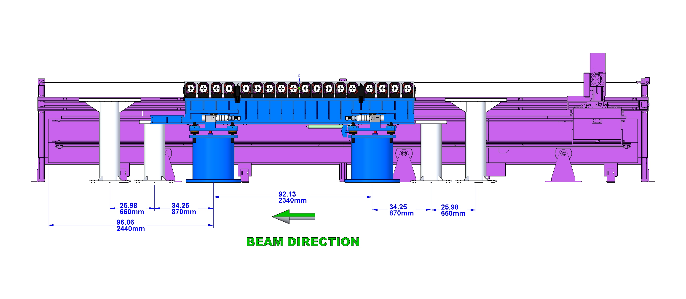
Undulator Placement
Steve Score
Yurii Levashov
Stand removed
MMF orientation same as tunnel orientation.

Slide 3
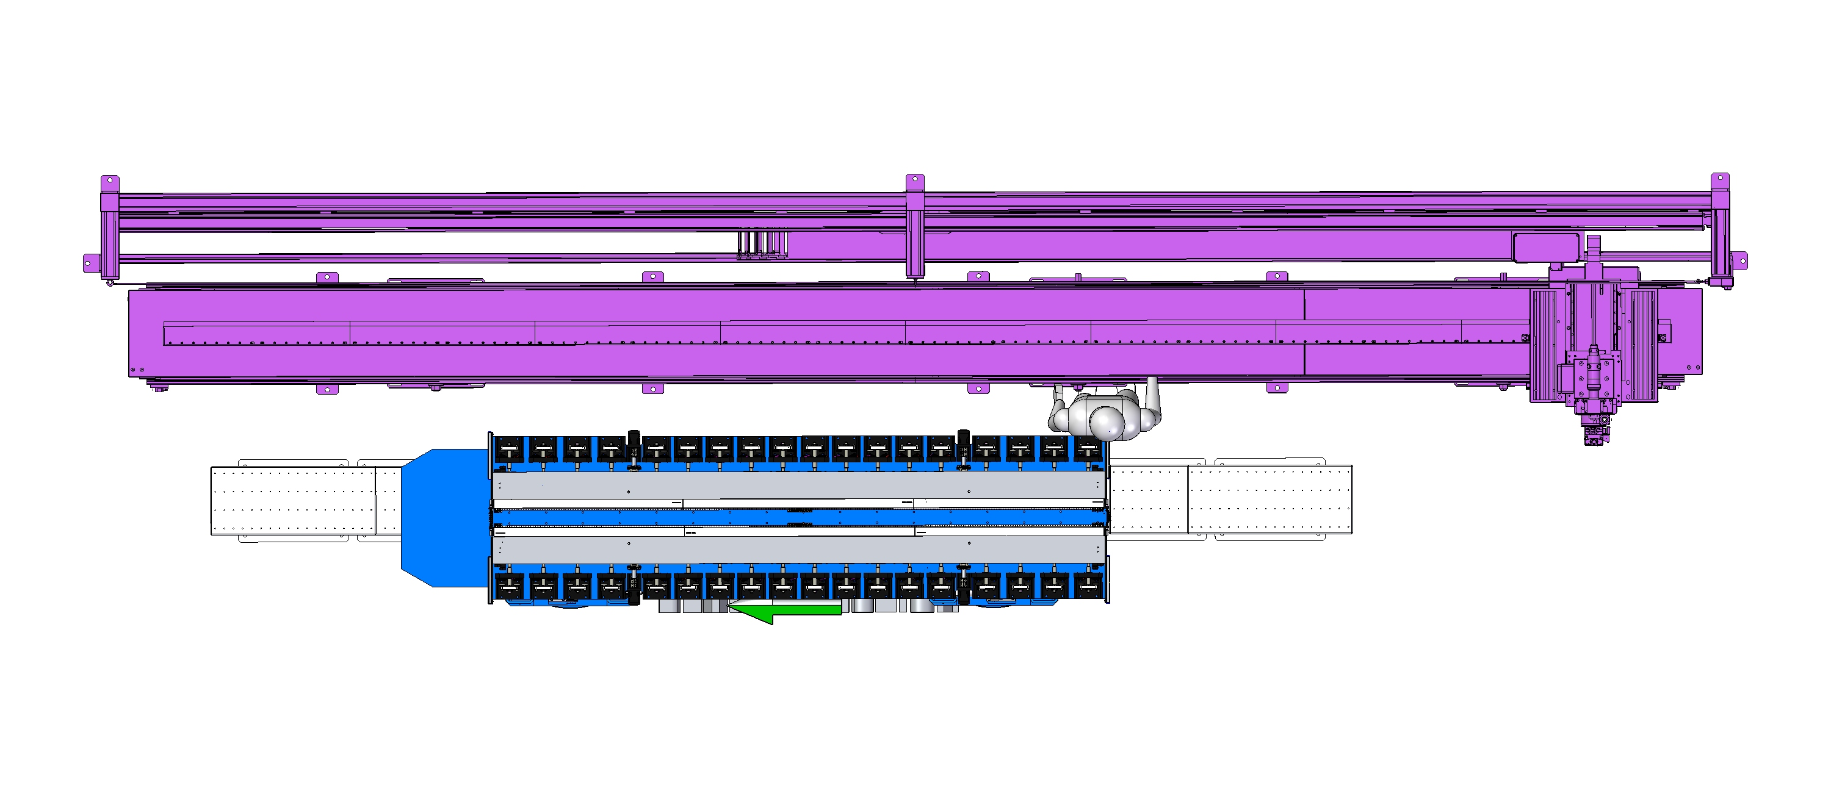
Undulator Placement
Undulator 12 inches from granite.
We can make adjustments on back of undulator.
Tuning done from front.

Slide 4
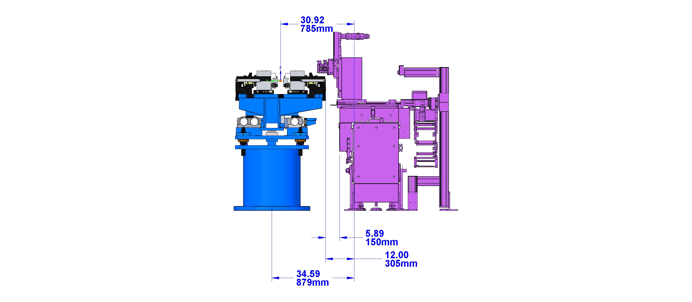
Undulator Placement
No interference with Kugler bench.

Slide 5
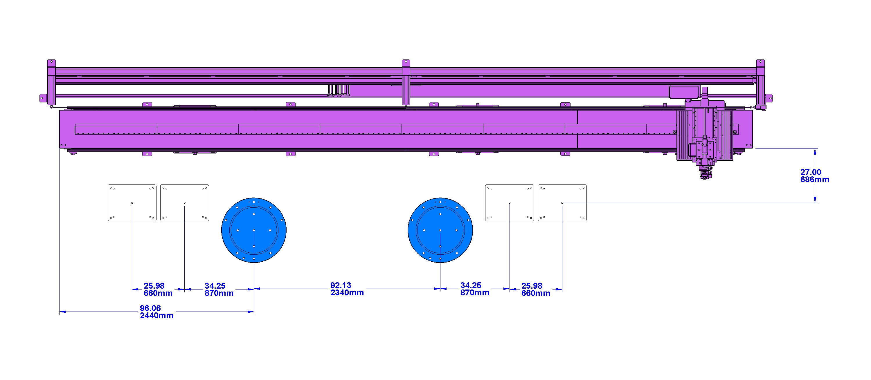
Undulator Placement
Pedestal locations.

Slide 6
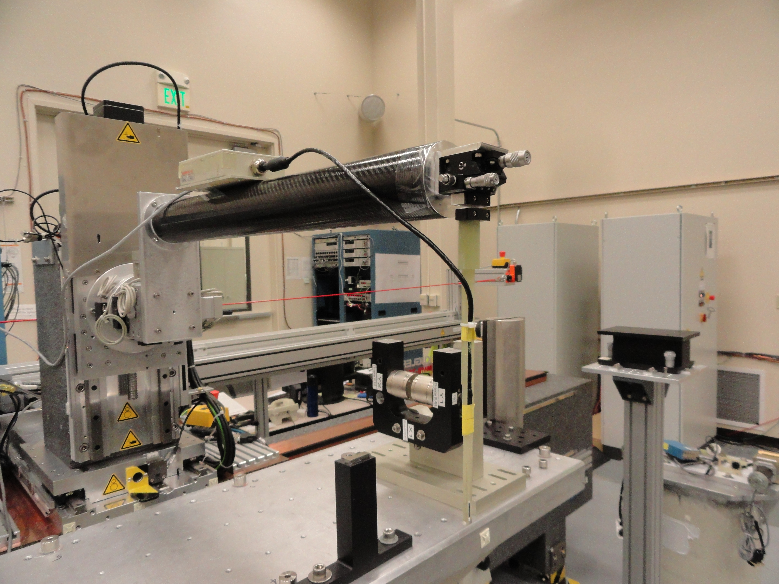
Arm For Probes
Yurii Levashov
Scott Jansson

Slide 7
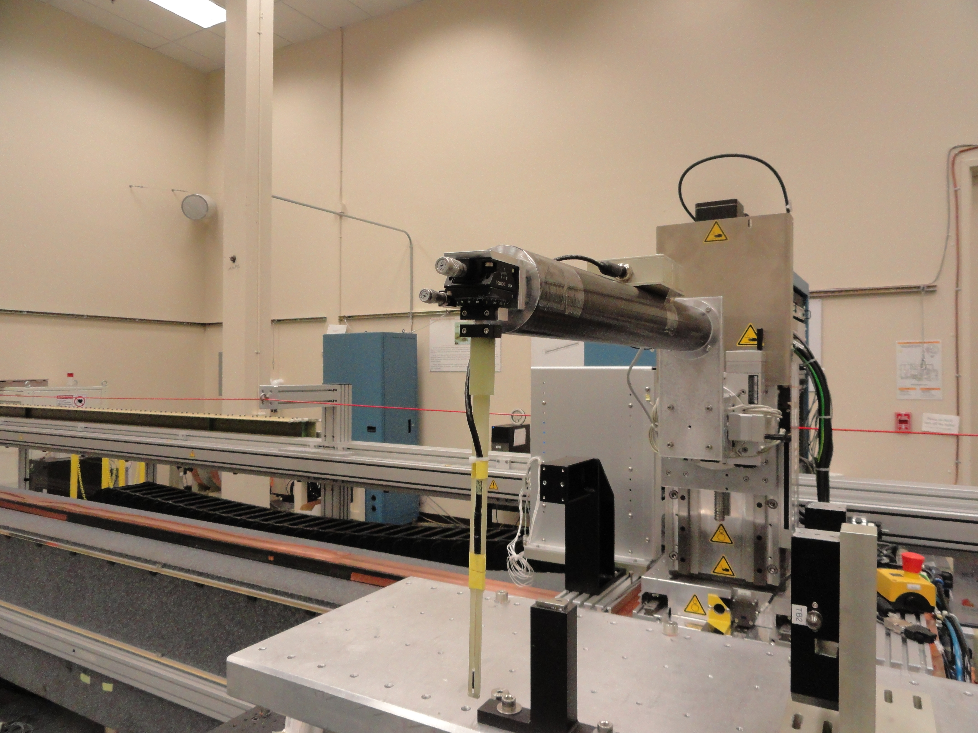
Arm For Probes
Small goniometer
Small rotary stage
Ceramic

Slide 8
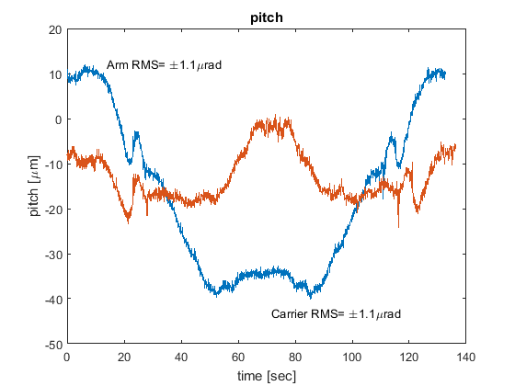
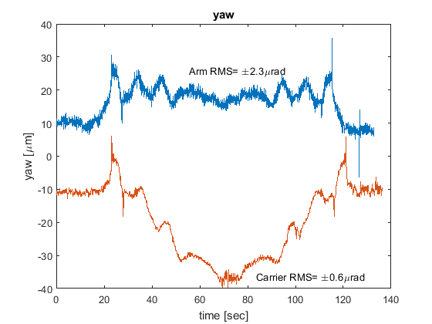
Arm Vibration Within Tolerance
Georg Gassner
“If the arm is 0.5m long than the z location has an RMS of 1.2µm.” Georg
LCLS-TN-04-8 Require pitch and yaw < 4.2 μrad
High frequency.
Does not affect K.
ΔB ~ k_{u} B₀ Δz ~ 3 Gauss

Slide 9
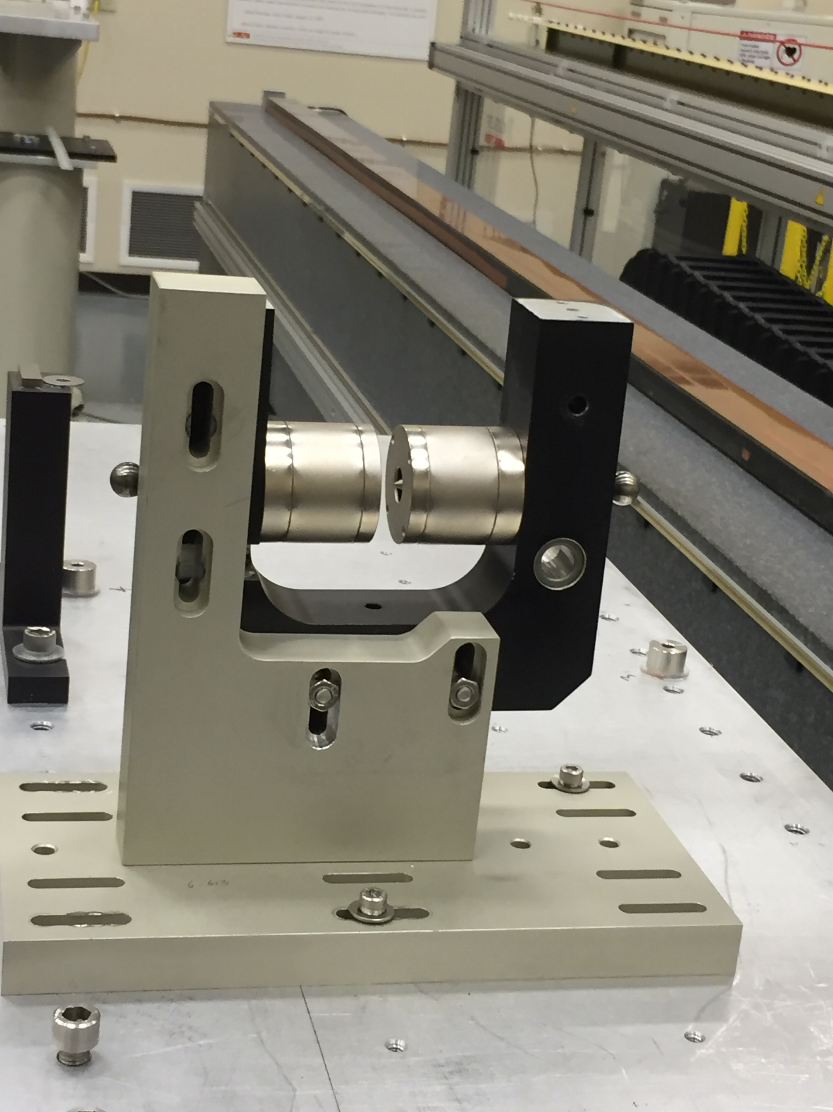
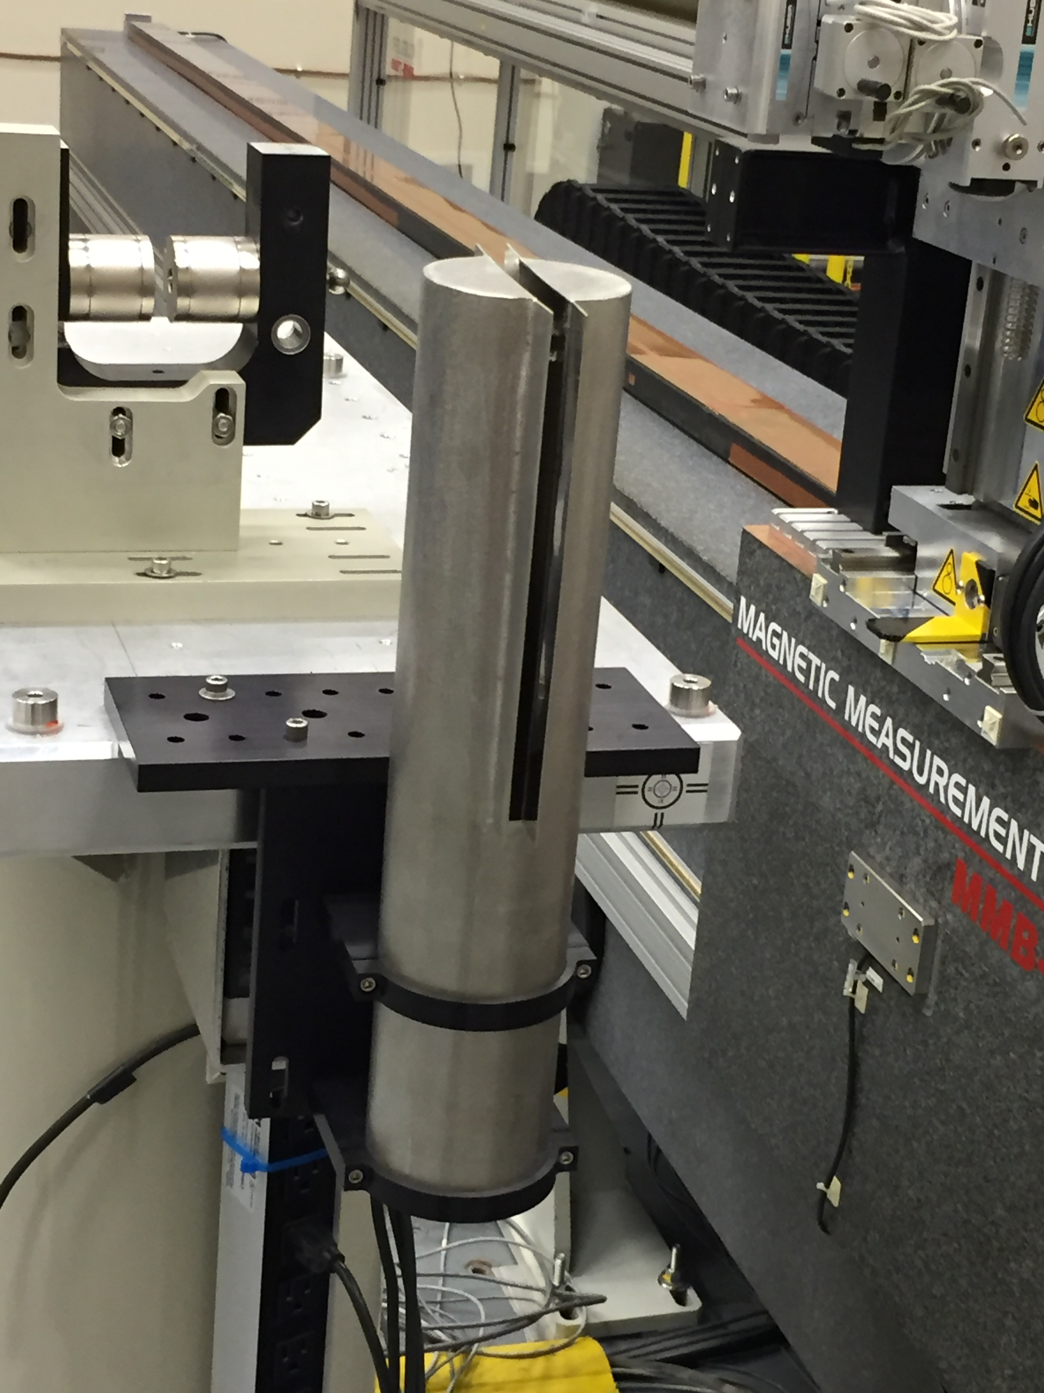
Rotate Equipment For Probes
Locate Hall Elements
Zero Gauss Chambers

Slide 10
Approximate Short Term Timeline
Friday 4/1: review, get BIO approval for anchors, order any parts, mark floor for holes
Monday 4/4: drill holes for pedestals, undulator arrives
Tuesday 4/5: mount pedestals, align cam movers
Wednesday 4/6: mount undulator
Thursday 4/7: controls setup
Friday 4/8: controls setup
Mon-Fri 4/11-4/15: monitor shelf as gap changes
Mon- Fri 4/18-4/29: measure undulator, compare to ANL
~5/1: send undulator to LBNL

Slide 11
Planned Production Workflow
SXU blue
HXU purple

Slide 12
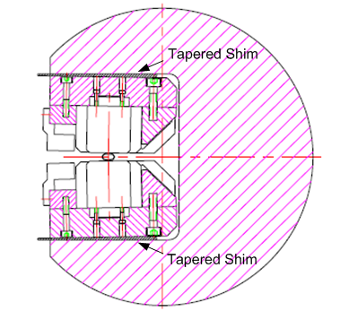
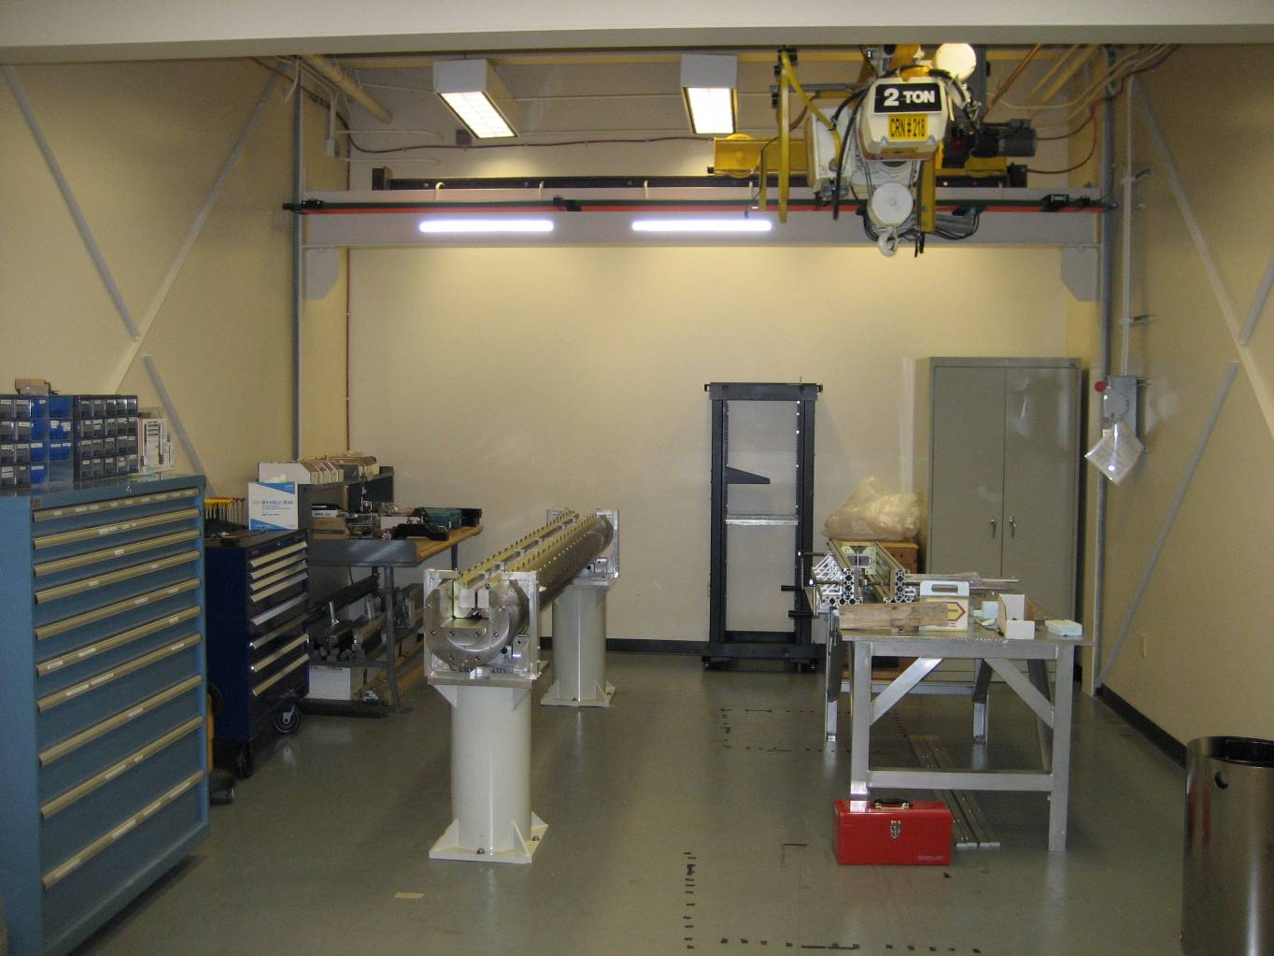
Reference Undulators
Have two fixed gap LCLS
undulators.
Will replace tapered shims with
flat shims.
Rotate HXU reference.

Slide 13
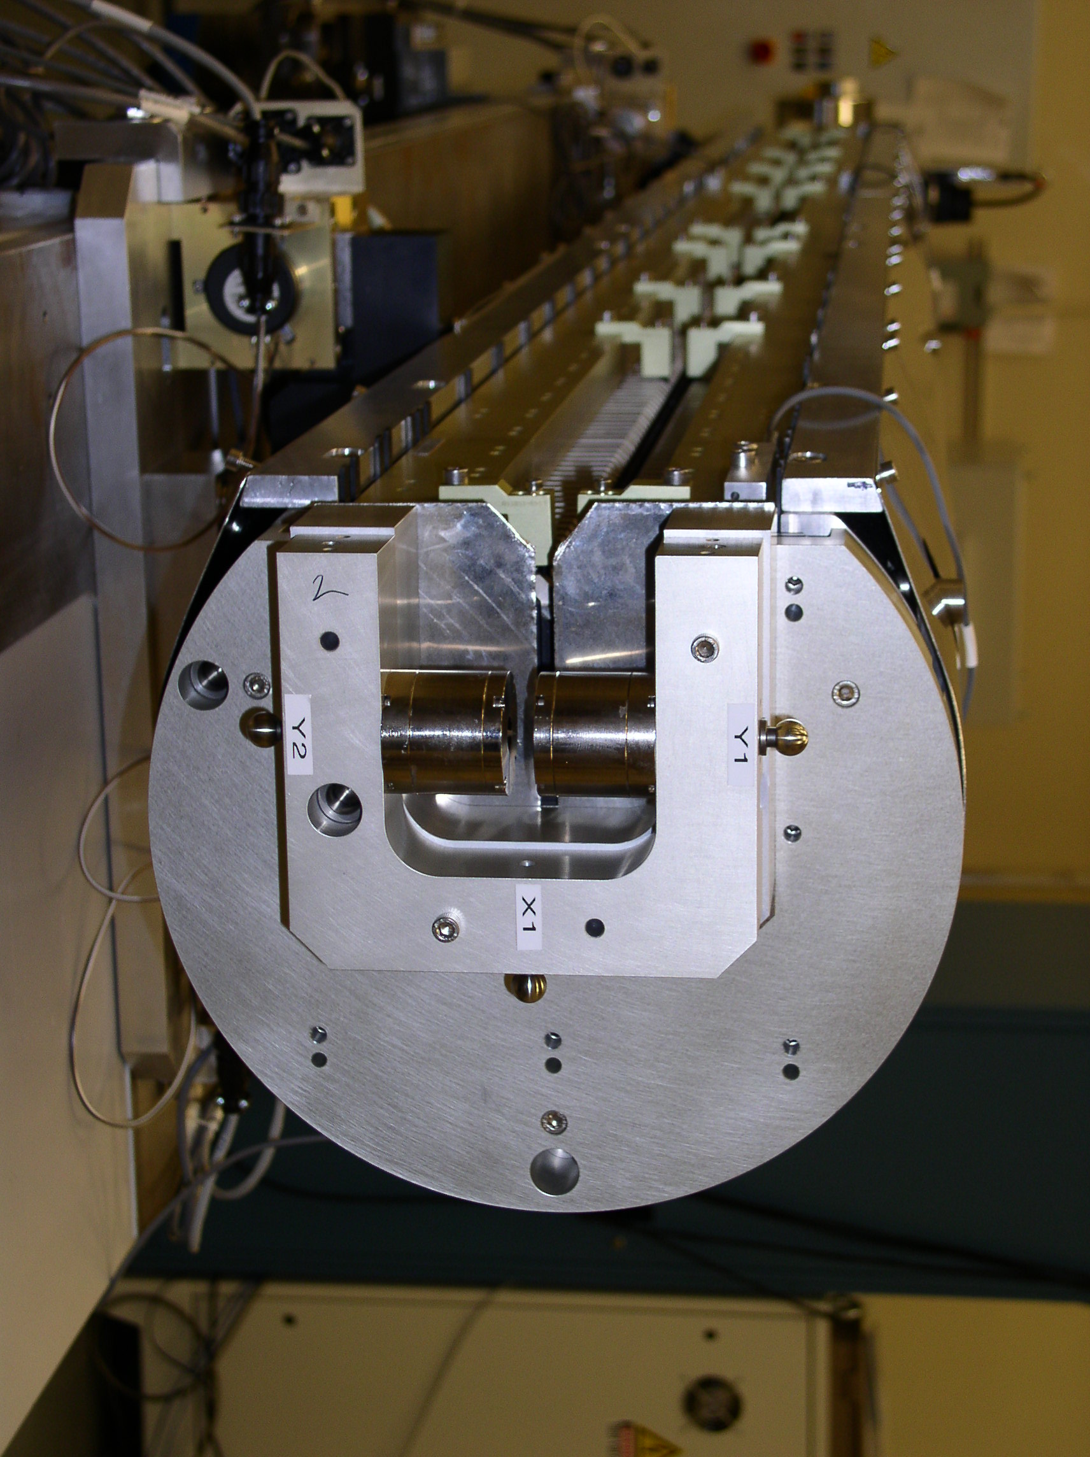
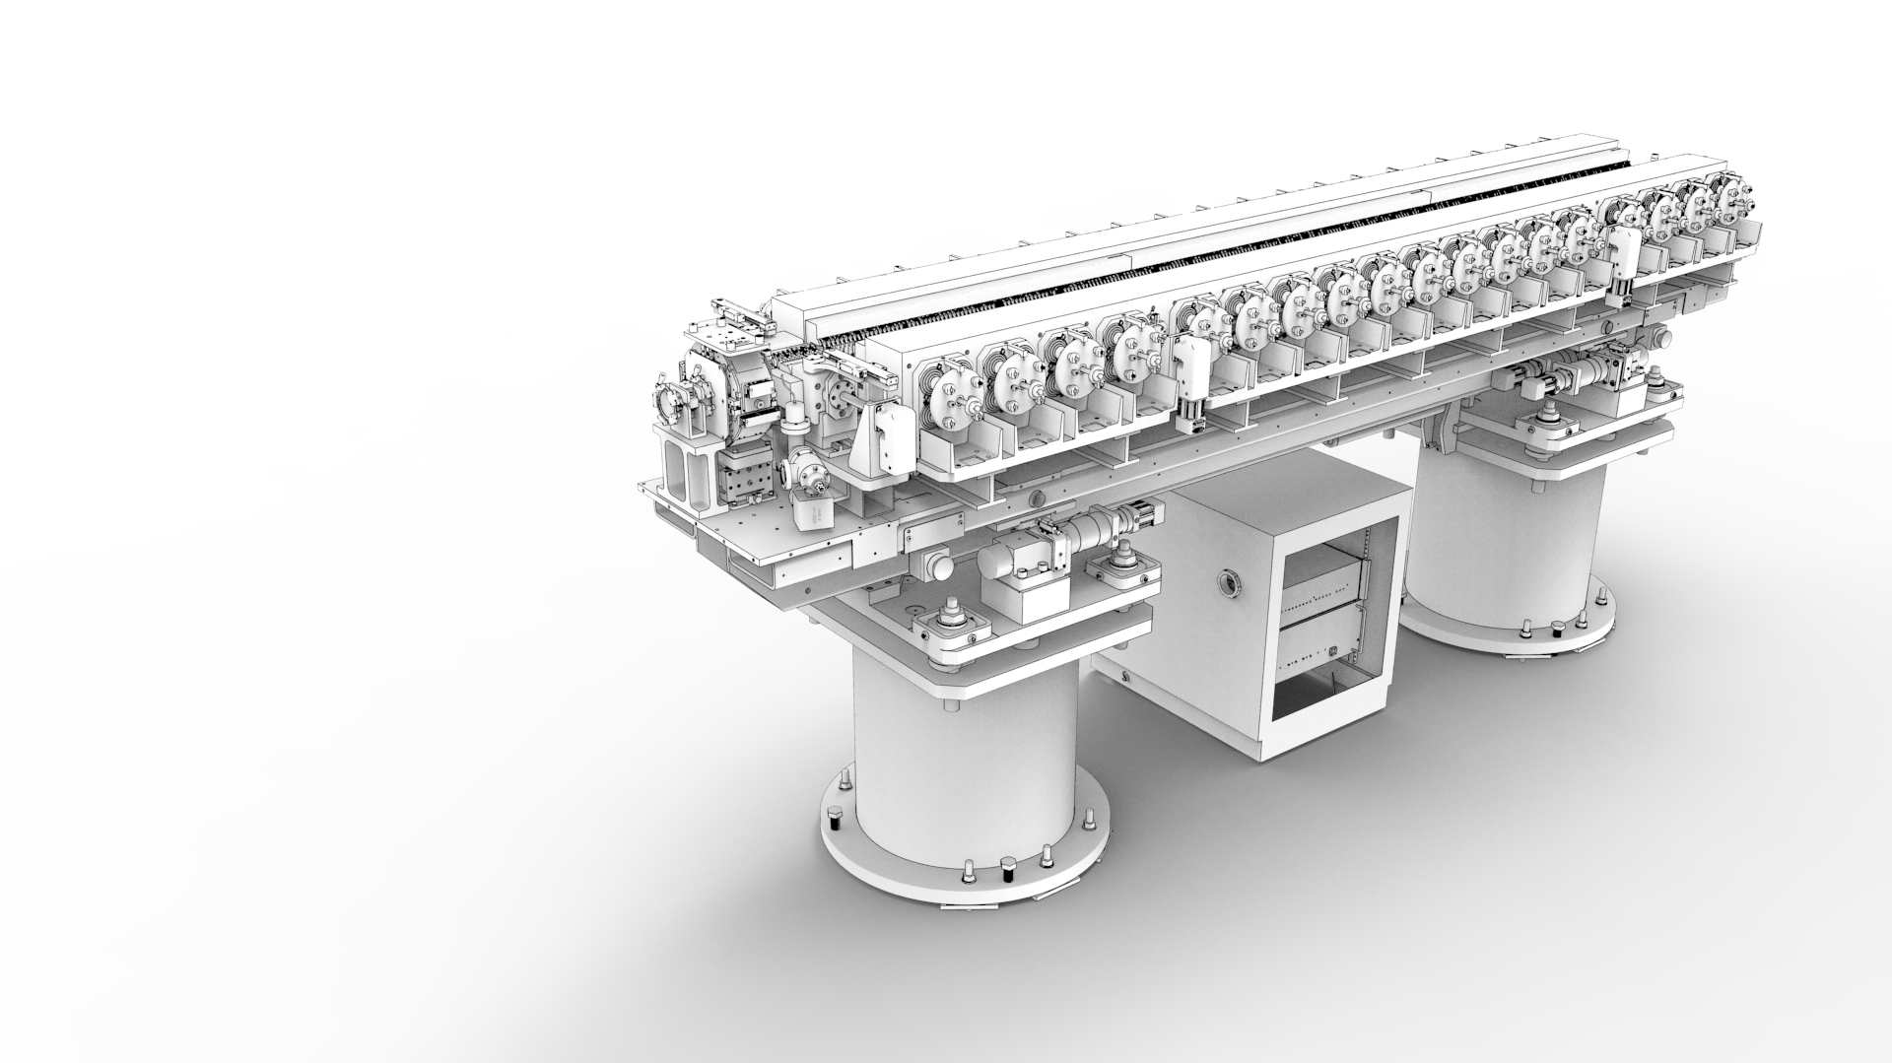
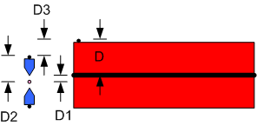
HGVPU CMM Work
Finish the fiducialization
Measure the gap
Install / straighten the beam pipe
Install / align the interspace components

Slide 14
Partial List Of Open Issues
Lock and tag during tuning.
Undulators must come fully protected. All parameters must be set. All limit switches must be set and tested. If we change an encoder offset, a switch must protect against a typing error.
We need controls at the benches, at the CMM, and at an undulator setup area. The controls will be used simultaneously so they cannot be moved.
Store HXU undulators on kinematic mounts.
HXU tuning ergonomics.

Slide 15
End

