Slide 1
FEL Magnetic Measurements At SLAC
Zachary Wolf
SLAC
PACMAN
March 20, 2017

Slide 2
Overview
Quadrupole Magnetic Center Stability
Rotating coil
Quadrupole Magnetic Center Fiducialization
Vibrating wire
Undulator Measurements
Hall probe
Moving wire

Slide 3
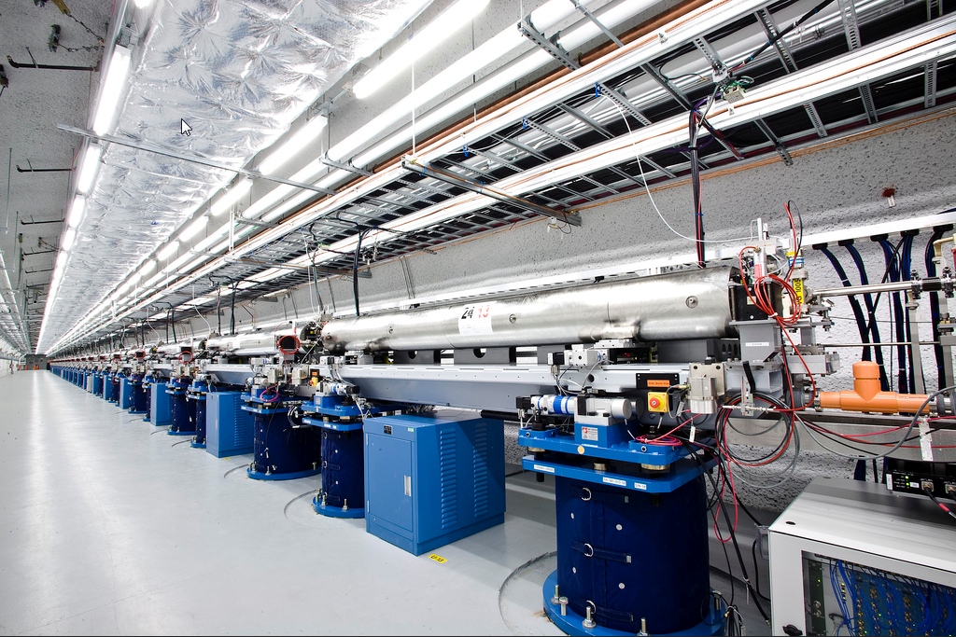
Linac Coherent Light Source

Slide 4
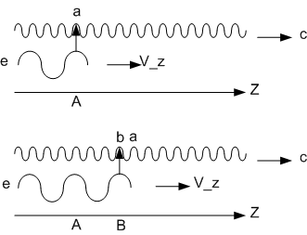
FEL Basic Idea
The light emitted by the electron bunch travels in a straight line.
The electron bunch must stay within the light wave in order to contribute.
The electron bunch must travel in a straight line.
The electron motion must stay in phase with the light wave.

Slide 5
Some Measurement Challenges
Undulator field B_{y} = B₀ cosh(k_{u} y) cos(k_{u} z).
The field must be correct to 10⁻⁴ in order to maintain the phase relationship.
For LCLS cosh(k_{u} y) changes by 10⁻⁴ when y = 70 microns.
The beam path is set by the quadrupole centers (BBA).
The quadrupole center must be aligned to the undulator axis with a tolerance much better than 70 microns.
The quadrupole center must not be affected by hysteresis in trim windings on the quadrupole, or by changing the quadrupole strength during beam based alignment.
Main topics of this talk.

Slide 6
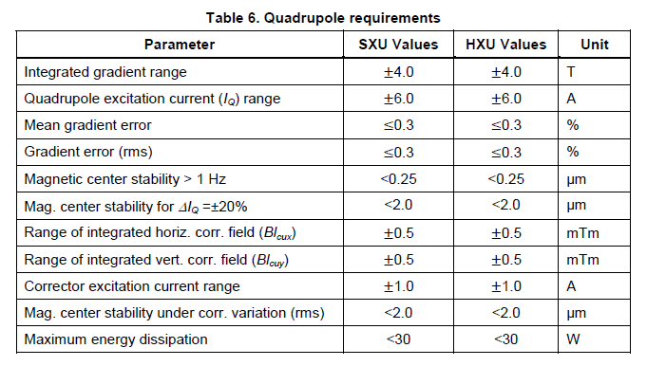
Quadrupole Center Stability
The quadrupole center should not move as the excitation changes
Otherwise the beam gets a kick
This is also important for ILC and other machines.
The dipole trim windings on quadrupoles should not have hysteresis.

Slide 7
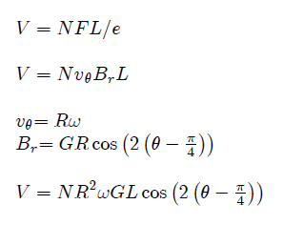
Rotating Coil In A Quadrupole
Good for measuring magnetic center position changes.

Slide 8
Find The Quadrupole Center Position
The dipole strength and the quadrupole strength can be used to
calculate the magnetic center position.

Slide 9
Speed Variations
Coil centered
Position dependent speed variation, first term in Fourier expansion
Produces a dipole signal. Can’t distinguish from a magnetic center shift.
A Cure: Integrate the voltage
No ω dependence

Slide 10
Bearing Errors
Coil centered
Position dependent bearing error, first term in Fourier expansion
Produces a dipole signal. Can’t distinguish from a magnetic center shift.
Cure: Bucking, Minimize δR
Eliminate the quadrupole signal.
Remain sensitive to dipole signals.

Slide 11
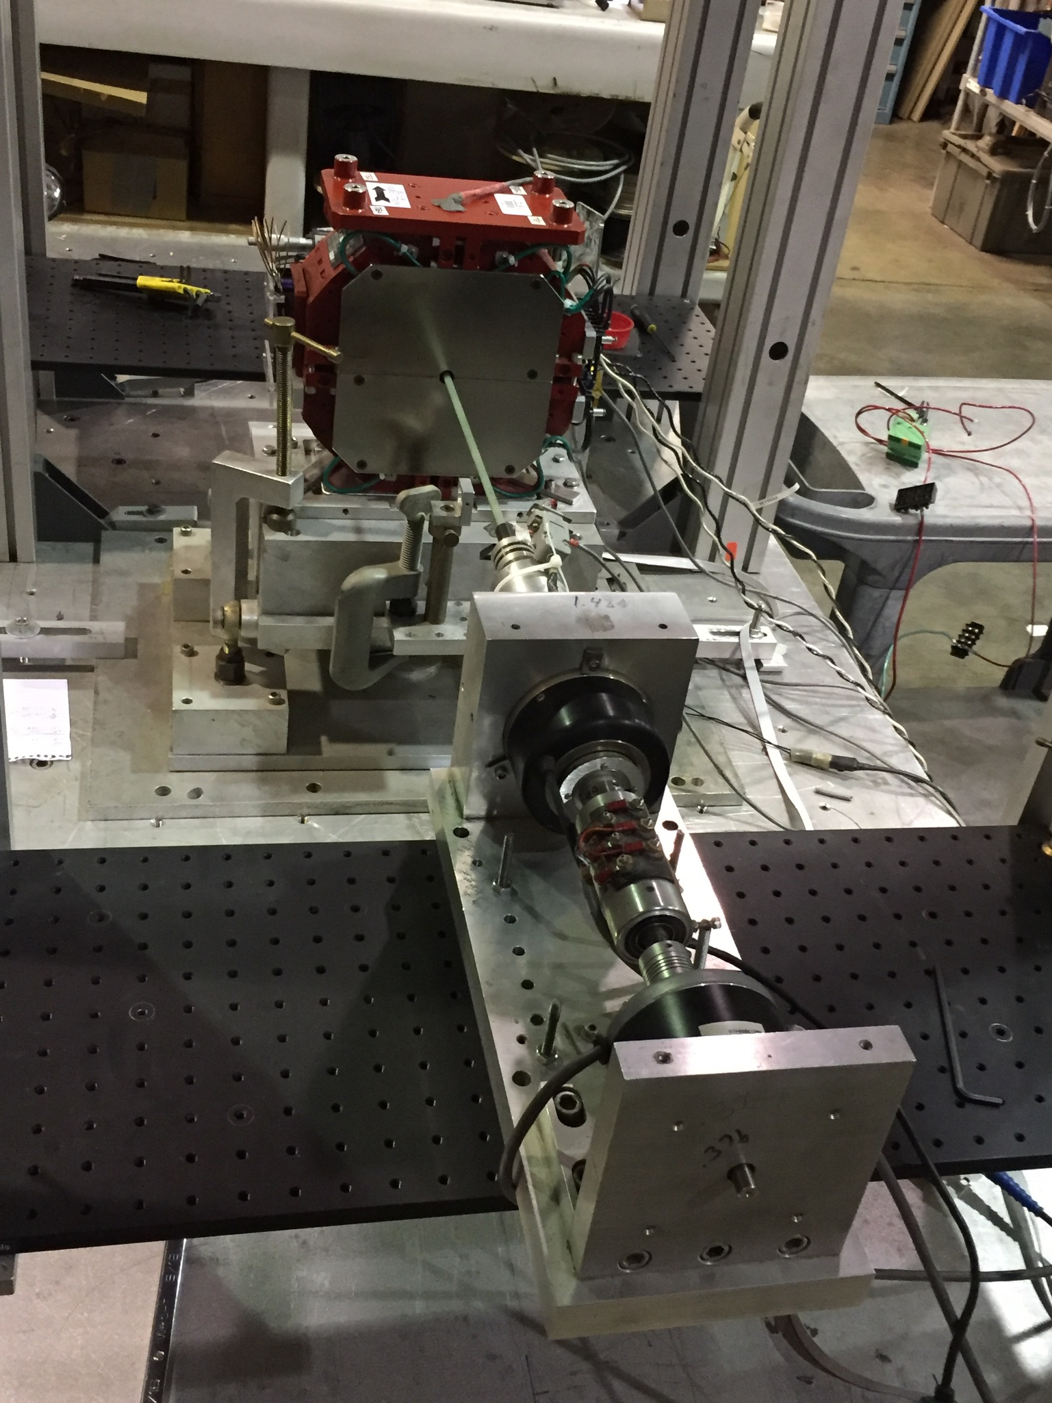
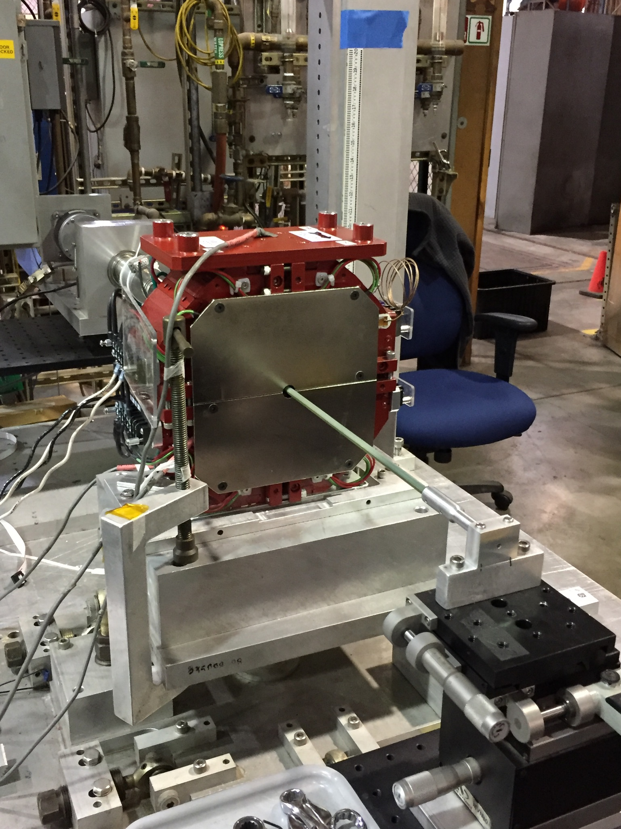
Rotating Coil Mechanical System
Encoder
Mercury wetted slip rings
Stepping motor
Printed circuit
coil
Jewel bearing

Slide 12
BBA center shift for +/- 1 amp around +/- 4.3 Amps

Slide 13
References
C. Spencer et al., “A Rotating Coil Apparatus With Sub-micrometer Magnetic Center Measurement Stability”, SLAC-PUB-11473, December 2005.
S. Anderson et al., “Magnetic Measurement Results of the LCLS Undulator Quadrupoles”, LCLS-TN-09-1, January, 2010.
J. DiMarco et al., “Application of PCB and FDM Technologies to Magnetic Measurement Probe System Development”, IEEE Transactions on Applied Superconductivity, Vol 23, No. 3, June 2013.
A. Jain, “Basic Theory of Magnets”, CERN 98-05, August 1998.
P. Bryant, “Basic Theory For Magnetic Measurements”, CERN 92-05, September 1992.
L. Walckiers, “The Harmonic Coil Method”, CERN 92-05, September, 1992.

Slide 14
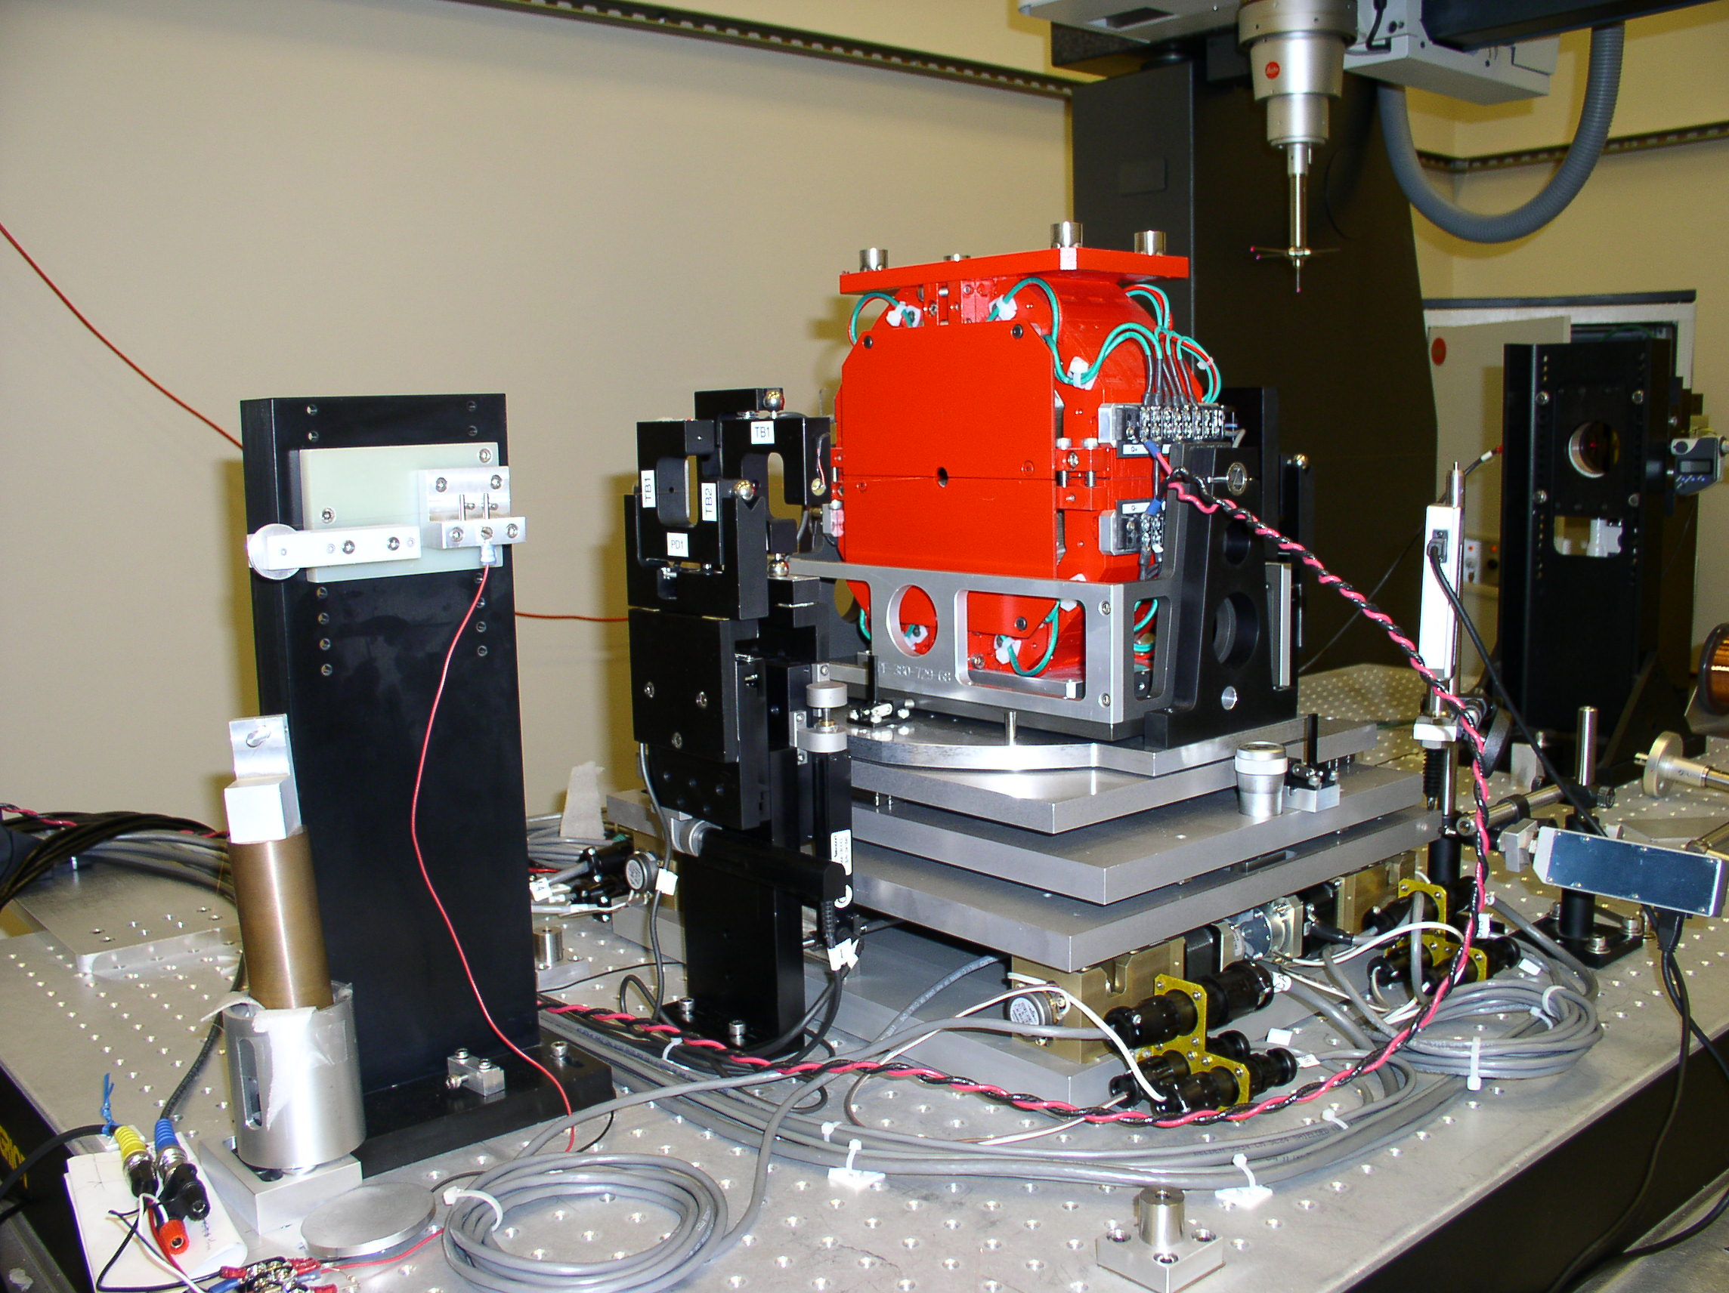
Quadrupole Fiducialization
Vibrating Wire System
Required fiducialization accuracy: 25 microns

Slide 15
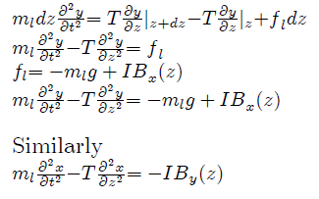
Vibrating Wire
Equation of motion of the wire
I = I₀ cos(ωt)
At the center of a quadrupole, B = 0, so there is no driving term.
The wire vibration goes to zero.

Slide 16
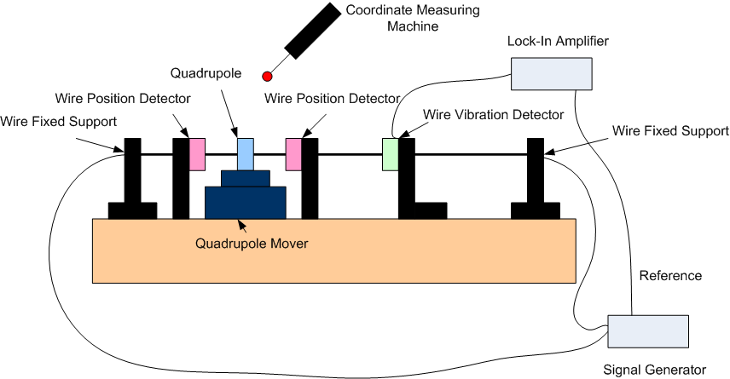
Vibrating Wire System

Slide 17
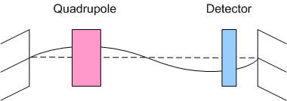
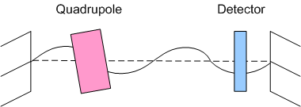
Vibrating Wire
If the ac current carrying wire goes
through a magnetic field, the force
excites a mechanical vibration of
the wire.
An optical detector gives
a signal that the wire is vibrating.
The vibration stops when the wire
is at the center of the quadrupole.
This method can also detect pitch and
yaw of the quadrupole.

Slide 18
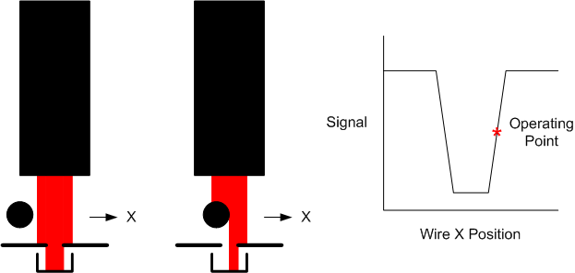
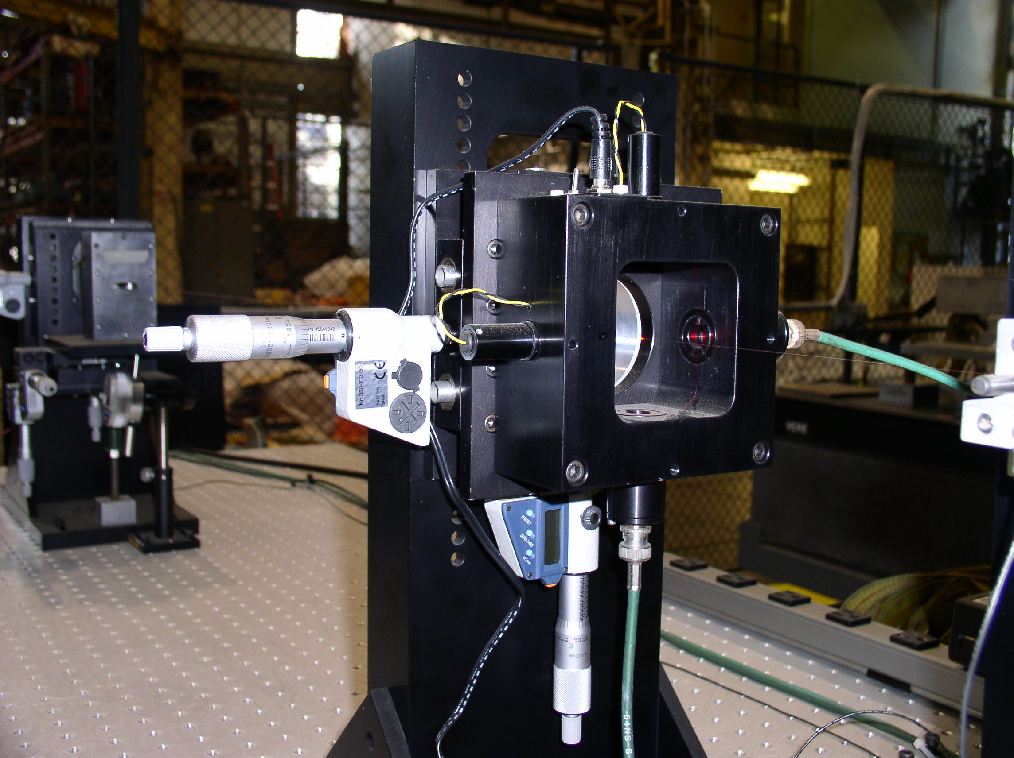
Wire Vibration Detector
Optical sensors
detect wire vibration.

Slide 19
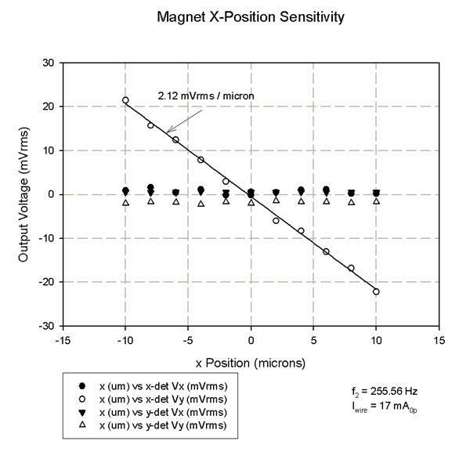
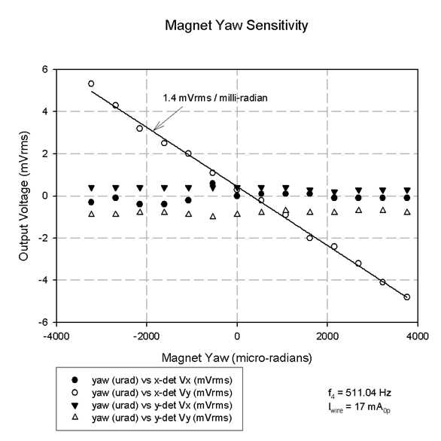
Vibrating Wire Signals
Examples:
Amplitude of signal from wire vibration sensor vs quadrupole x-position
and quadrupole yaw.

Slide 20
Vibrating Wire Signals
Examples:
Amplitude of signal from wire vibration sensor vs quadrupole y-position
and quadrupole pitch.

Slide 21
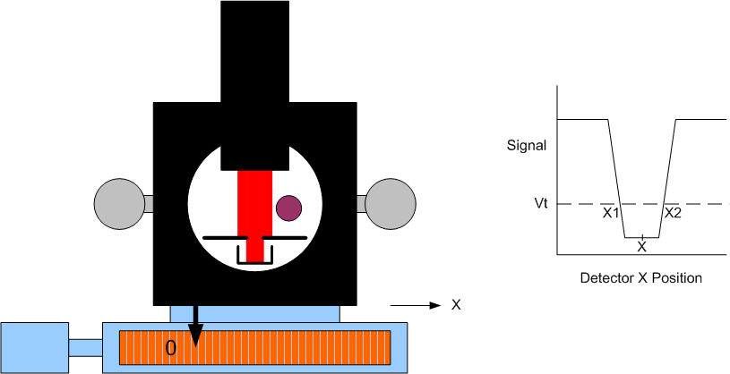
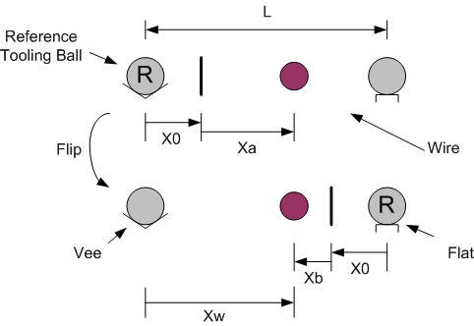
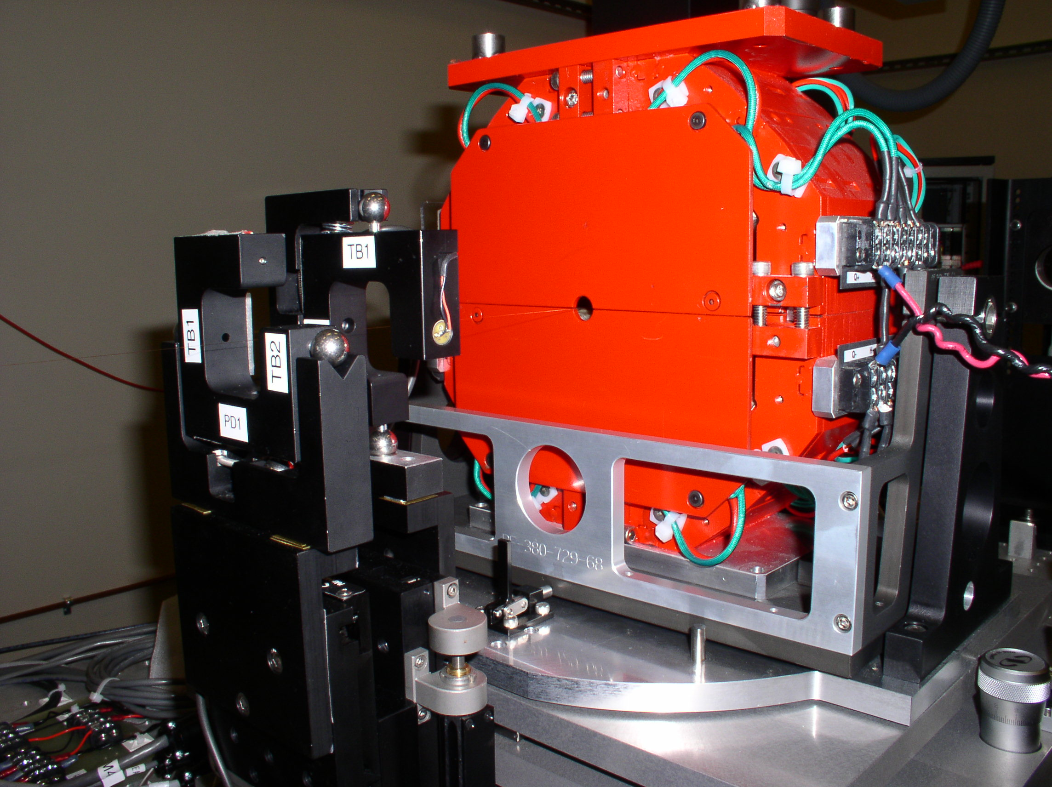
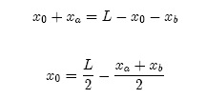
How To Locate A Wire
Find the center of the wire by
finding its edges.
Calibrate the scale offset by
flipping the detector in a
kinematic mount.

Slide 22
References
A. Temnykh, “Vibrating Wire Field-Measuring Technique”, NIM A399 (1997) 185-194.
Z. Wolf, “A Vibrating Wire System For Quadrupole Fiducialization”, LCLS-TN-05-11, May, 2005.
M. Levashov, “Commissioning a Vibrating Wire System for Quadrupole Fiducialization”, LCLS-TN-07-8, September, 2007.
S. Anderson et al., “Magnetic Measurement Results of the LCLS Undulator Quadrupoles”, LCLS-TN-09-1, January, 2010.

Slide 23
Undulator Measurements
Challenges:
Temperature dependence
Bench tolerances
Align undulator to bench
Hall probe measurements
Shimming
Fiducialization

Slide 24
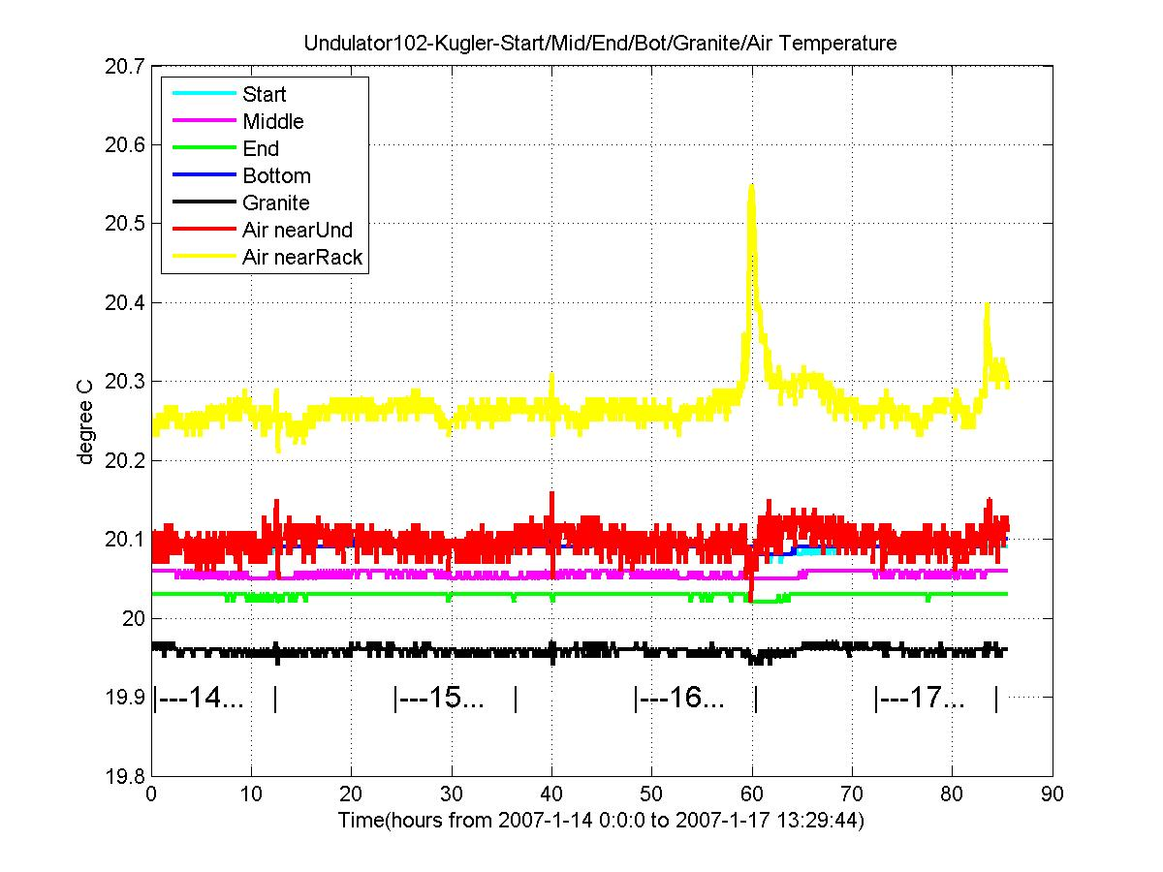
Measurement Lab Temperature Requirements
Permanent magnets:
(1/B) (dB/dT) = 1.e-3 / C
Need to set K to 1.e-4
Need temperature stable to 0.1 C

Slide 25
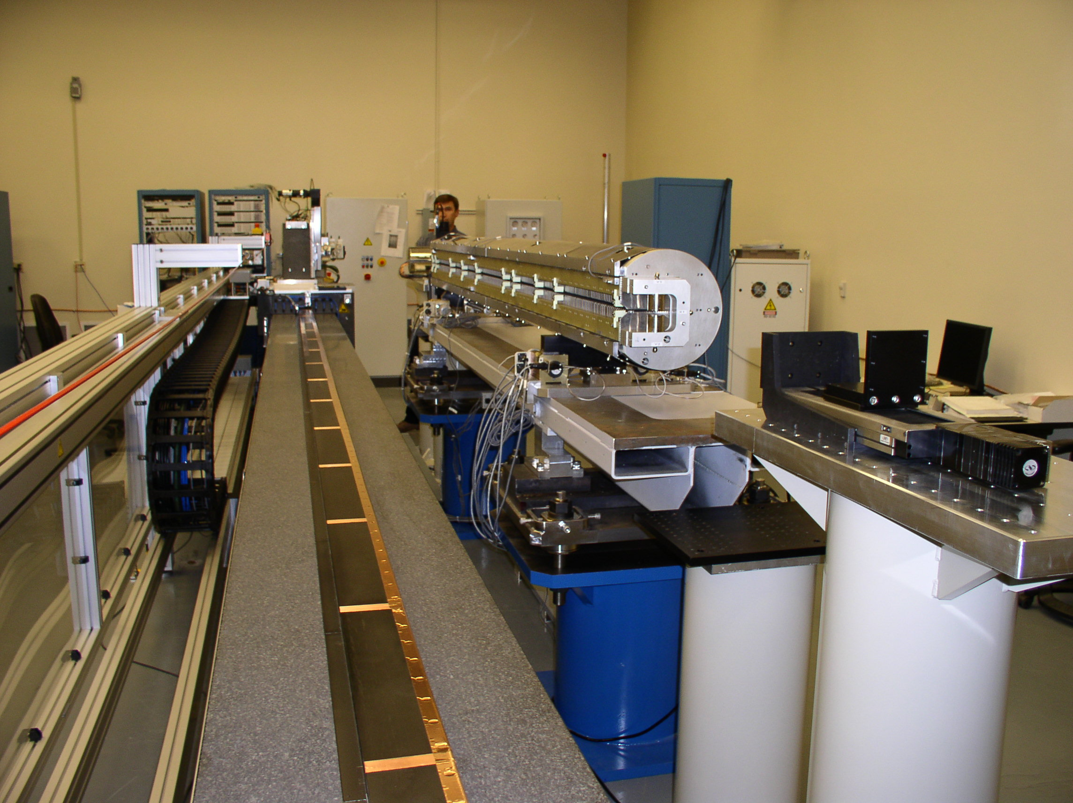
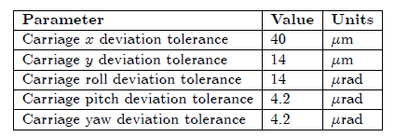
Bench Requirements

Slide 26
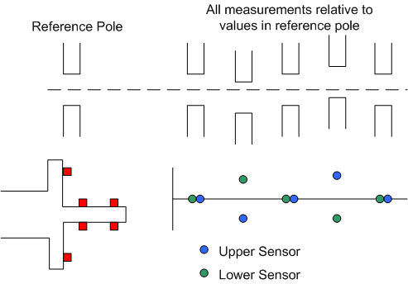
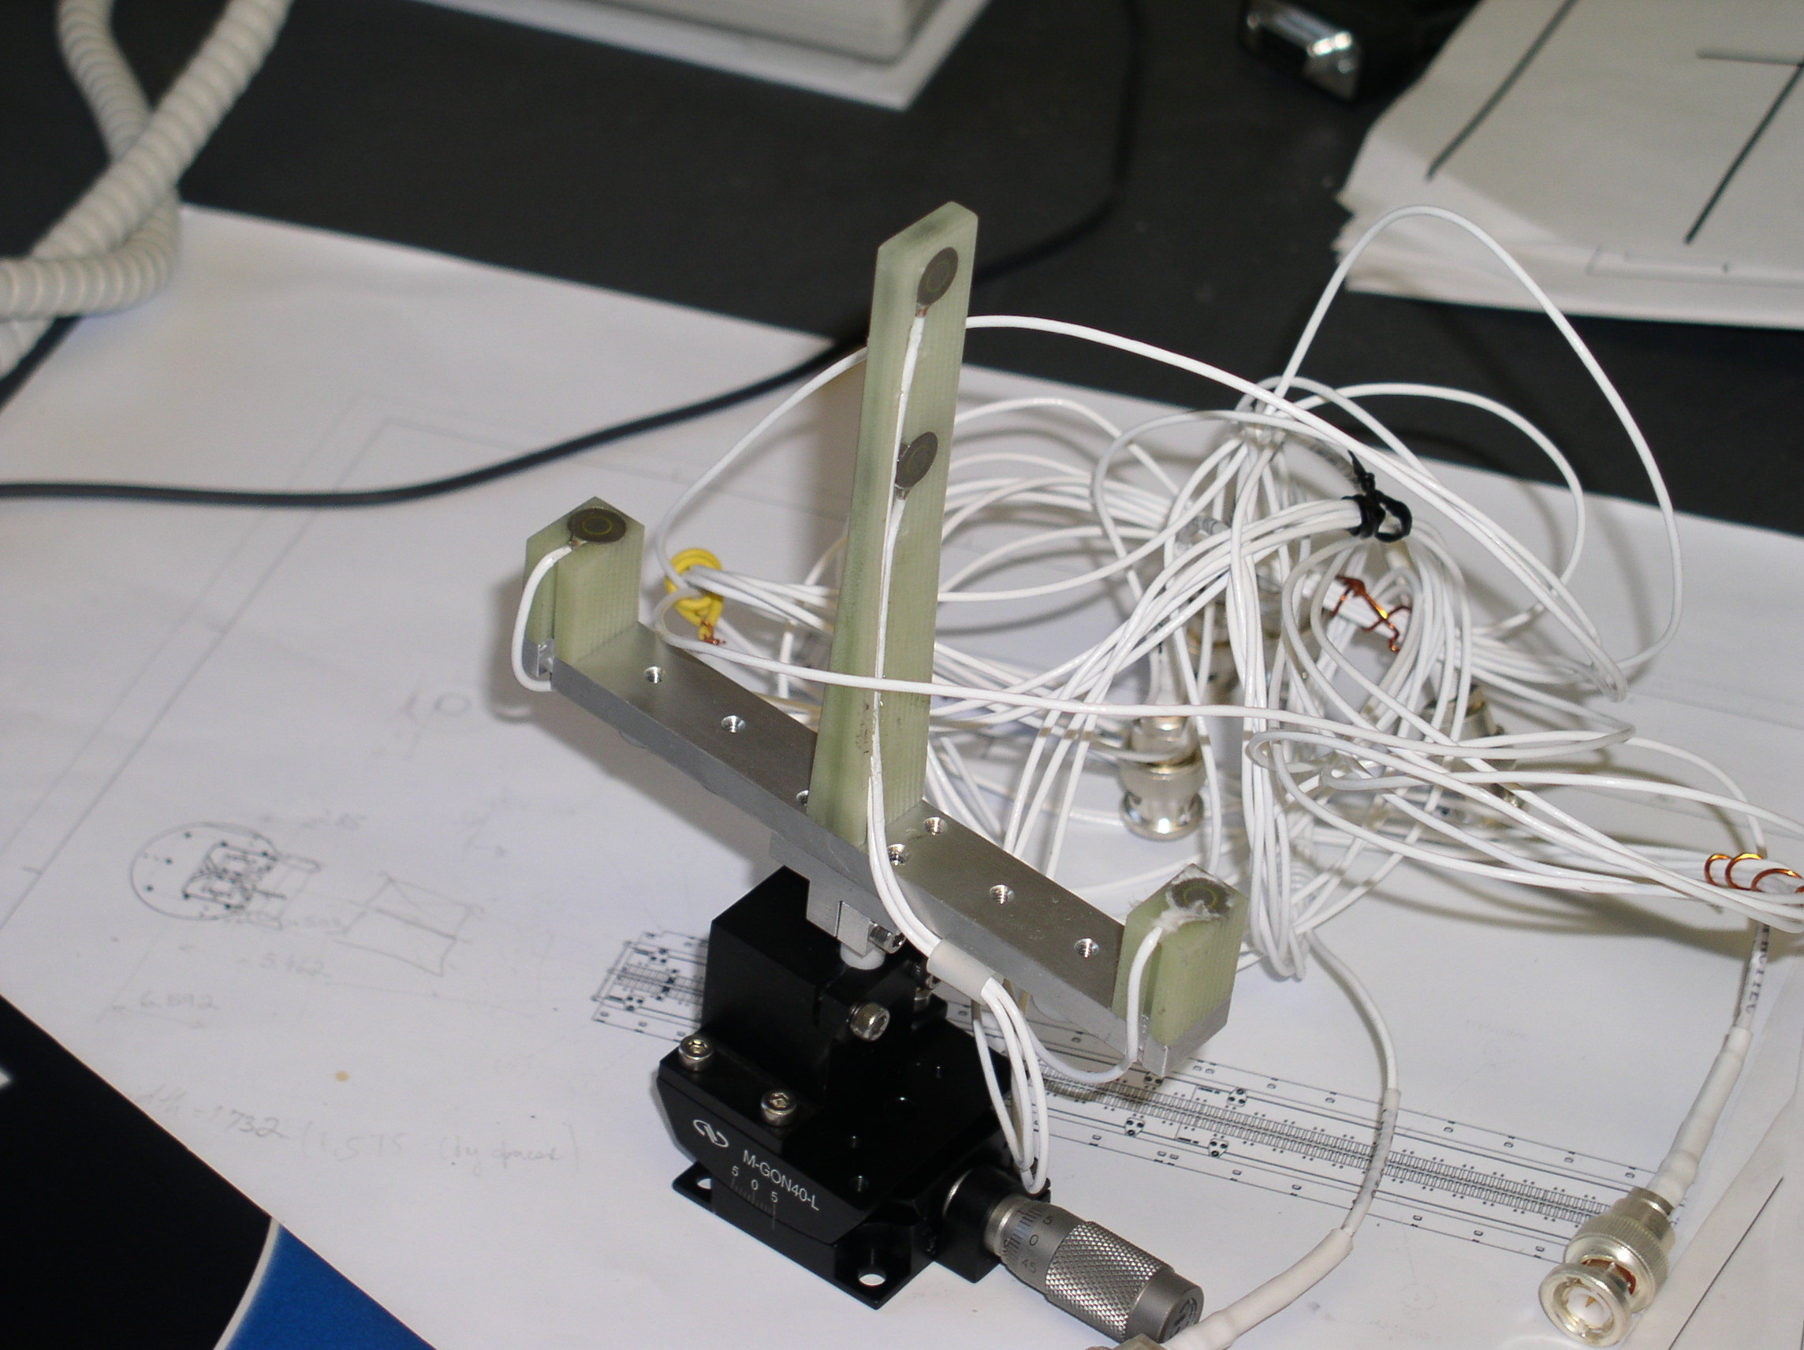
Mechanical Alignment To Bench
Capacitive sensors can be used to mechanically align a hybrid undulator
to a reference pole.
Afterward, magnetically align with Hall probe.

Slide 27
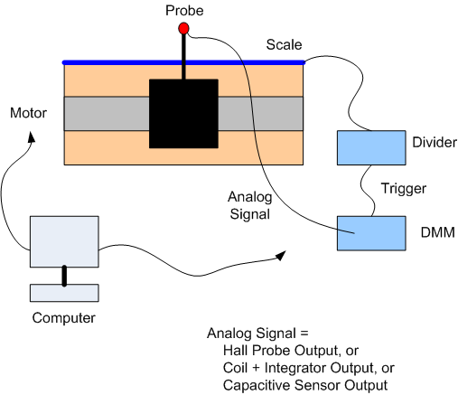
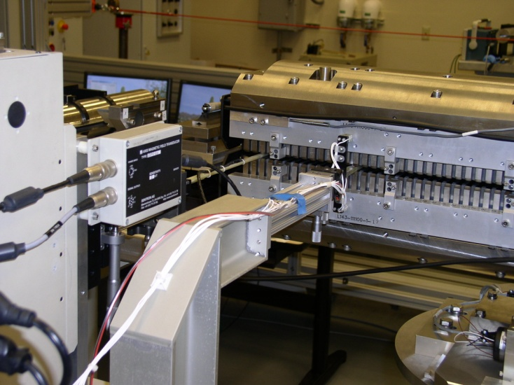
Hall Probe Measurements
LCLS undulator

Slide 28
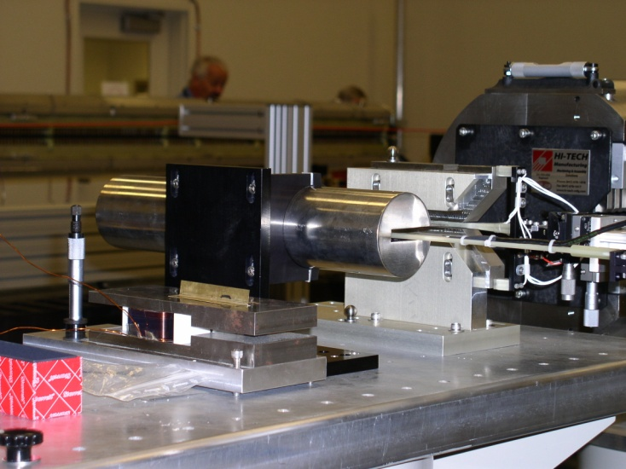
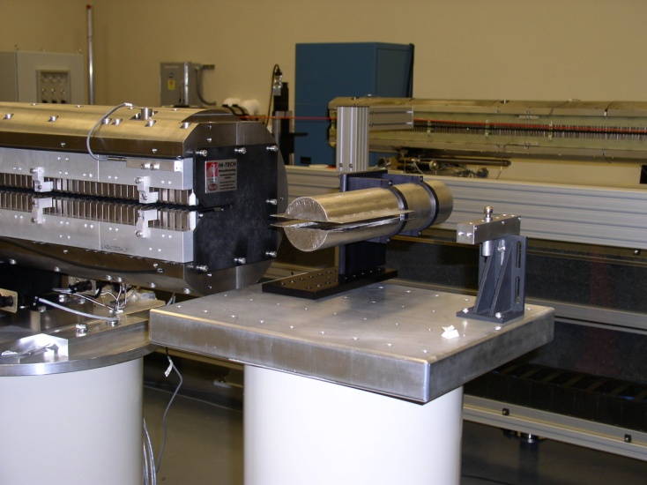
Hall Probe Measurements
Beginning
zero field
measurement
Ending
zero field
measurement
Senis Hall probe
Capacitive sensors used to align undulator to bench
Zero offset correction assumes linear
offset dependence on time. Want low
drift Hall probe.

Slide 29
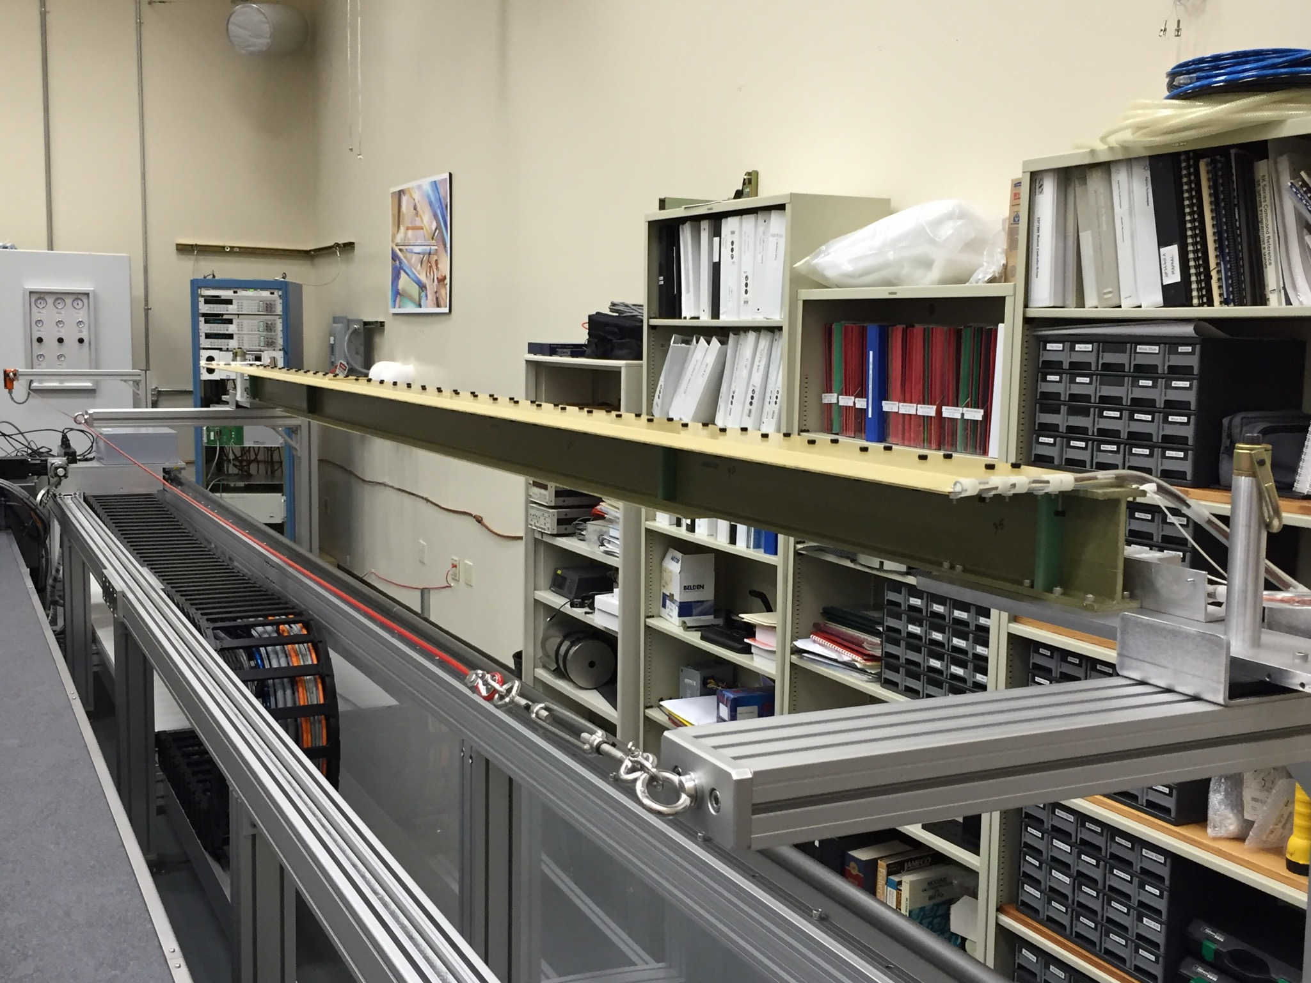
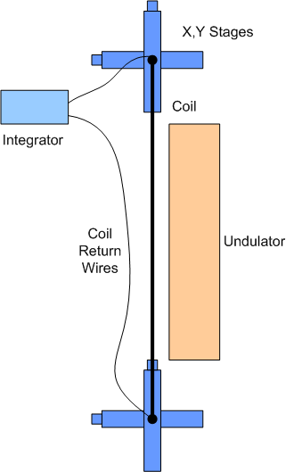
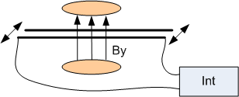
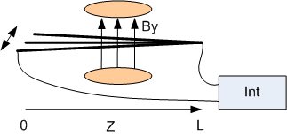
Field Integral Measurements
130 Turns
Must straighten coil
Use to measure first and second field integrals
Use to correct Hall probe offsets

Slide 30
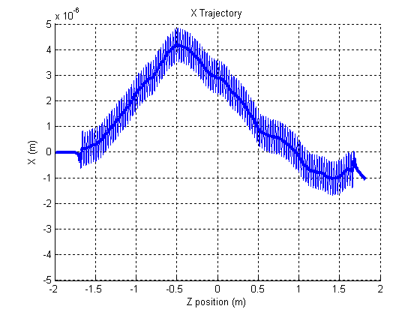
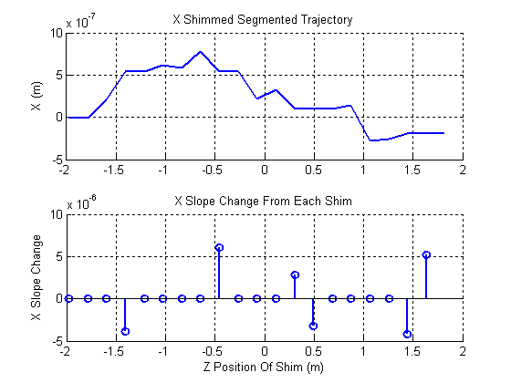
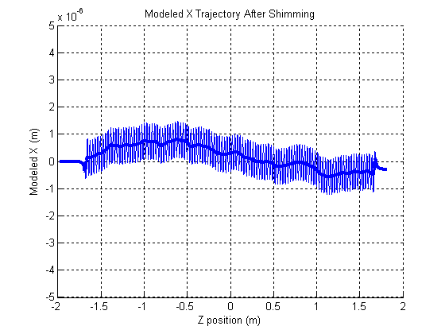
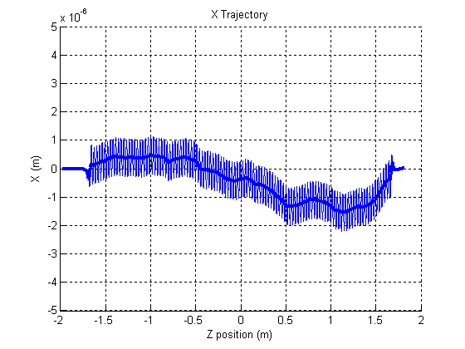
X And Y Trajectory Shimming
Measured
X
Trajectory
Calculate
Shims
Modeled
X Traj
With
Calc
Shims
Measured
X Traj
After Calc
Shims
Applied
LCLS-TN-06-8

Slide 31
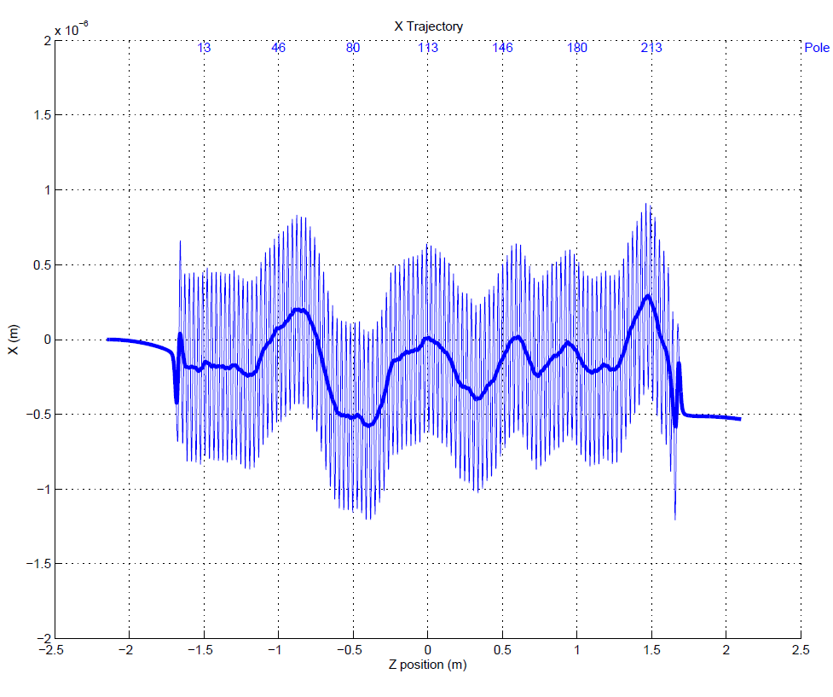
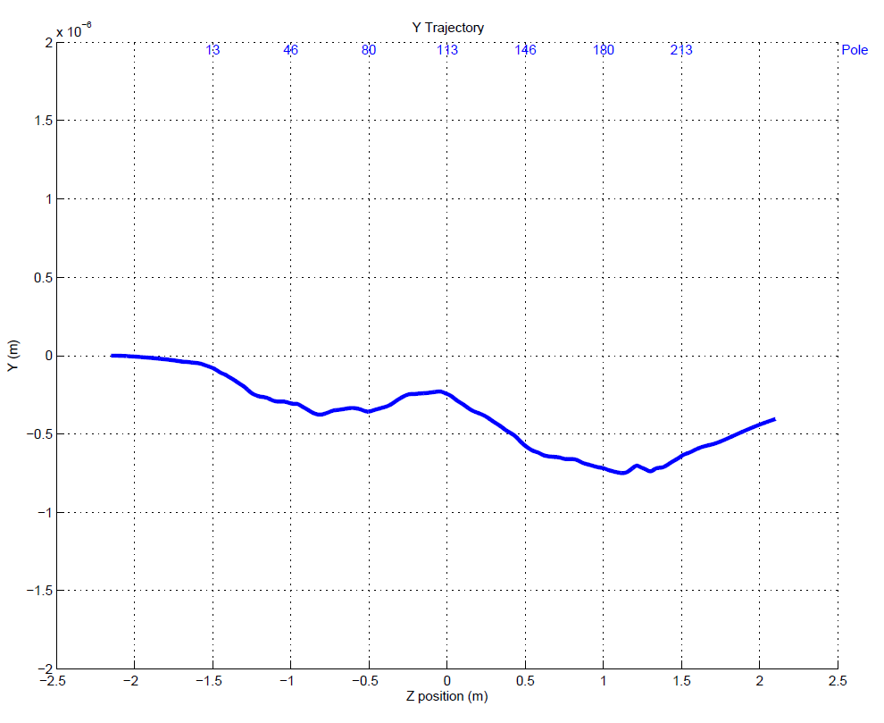
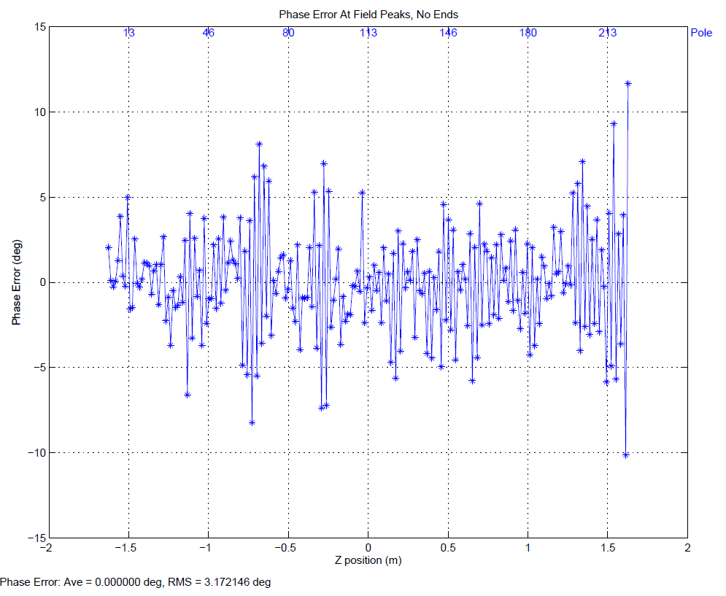
Undulator Alignment
Fiducialization tolerance
40 microns.
Probe position given to
100 microns in specs.
After undulator is tuned:
X trajectory good.
Y trajectory good.
Phase errors good.
Want the beam to go where
the Hall probe is measuring.
But where is the Hall probe
actually measuring?

Slide 32
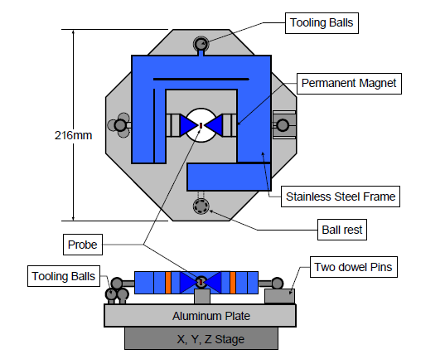
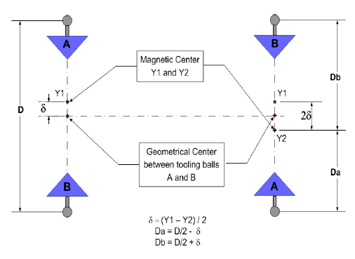
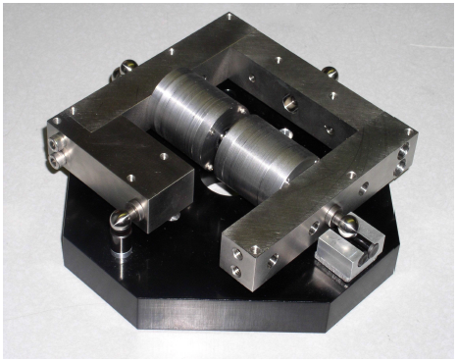
Pointed Magnet Calibration
Flip magnet in fixture. Distance zero field
point moves gives zero field position
relative to tooling balls.
Yurii Levashov

Slide 33
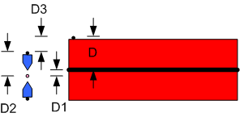
Undulator Fiducialization
Want D
D1 : Magnetic Measurement
D2 : Calibration
D3 : CMM
D = D1 + D2 + D3

Slide 34
References
Z. Wolf, “Requirements for the LCLS Undulator Magnetic Measurement Bench”, LCLS-TN-04-8, August, 2004.
Z. Wolf, “Introduction to LCLS Undulator Tuning”, LCLS-TN-04-7, June, 2004.
Many other LCLS Tech Notes on the measurement techniques, see http://www-ssrl.slac.stanford.edu/lcls/lcls_tech_notes.html.

Slide 35
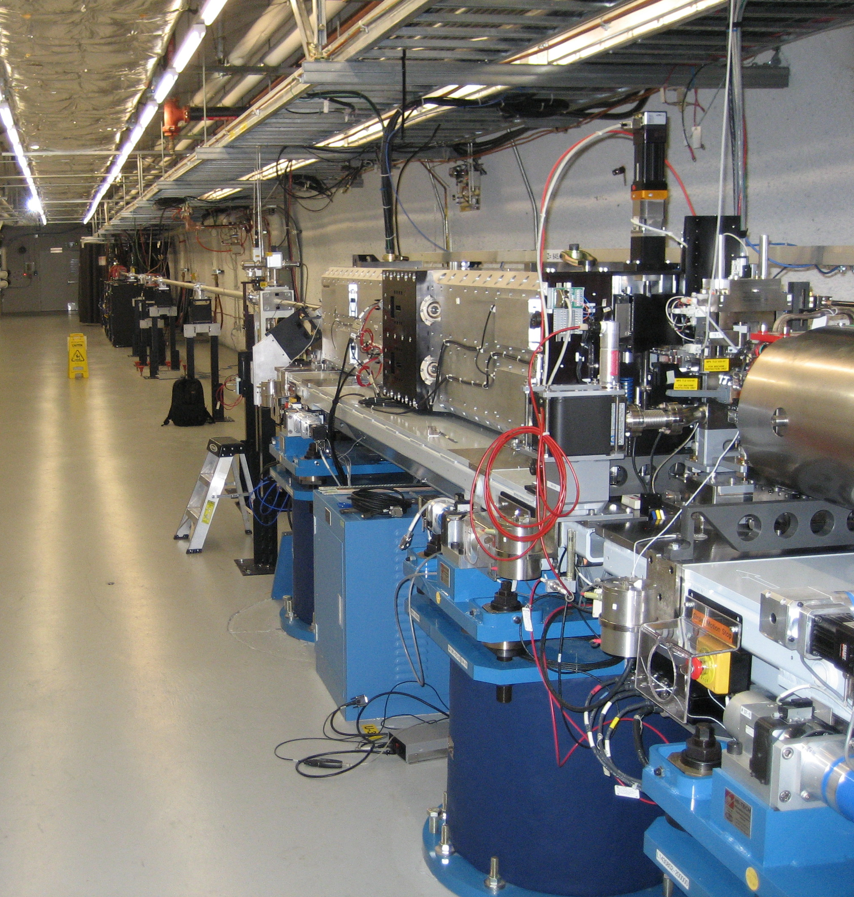
Delta Undulator
Produces elliptically polarized light.
Placed at end of LCLS. Uses the microbunched beam.

Slide 36
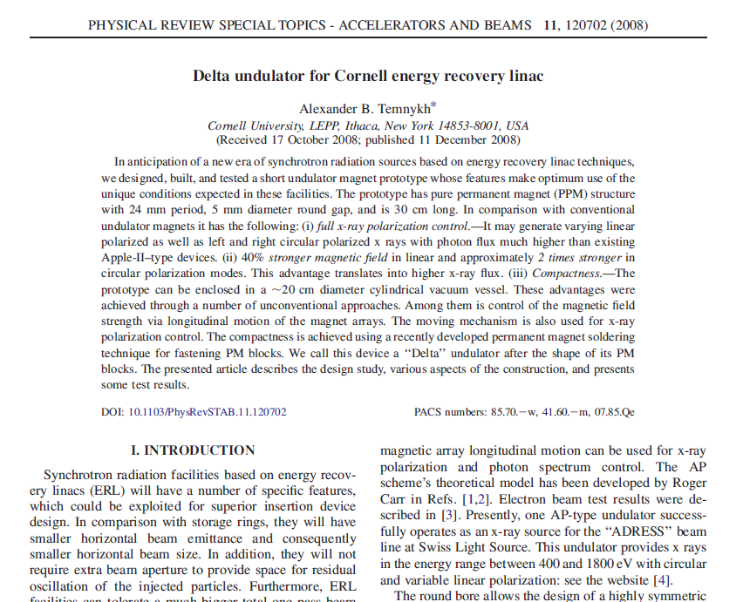
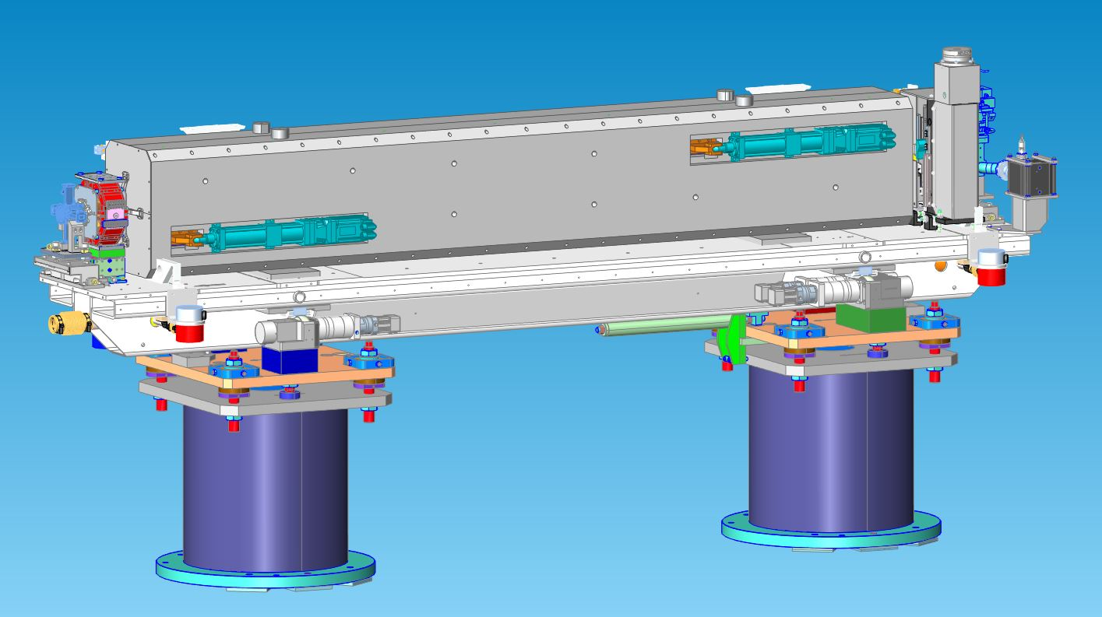
Delta Undulator
EPU in a package compatible with LCLS
Use same alignment strategy. Undulator
and quadrupole on the same girder.

Slide 37
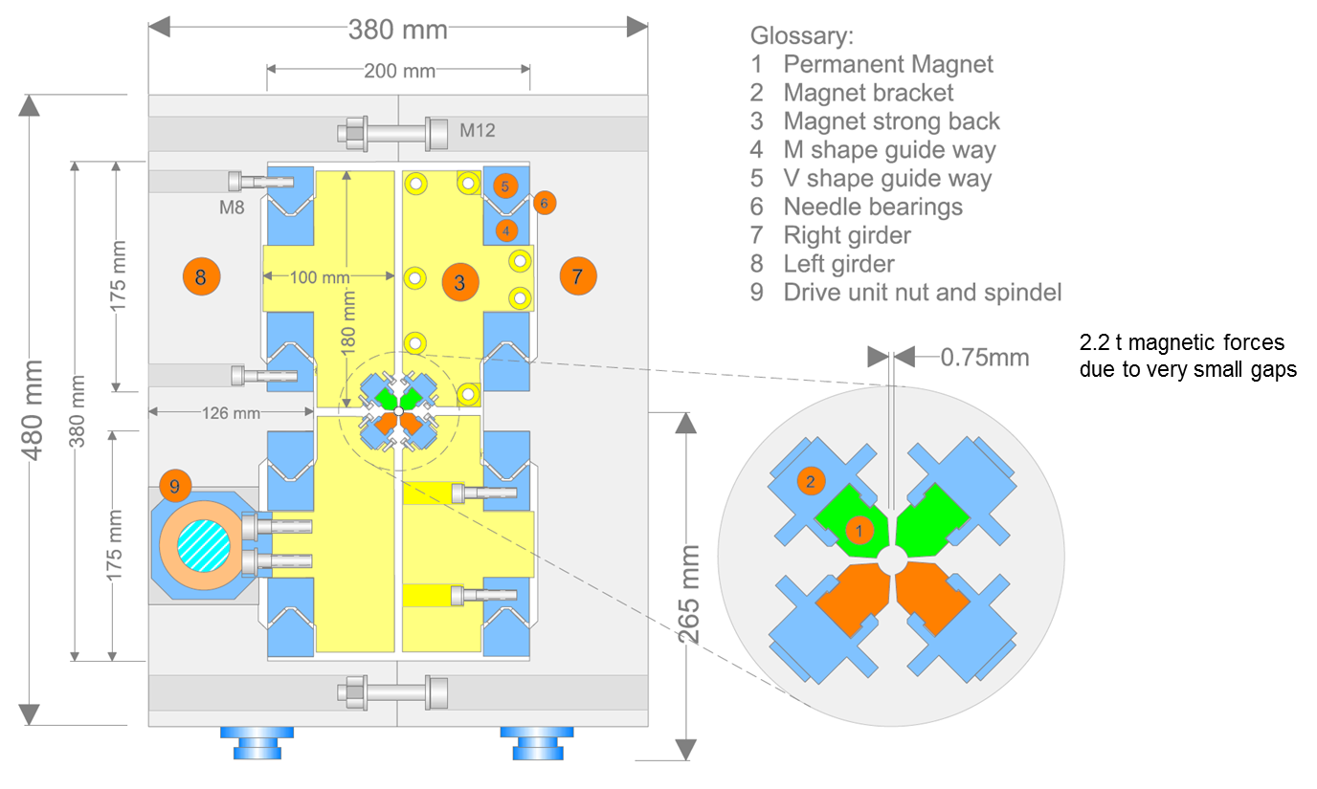
Delta Cross Section
Franz Peters

Slide 38
Delta Undulator
Very compact source of elliptically polarized light
Can’t tune after assembly
Tune quadrants, use superposition
Very tight assembly tolerances
Measurements can only be done from the ends in a 6 mm diameter tube
Can we achieve the tolerances to make an FEL out of Delta undulators?

Slide 39
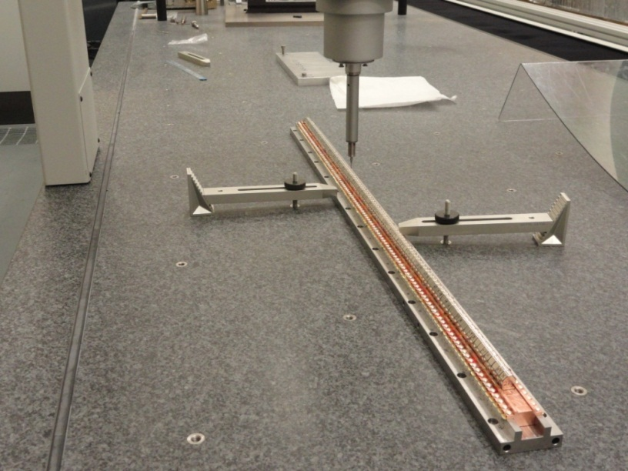
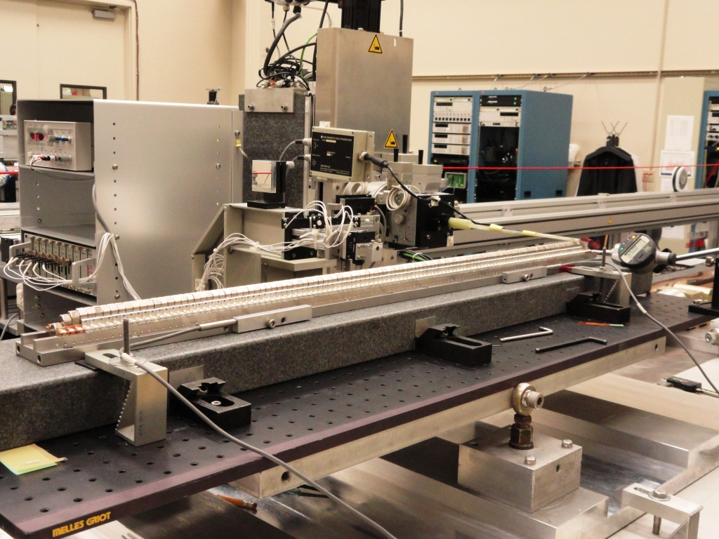
Delta Quadrant Assembly And Tuning
Mechanically align blocks
using CMM.
Move blocks using magnetic
measurements to straighten
trajectories and minimize
phase errors.
(Photos of prototype)

Slide 40
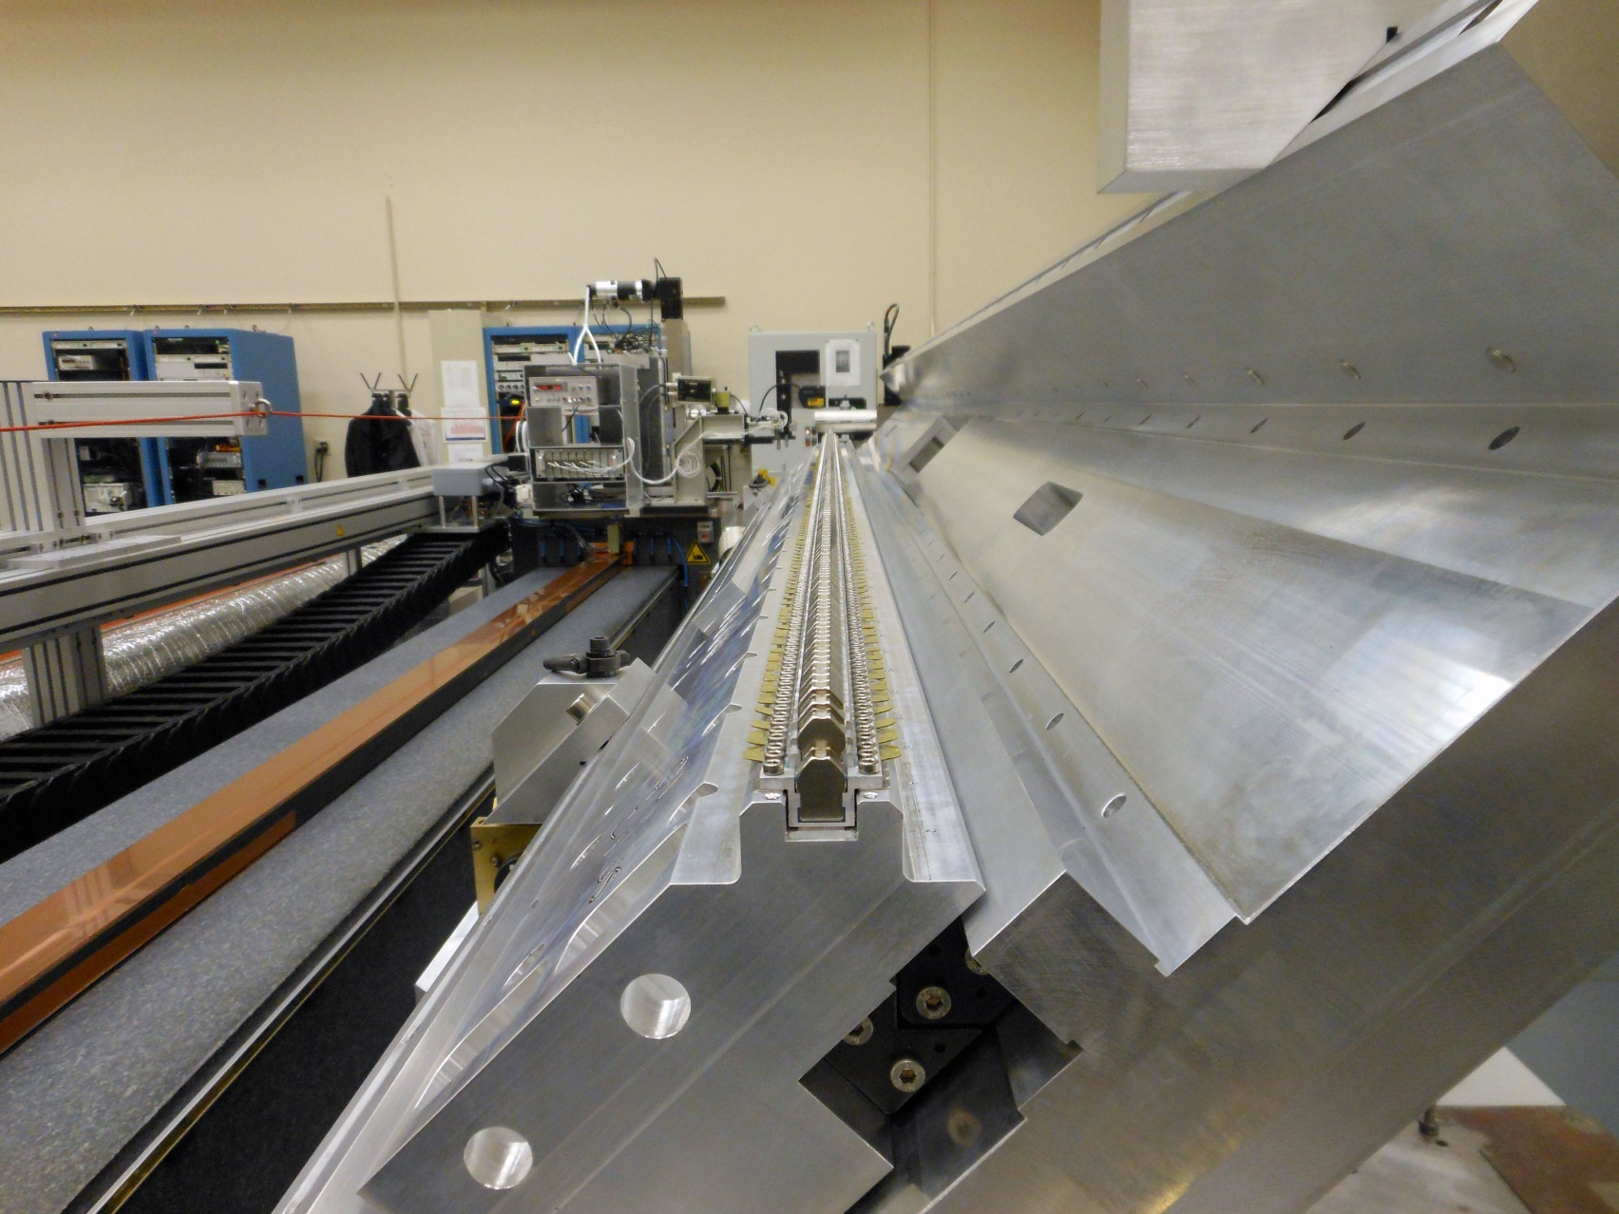
3.2 m Quadrant Tuning
3 Carriers
Nd₂Fe₁₄B Magnets
Linear Bearings

Slide 41
In Software Superpose Quadrant Fields To Simulate Assembled Undulator, Correct If Necessary
Example CP+. Expect undulator within tolerance, but no permeability effects in superposition.
(Prototype)

Slide 42
Delta Assembly

Slide 43
Hall Probe Measurements
The only access for measurements is through the end of the beam pipe.

Slide 44
Measure Probe Position
Transverse location from corner cube. Longitudinal location from interferometer.
Georg Gassner

Slide 45
References
A. Lutman, “Polarization Control in an X-ray Free Electron Laser”, Nature Photonics, May, 2016.
See technical notes at
http://www-ssrl.slac.stanford.edu/lcls/lcls_tech_notes.html

